Slide 1

Putting your knowledge into practice

Slide 2

Hello!
I am Brian Lenzkes, MD
Co-host Low Carb MD Podcast, Host of Life’s Best Medicine Podcast, 19 years in Internal Medicine Practice.
You can find me at:
LowCarbMDSanDiego.com
@BrianLenzkes on Twitter/GETTR

Slide 3
Educational Objectives:
Figuring out how to help others with all of the crap that you learned over the years
When stuff doesn't work, figure out how to make it work
Our patients are depending on us to help them figure it out

Slide 4

Notes:
Patients are a complex puzzle. What do we focus on first?

Slide 5



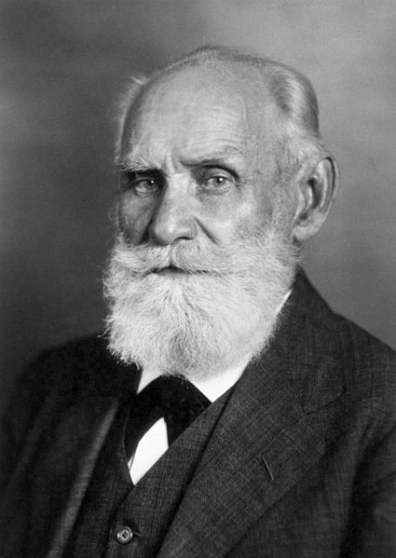


Slide 6

My biggest challenge:
Notes:
Avalanch of information at one time

Slide 7

My biggest challenge:
Notes:
Avalanch of information at one time. Meal Plans, Body Composition, Food List/Menu

Slide 8

Physician
Health Coach
Office Manager
And Staff
Personal Trainer
Nutritionist
Psychologist

Slide 9
“You Got This!”
“You Crushed that Workout”
“How’s Your Stress Level?”
.

Slide 10
What are the puzzle pieces?
Patient education/Resources
Sticking to the Program
Talking them off the ledge
Getting back on track
Encouragement
Teaching self compassion
Tools for long-term success
Building community

Slide 11

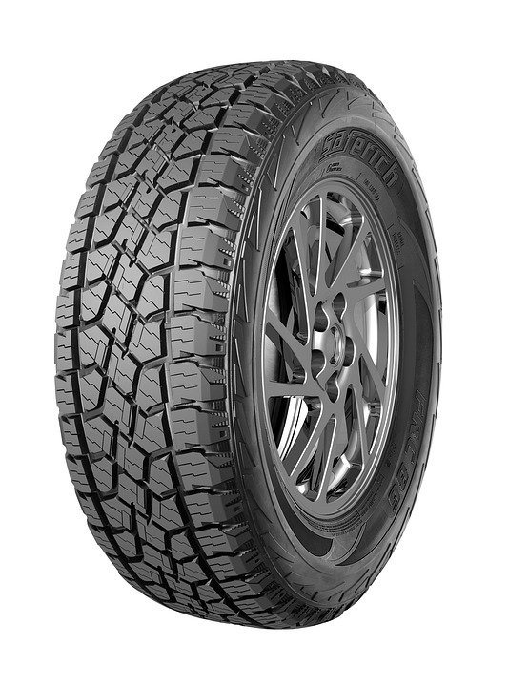
Do we have to re-invent this?

Slide 12
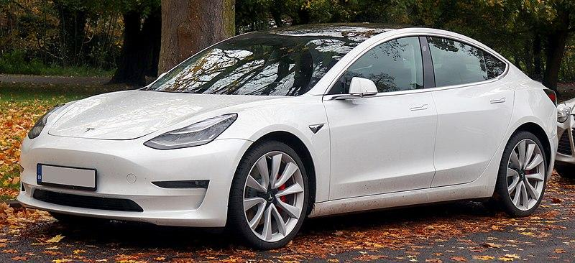

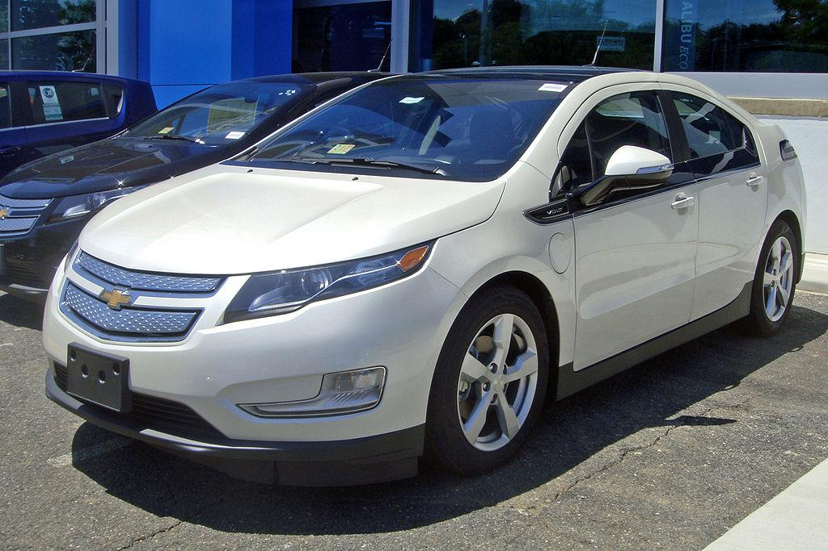
What is the best model?

Slide 13
Who are the team members?
Physician (Labs, medication tapering, CGM)
Office Manager/Health Coach
Health Coaches
Medical Assistant
Trainer/Fitness Expert
Psychology/Psychiatry
Addiction Specialist
Family/Community

Slide 14
What can we monitor remotely?
Weight
Blood Pressure
Sugar Levels (CGM)
Ketone Levels
Laboratories
Steps/Activity/HR
Meals
EKG/Holter Monitor/Sleep Study

Slide 15


Slide 16


Slide 17


Slide 18
Our Journey
Easter
Halloween Candy
Christmas/Holidays
1
3
5
2
4
6
In-Laws Visiting
Thanksgiving
New Years Eve/Day

Slide 19
Daily Questions in Clinic
What is more important diet or exercise?
Should I weigh myself every day?
How many cheat days do I get a week?
How much alcohol can I drink?
Do I need to fast?
Are artificial sweeteners OK?
Should I eat more protein or more fat?
How strict should I be on my carb intake?
My answer: It depends

Slide 20
LONGEVITY 101
Insulin Resistance is related causally with almost every non-infectious chronic disease known (Dr. Ben Bikman, Phd Assoc. Professor of Physiology and Developmental Biology at BYU)
If we recognize the role of insulin resistance, then rather than trying to address each disorder separately, we simply address the common root, which empowers the role of lifestyle (Stress, sleep, smoking/alcohol, exercise, diet) as an intervention not drugs (Ben Bikman)
Ben Bikman says to keep visceral fat as low as possible for longevity
Ben Bocchicchio says keep muscle mass as high as possible for longevity

Slide 21
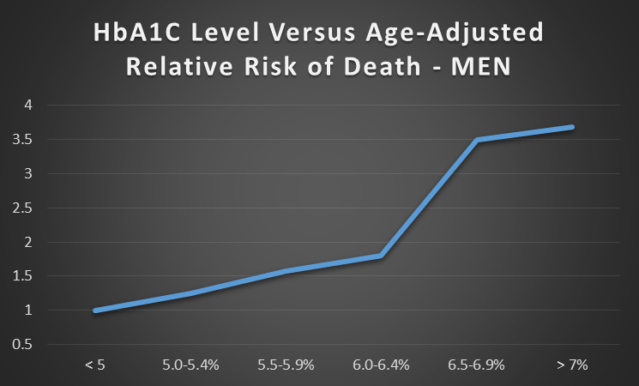
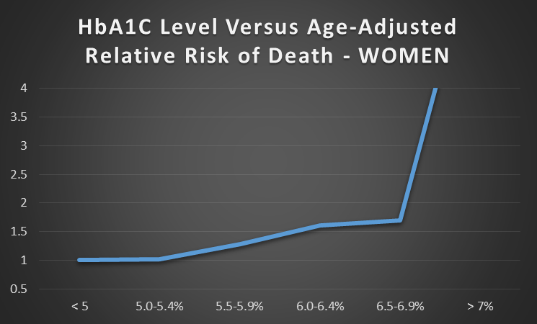
What strongly predicts outcomes?
Data taken from Table 2: Association of Hemoglobin A1c with Cardiovascular Disease and Mortality in Adults: The European Prospective Investigation into Cancer in Norfolk
Kay-Tee Khaw, MBBChir, FRCP; Nicholas Wareham, MBBS, FRCP; Sheila Bingham, PhD; Robert Luben, BSc; Ailsa Welch, BSc;
and Nicholas Day, PhD
Notes:
Ivor

Slide 22
Glucose
Insulin
Insulin Resistance
Type 2 Diabetes
Time
Notes:
Jason Fung said to check insulin in newly diagnosed diabetics and it will be high. My patient AIC 5.2 but insulin 40, next AIC 6.4---now 6.5..Dx DM

Slide 23
Heart
Disease
Diabetes
Cancer
Fatty
Liver
Body Fat
Insulin
Resistance
Dementia
PCOS
Stroke
Erectile
Dysfunction
Arthritis
Migraines

Slide 24
Sobering US Diabetes Numbers:
Over 34 million cases in the US (1 in 10)
88 million Americans have pre-diabetes
1.5 million Americans are diagnosed with diabetes each year (1 every 21 seconds)
Diabetes is the primary cause of death for 83,565 Americans per year and a contributing cause in 270,702 per year
Causes over 130,000 nontraumatic lower-limb amputations annually
Causes 58,400 Americans to begin dialysis annually
Diabetics die 6 years earlier than peers without diabetes

Slide 25



Can You Spot the Elephant in the Room?
STRESS!!!

Slide 26
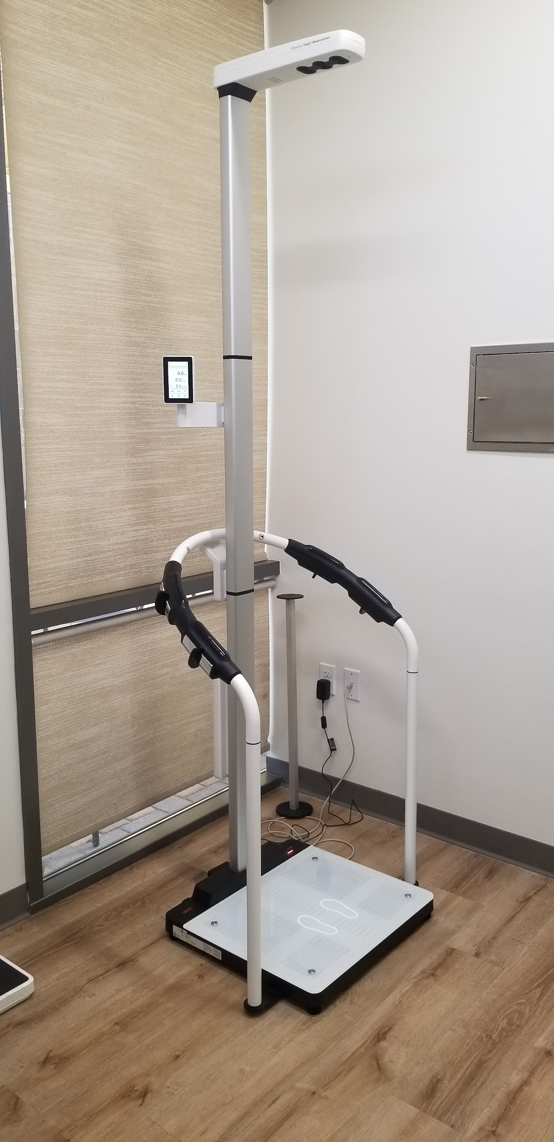
Notes:
Visceral Fat, Muscle Mass

Slide 27
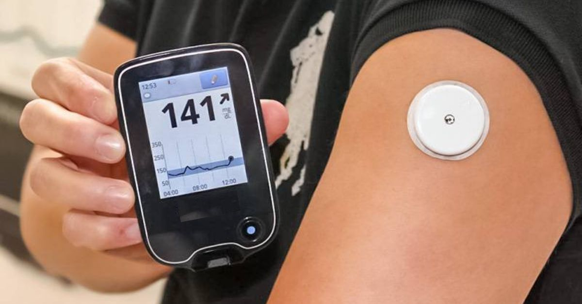

Slide 28
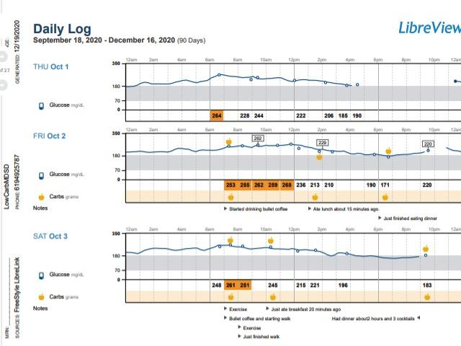

Slide 29
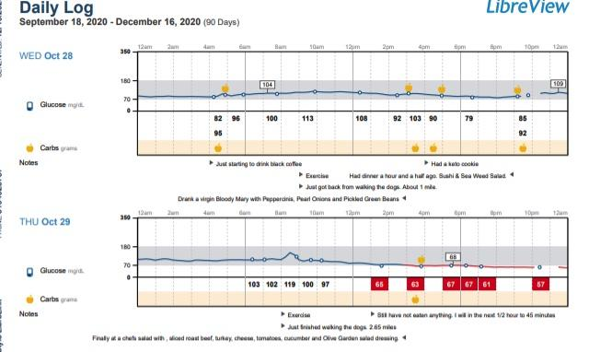

Slide 30
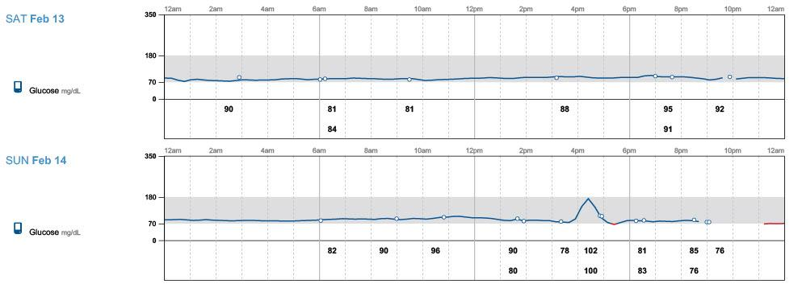
Happy Hour!!

Slide 31
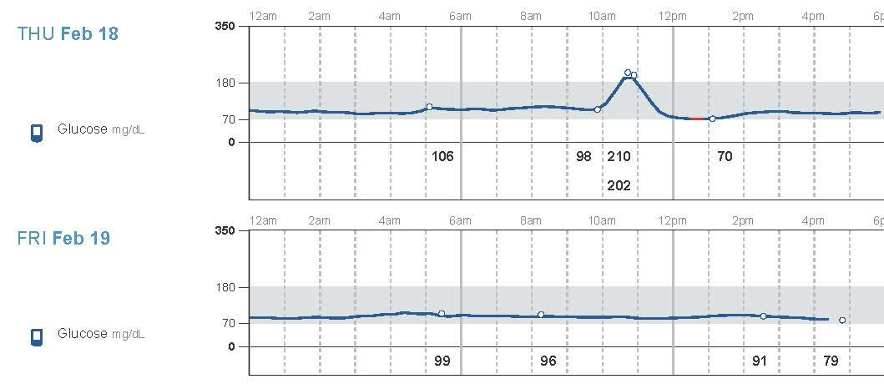

Zoom Consult

Slide 32
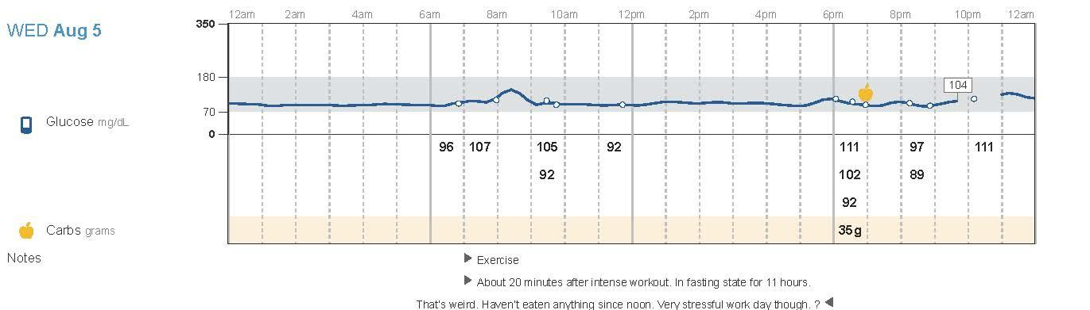
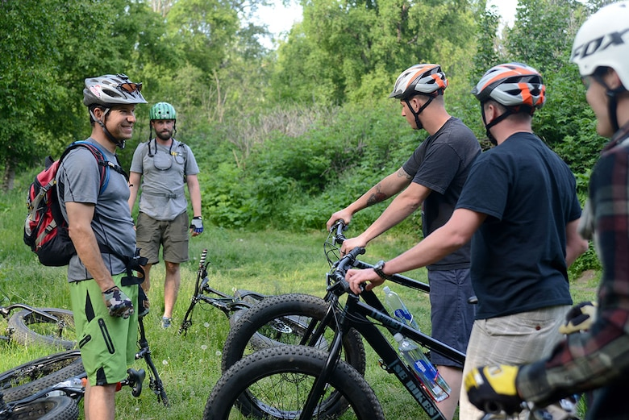
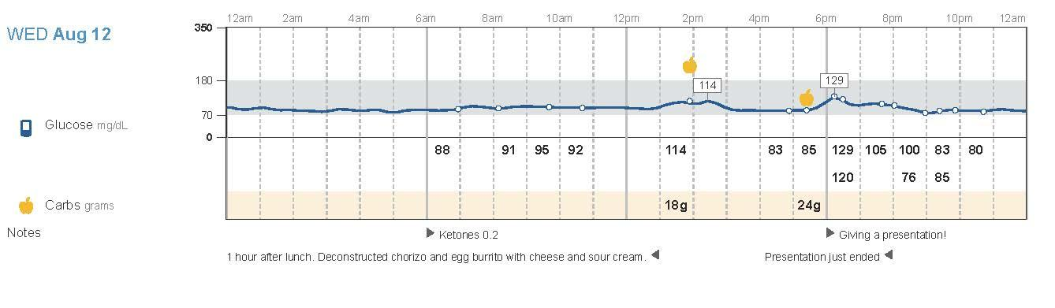


Slide 33
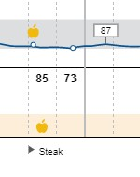
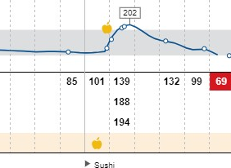

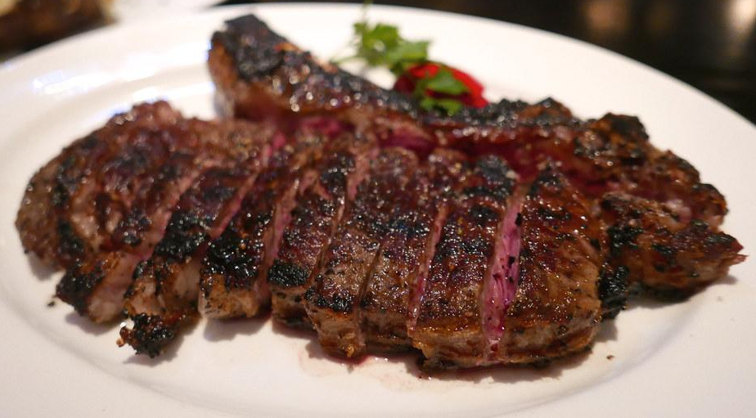
Sushi vs Steak!

Slide 34
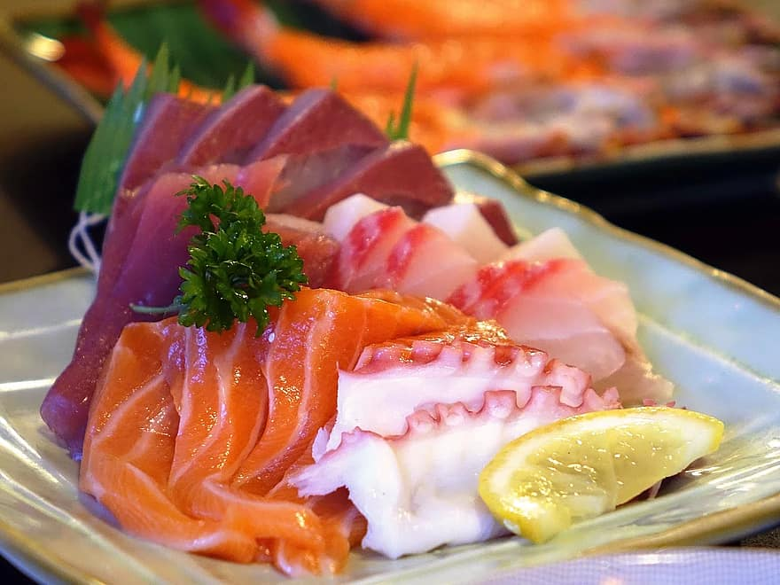
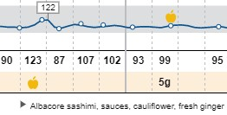
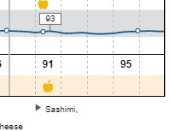
Can Sashimi Spike my Sugars?

Slide 35
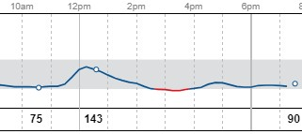
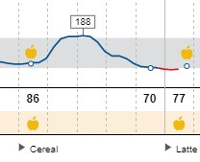
Oatmeal or Cereal for Breakfast?

Slide 36
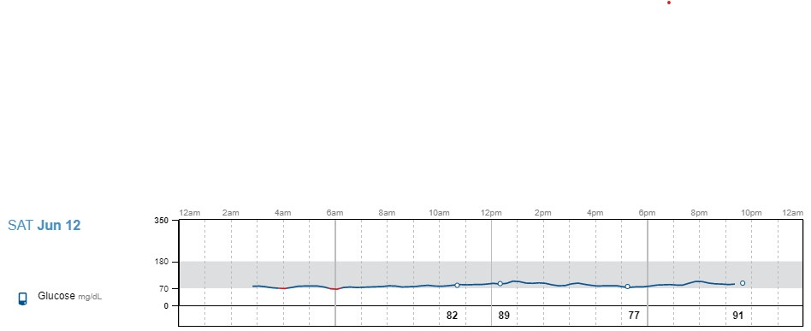
Answer: Eggs

Slide 37
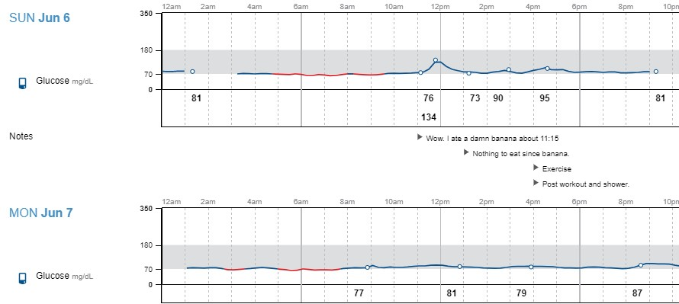

Fruit is fine, right? It is “Natural” Sugar

Slide 38
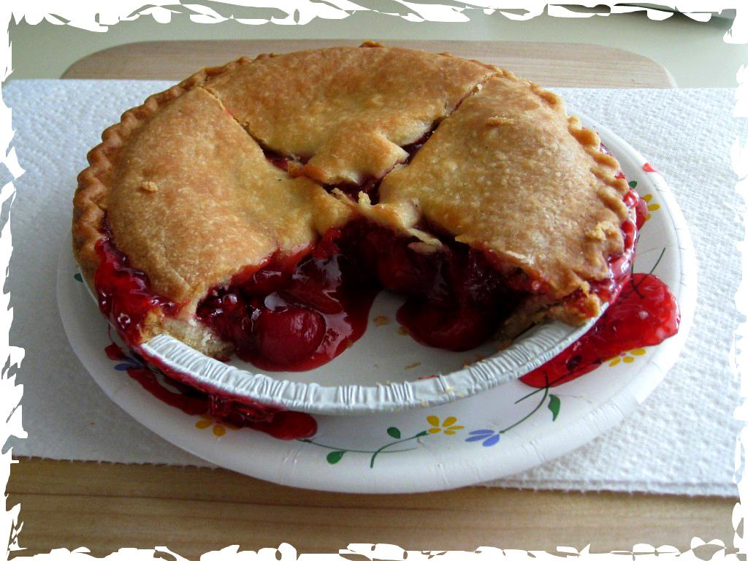
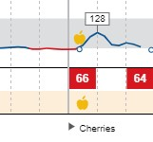
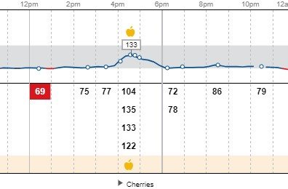


Slide 39
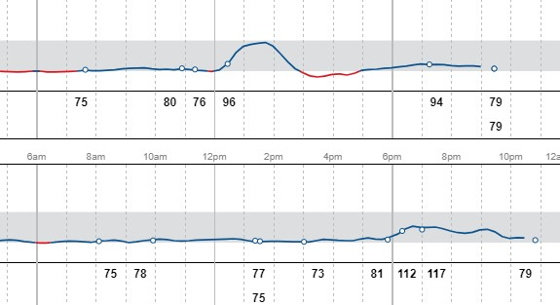
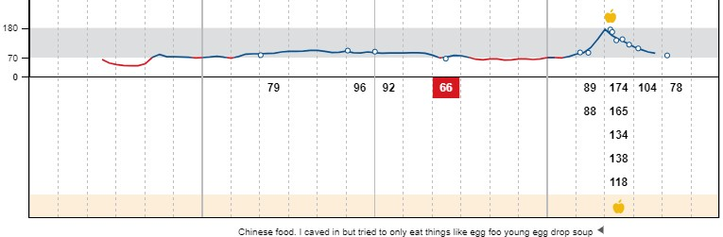
Chinese Food Without Rice?

Slide 40
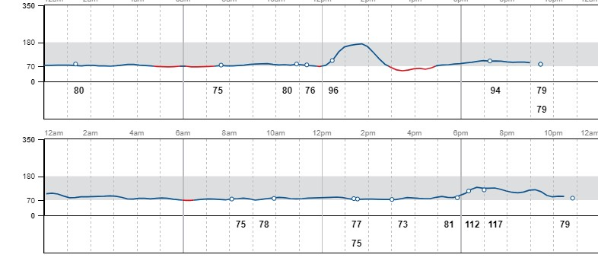
Thai Food?

Slide 41
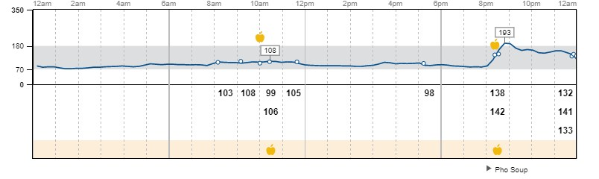
Vietnamese Pho Soup...It is Mostly Broth and Veg?

Slide 42
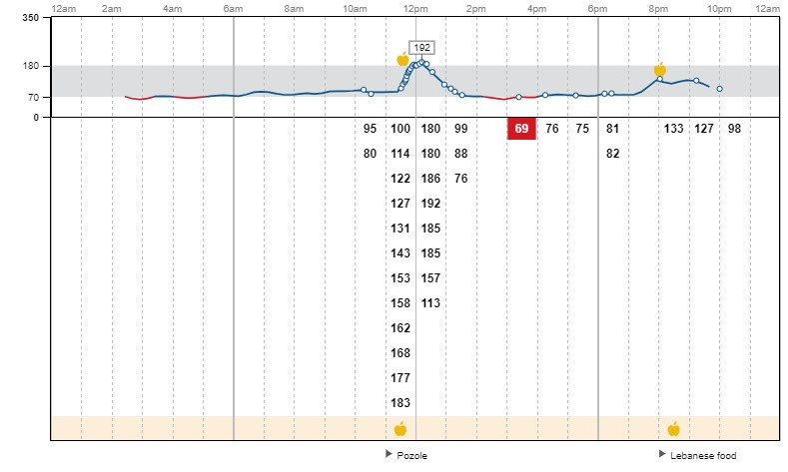
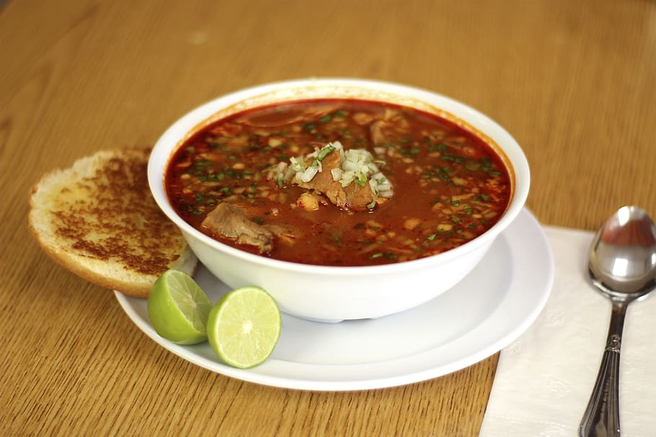

Slide 43
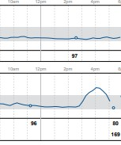
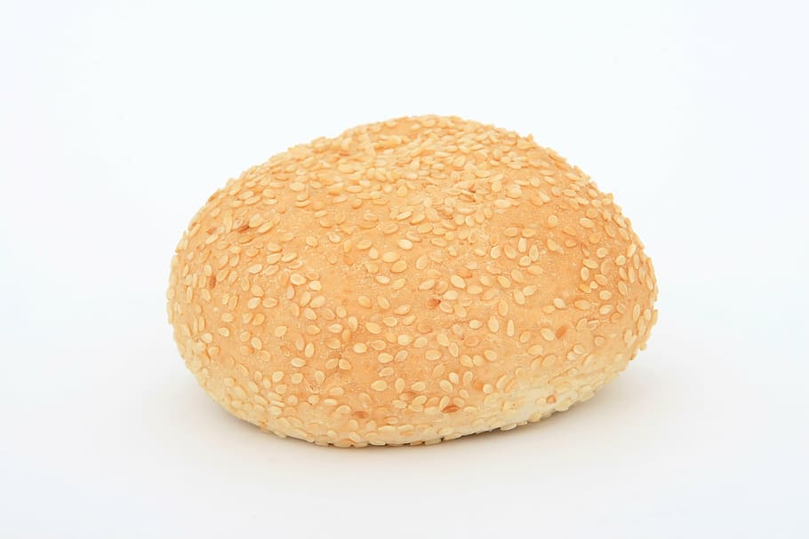
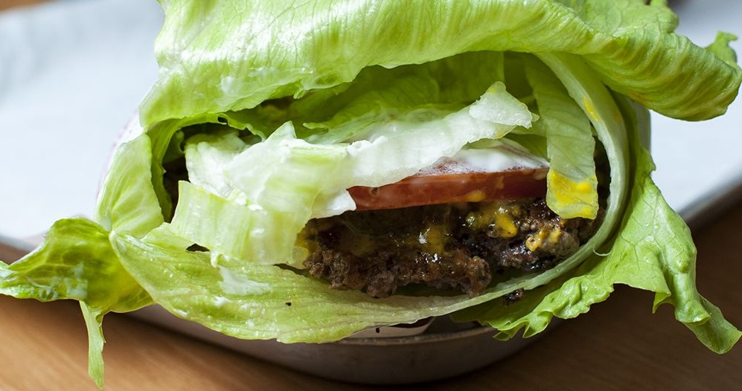
The Difference in the Top and Bottom Tracings?

Slide 44
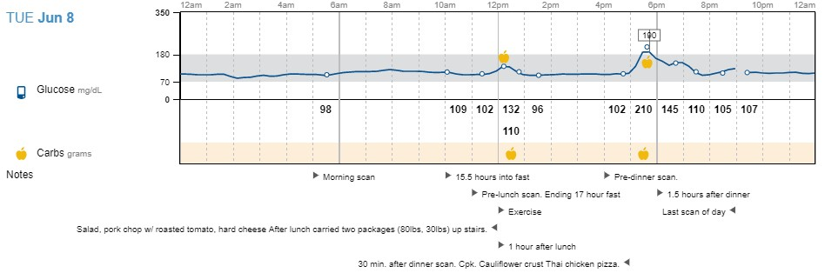
Cauliflower Crust Pizza? But it Says Keto!

Slide 45
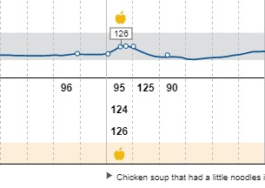

Chicken Broth?

Slide 46
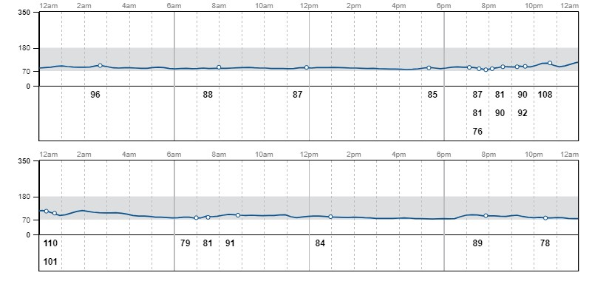
Boring is Good on CGMs!

Slide 47
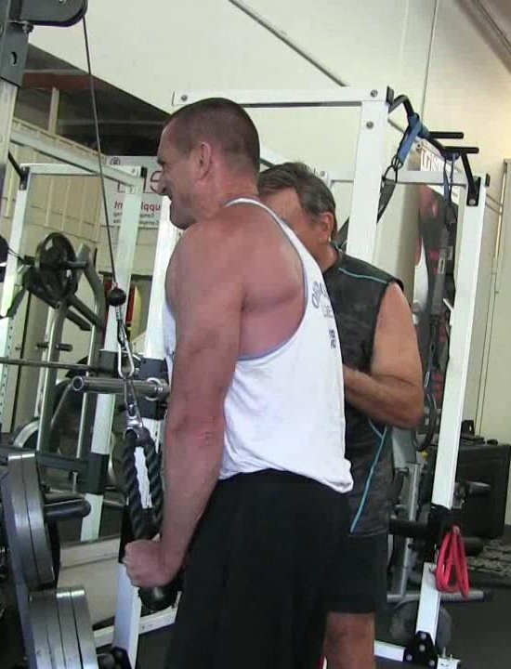
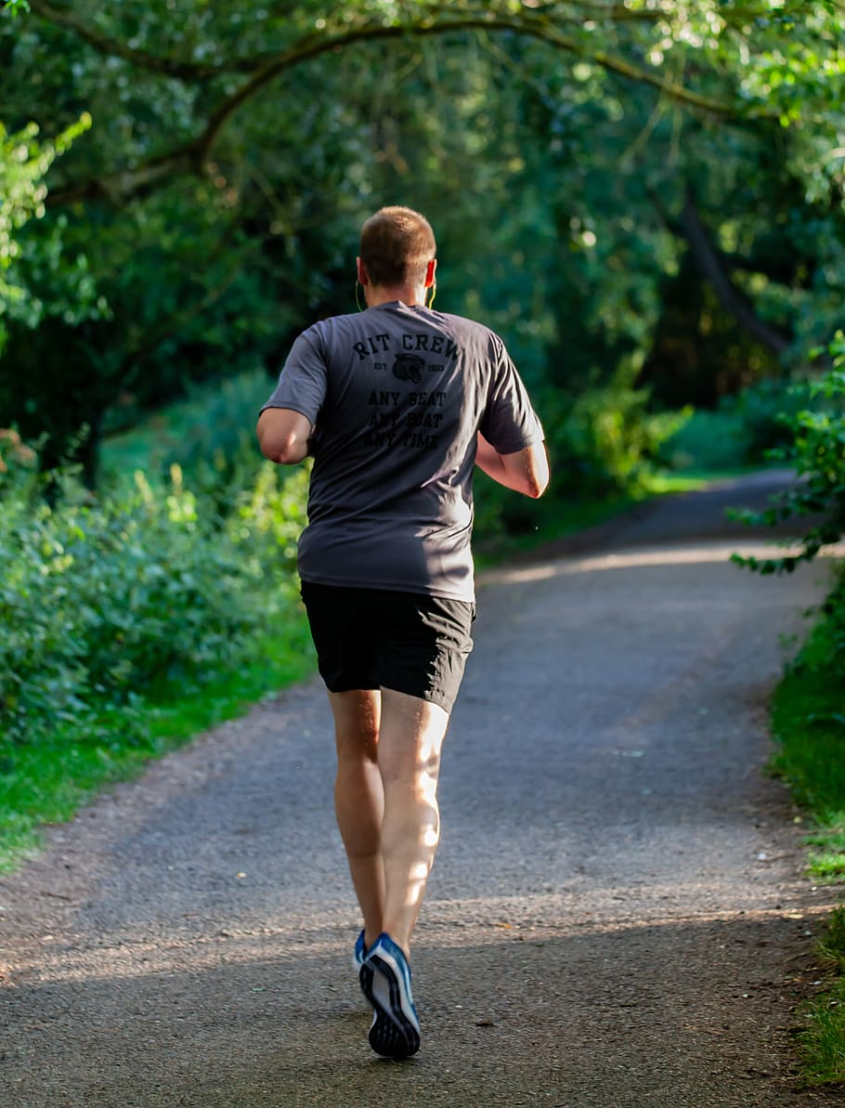
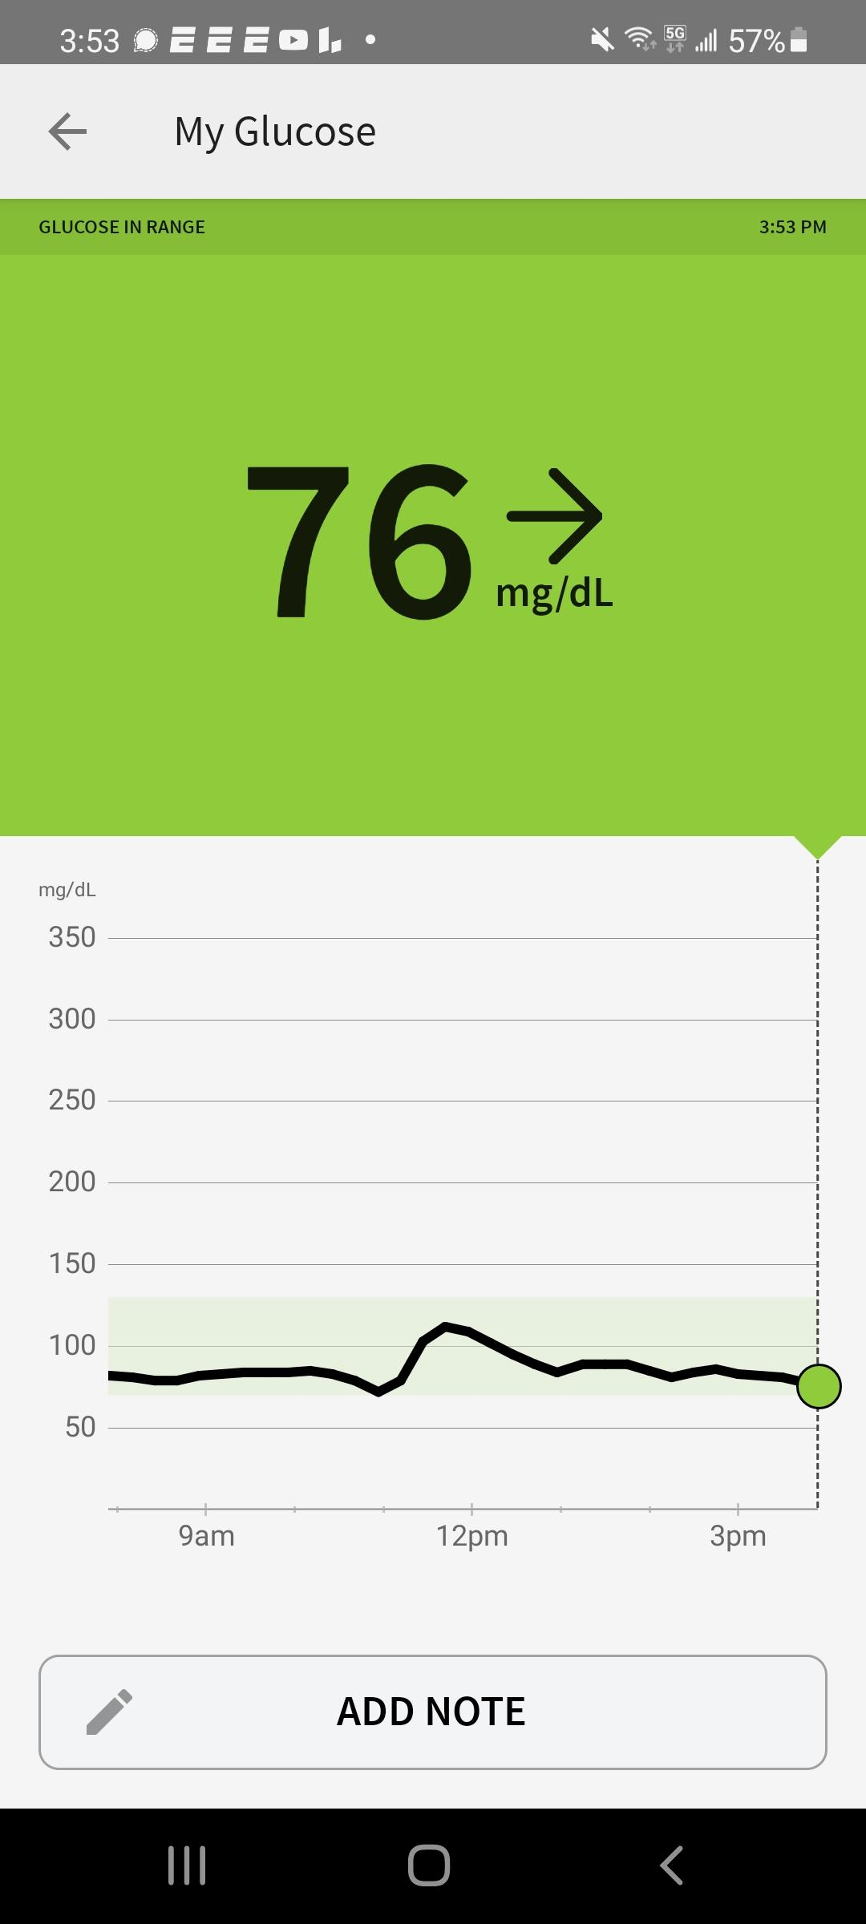
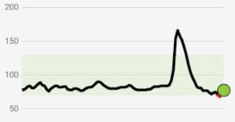
What in the Heck Did You Do??

Slide 48
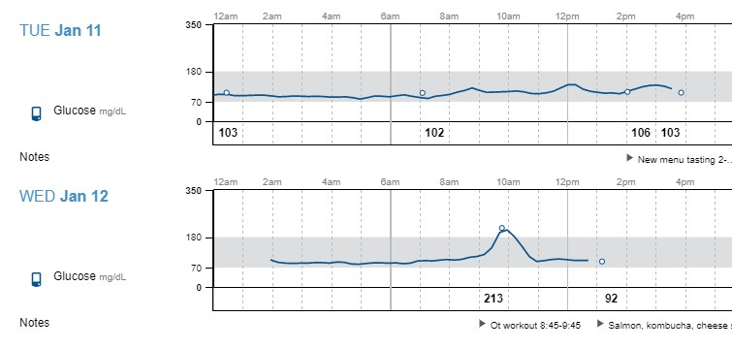

What in the Heck Did You Do??

Slide 49
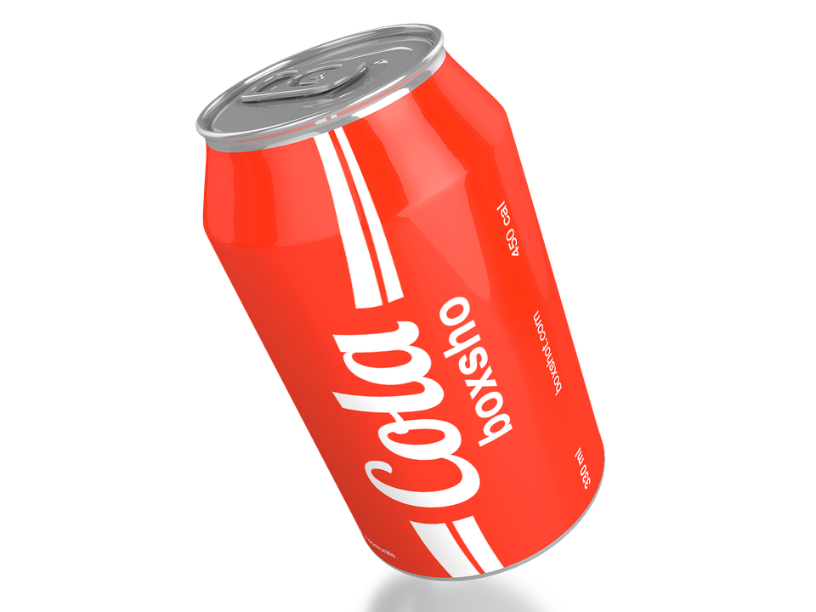

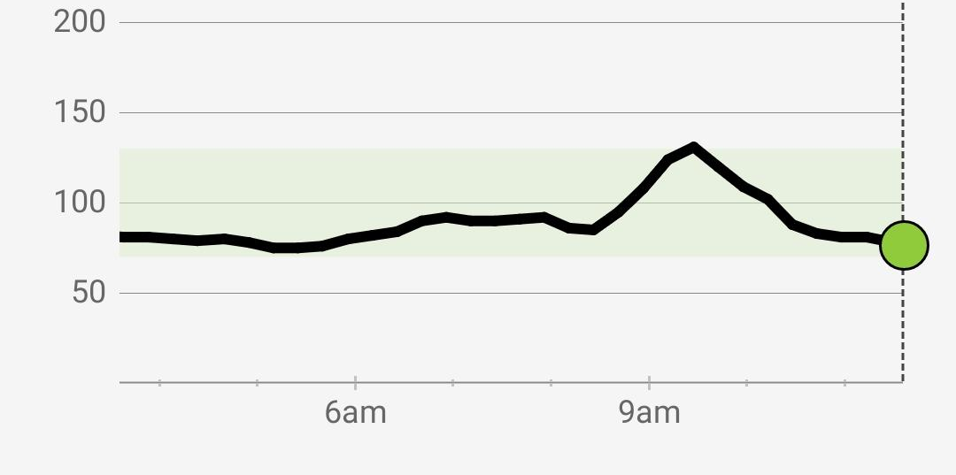
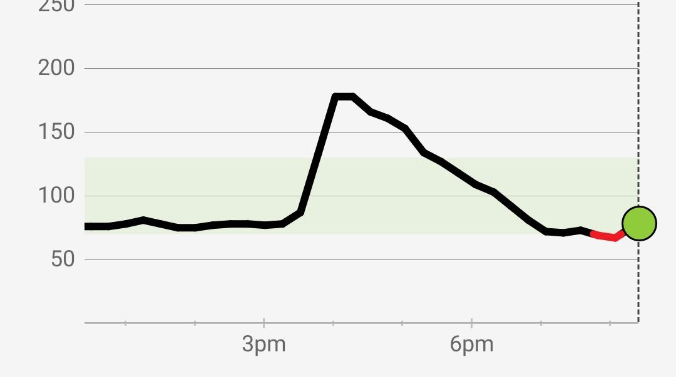

Slide 50
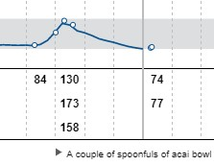
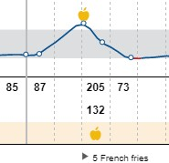
Everything in Moderation?

Slide 51





Mobile project
Show and explain your web, app or software projects using these gadget templates.

Slide 52


Slide 53


A picture is worth a thousand words
If you are Type “A” you can list all of the ingredients, the rest of us will just take a picture for our coach to figure out.

Slide 54


Slide 55




Health Coaches

Slide 56


Slide 57







Slide 58



Slide 59



Slide 60




Slide 61


Slide 62
Net result that week?
10 days on vacation seeing his grandchild
Away from his stressful job
Less weights, more walking
Spent time with his wife and family
Laughed more than usual
Net weight loss in 10 days: 8.8 lbs

Slide 63
Virta Studies
Long-Term, sustainable benefit to key diabetes outcomes
  At 2 yrs treatment clinically significant improvements in HbA1c%, metabolic syndrome rate and markers of inflammation
  >50% met criteria for DM reversal. Others had significant improvements.
  67% of DM -specific prescriptions were discontinued
  91% who began on insulin reduced or eliminated their insulin dosage

Slide 64
Virta Studies
1 Yr data: 94% on insulin reduced or eliminated dosage.
12% average weight loss
Improvements in CV disease markers, inflammation and liver function

Slide 65
Virta:
Long-term prediabetes reversal and type 2 diabetes prevention
  Only 3% progressed to type 2 DM over 2 year period
  Over half achieved normoglycemia
  75% of patients retained at 2 yrs

Slide 66
Virta (Again):
Long-term improvement in cardiovascular risk factors
  Patients with Type 2 DM had long-term improvement in triglycerides, HDL and reduced small LDL particles
Evidence of NAFLD disease improvement
Improved patient-reported sleep quality

Slide 67
Virta (Again)
So if Virta is the Big Brother, maybe we can be a bunch of Little Brothers and Sisters or something.

Slide 68

How do we improve our odds of success?
Physician
APP
Motivated Patient

Slide 69


Slide 70


Slide 71





Slide 72





Slide 73


Slide 74







Slide 75


Slide 76
Thanks!
Any questions?
You can find me at:
@BrianLenzkes (Twitter/GETTR)
LowCarbMDSanDiego.com

Slide 77
Resources: SMHP Grand Rounds 2022
Athinarayanan SJ, Adams RN, Hallberg SJ, McKenzie AL, Bhanpuri NH, Campbell WW, Volek JS, Phinney SD, McCarter JP. Long-Term Effects of a Novel Continuous Remote Care Intervention Including Nutritional Ketosis for the Management of Type 2 Diabetes: A 2-Year Non-randomized Clinical Trial. Front Endocrinol (Lausanne). 2019 Jun 5;10:348. doi: 10.3389/fendo.2019.00348. PMID: 31231311; PMCID: PMC6561315.
Athinarayanan, S.J., Hallberg, S.J., McKenzie, A.L. et al. Impact of a 2-year trial of nutritional ketosis on indices of cardiovascular disease risk in patients with type 2 diabetes. Cardiovasc Diabetol 19, 208 (2020). https://doi.org/10.1186/s12933-020-01178-2
Abbott S, Smith E, Tighe B, Lycett D. Group versus one-to-one multi-component lifestyle interventions for weight management: a systematic review and meta-analysis of randomised controlled trials. J Hum Nutr Diet. 2021 Jun;34(3):485-493. doi: 10.1111/jhn.12853. Epub 2020 Dec 28. PMID: 33368624.
Bollyky JB, Bravata D, Yang J, Williamson M, Schneider J. Remote Lifestyle Coaching Plus a Connected Glucose Meter with Certified Diabetes Educator Support Improves Glucose and Weight Loss for People with Type 2 Diabetes. J Diabetes Res. 2018 May 16;2018:3961730. doi: 10.1155/2018/3961730. PMID: 29888288; PMCID: PMC5977036.
Flores Mateo G, Granado-Font E, Ferré-Grau C, Montaña-Carreras X. Mobile Phone Apps to Promote Weight Loss and Increase Physical Activity: A Systematic Review and Meta-Analysis. J Med Internet Res. 2015 Nov 10;17(11):e253. doi: 10.2196/jmir.4836. PMID: 26554314; PMCID: PMC4704965.

Slide 78
Resources: SMHP2 Grand Rounds 2022
Johnson KE, Alencar MK, Coakley KE, Swift DL, Cole NH, Mermier CM, Kravitz L, Amorim FT, Gibson AL. Telemedicine-Based Health Coaching Is Effective for Inducing Weight Loss and Improving Metabolic Markers. Telemed J E Health. 2019 Feb;25(2):85-92. doi: 10.1089/tmj.2018.0002. Epub 2018 May 30. PMID: 29847222; PMCID: PMC6384514.
Lee, P.A., Greenfield, G. & Pappas, Y. The impact of telehealth remote patient monitoring on glycemic control in type 2 diabetes: a systematic review and meta-analysis of systematic reviews of randomised controlled trials. BMC Health Serv Res 18, 495 (2018). https://doi.org/10.1186/s12913-018-3274-8

