Slide 1
Programs to help the population you serve, achieve metabolic health
Tony Hampton, MD, MBA, CPE, ABOM
Chair Outreach Committee, Society of Metabolic Health Practitioners
Grand Rounds: Comprehensive Lecture Series on the Science and Clinical Application of Metabolic Medicine

Slide 2
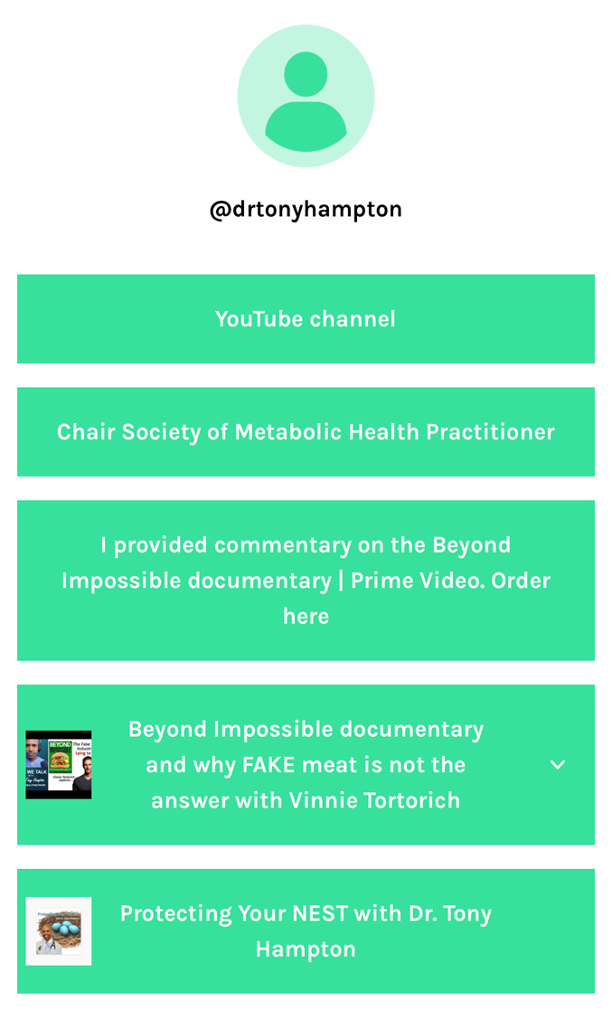
How to find me:

Slide 3
Disparities in healthcare:
What are the key drivers?
Who is being impacted?
How can we address it?

Slide 4
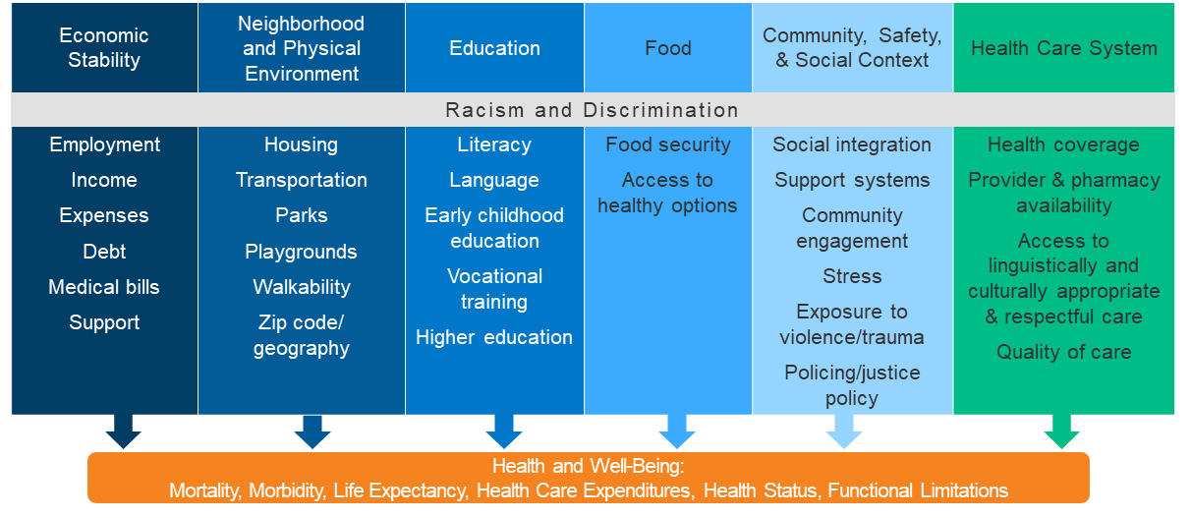
DISPARITIES IN HEALTHCARE
LARGELY DRIVEN BY SOCIAL & ECONOMIC INEQUITIES

Slide 5
Health inequities: people of color

Slide 6
What does metabolic health mean?

Slide 7
METABOLIC SYNDROME
12%
factors
only
of American adults are
Heart Disease
Lipid Problems
Hypertension
Type 2 Diabetes
METABOLICALLY HEALTHY
1 in 8
that’s just
Dementia
Cancer
Polycystic Ovarian Syndrome
Non-Alcoholic Fatty Liver Disease
Americans, which carries significant implications for
PUBLIC HEALTH

Slide 8
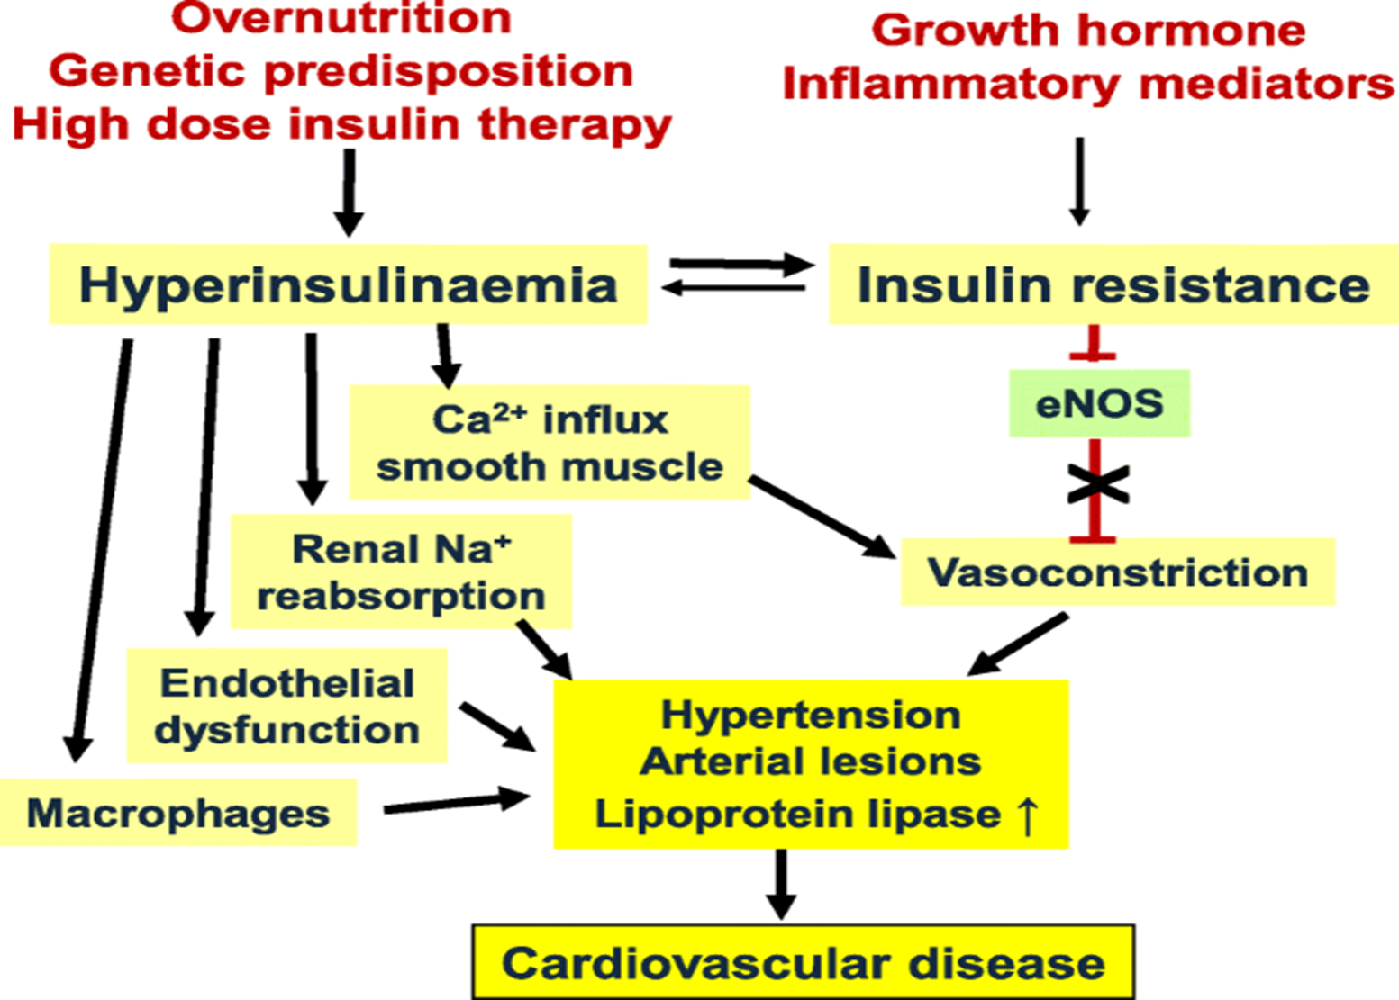
METABOLIC SYNDROME:
How does it work?

Slide 9
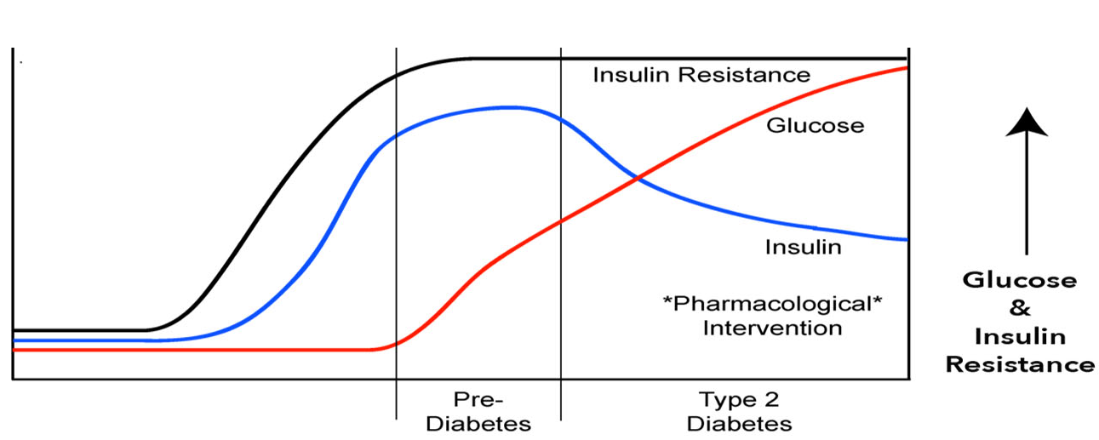
PROGRESSION OF TYPE 2 DIABETES

Slide 10
MEDICATIONS
Metformin, intensive lifestyle modification delayed or prevented Type 2 diabetes vs. placebo
Placebo: 11% per year incidence
Metformin: 7.8% per year incidence*
Lifestyle intervention: 4.8% per year incidence*
Risk reduction
30% by Metformin
58% by Lifestyle
39% Lifestyle vs Metformin
DPP: Metformin Intervention
* P<0.001 vs placebo
SOURCE: New England Journal of Medicine (2002)

Slide 11
The importance of diet on metabolic health

Slide 12
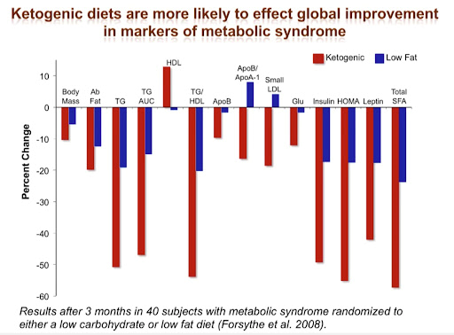
Keto intervention:
Impact on Metabolic Syndrome Markers
Keto diets are more likely to effect global improvement in markers of metabolic syndrome
Results after 3 months in 40 subjects with metabolic syndrome randomized to either a low carb or low-fat diet
SOURCE: Forsythe et al (2008)

Slide 13
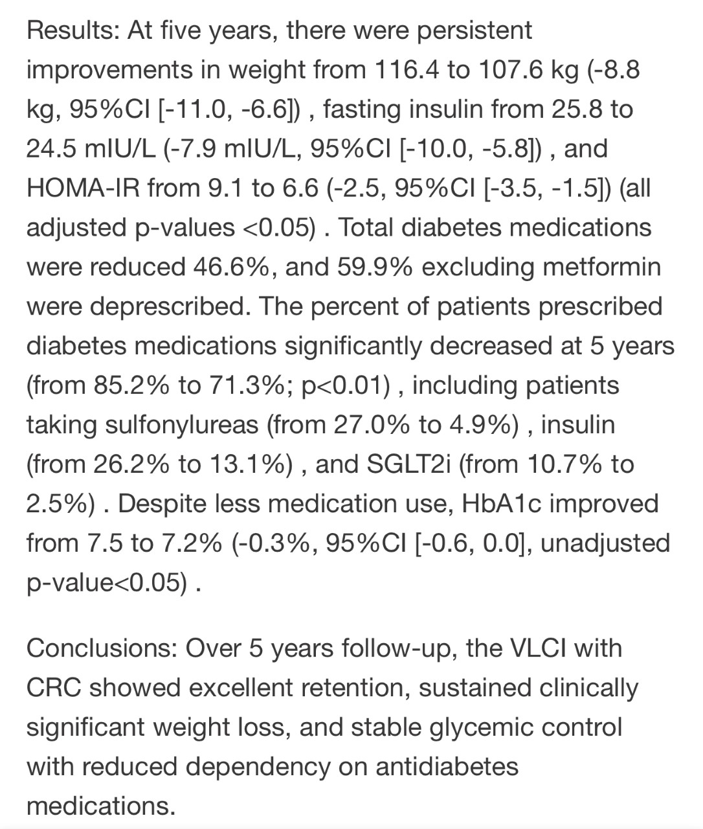
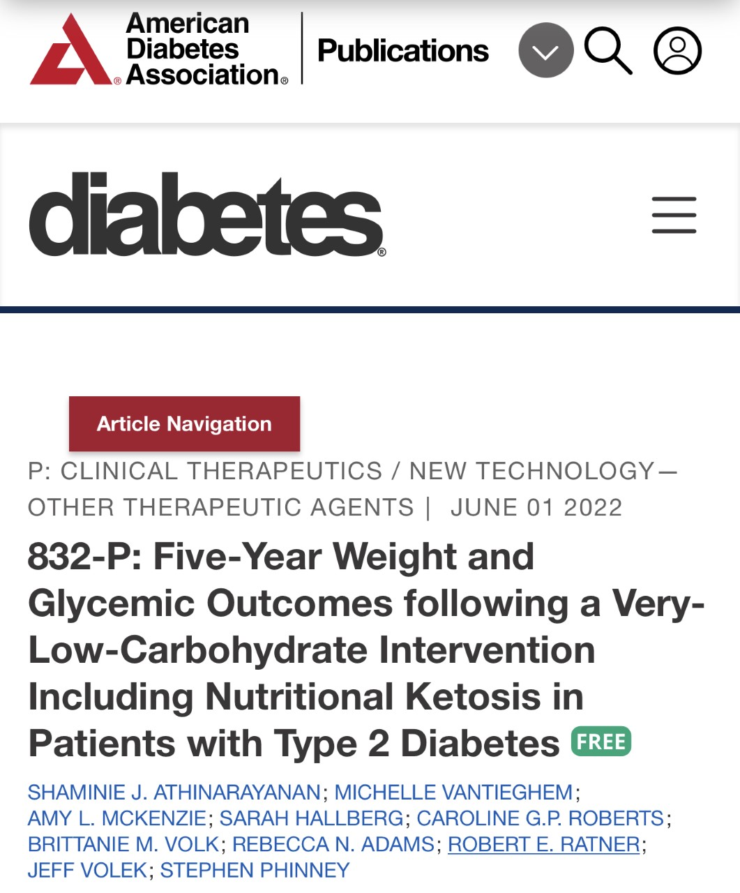
Keto intervention:

Slide 14
Low carb VS low fat:
Randomized Control Trials
Comparison of Low Carb Diets of <130g Carbohydrates/Day to Low Fat Diets of <35% fat of total calories
SOURCE: Public Health Collaboration

Slide 15
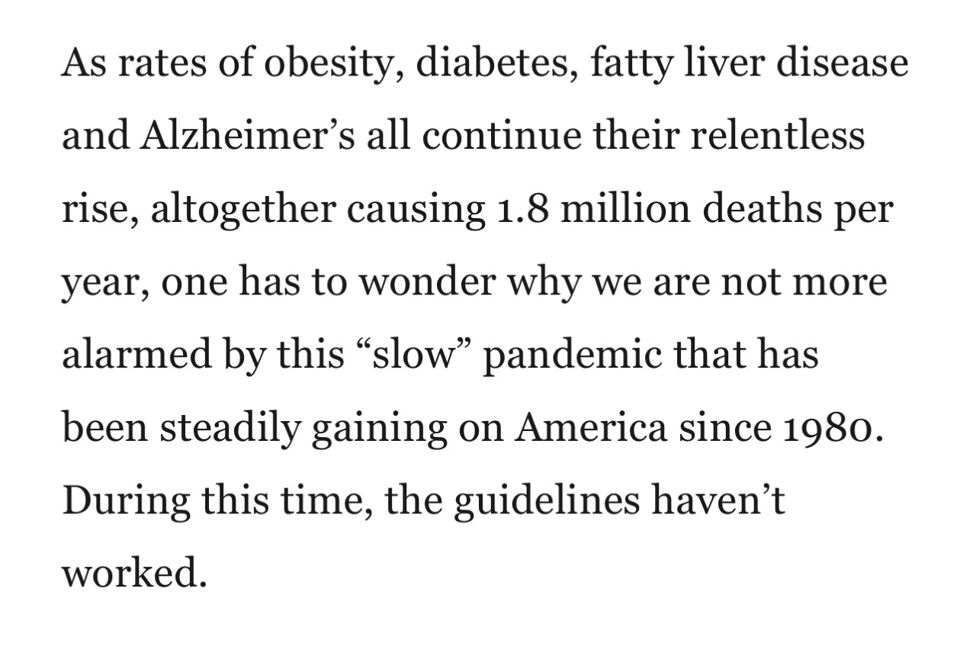
Dietary guidelines do not address chronic health issues

Slide 16
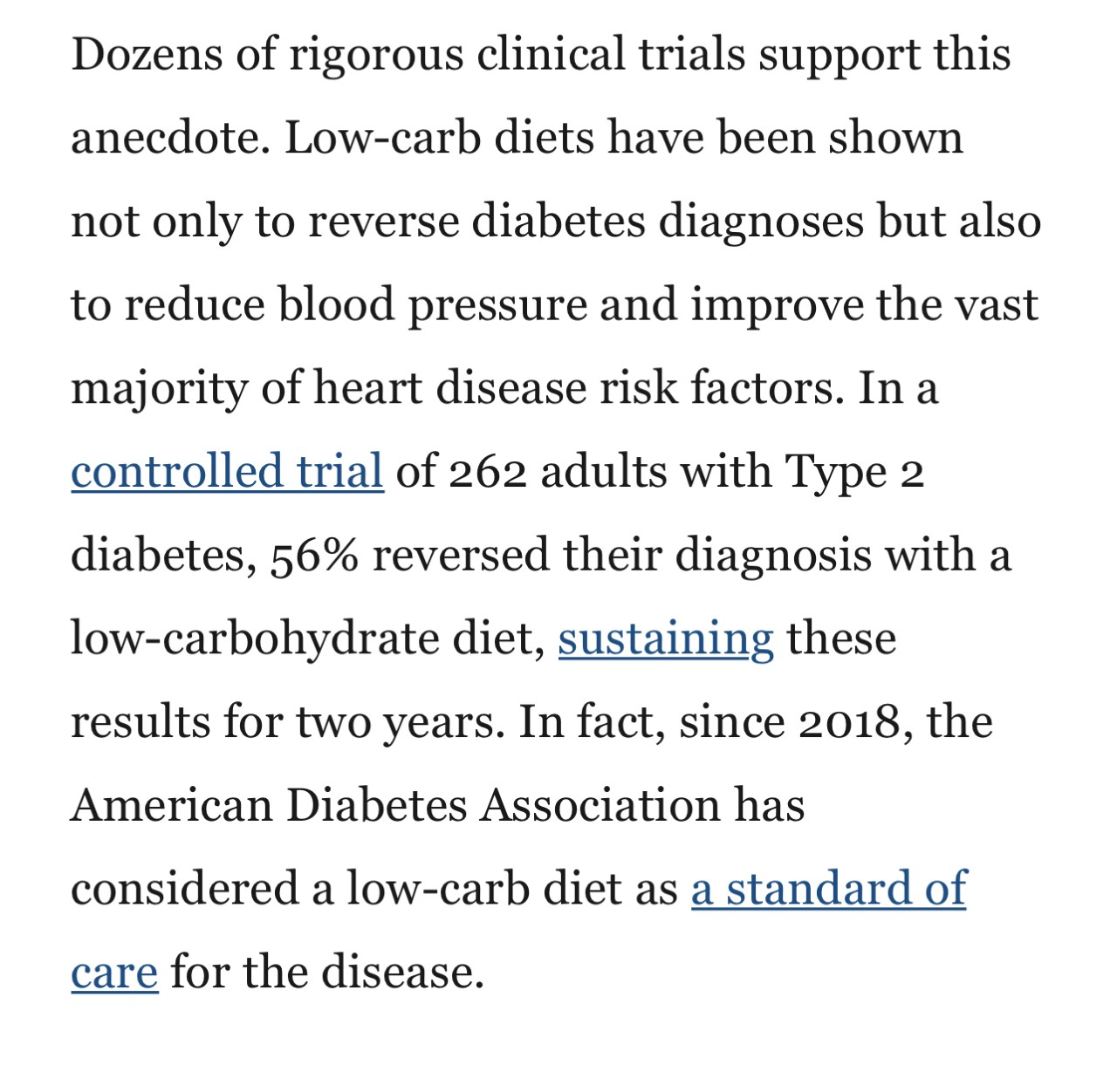
Ignore dietary guidelines?
It could save your patient’s life

Slide 17
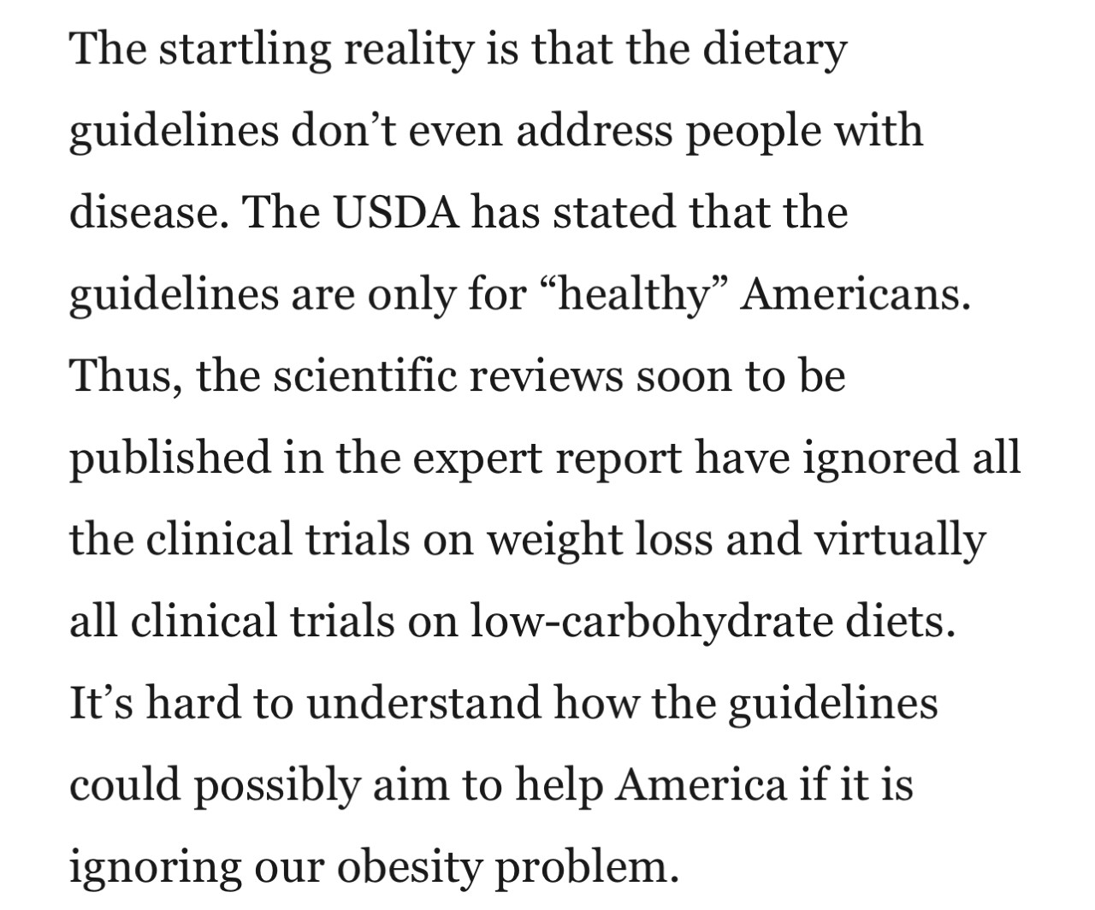
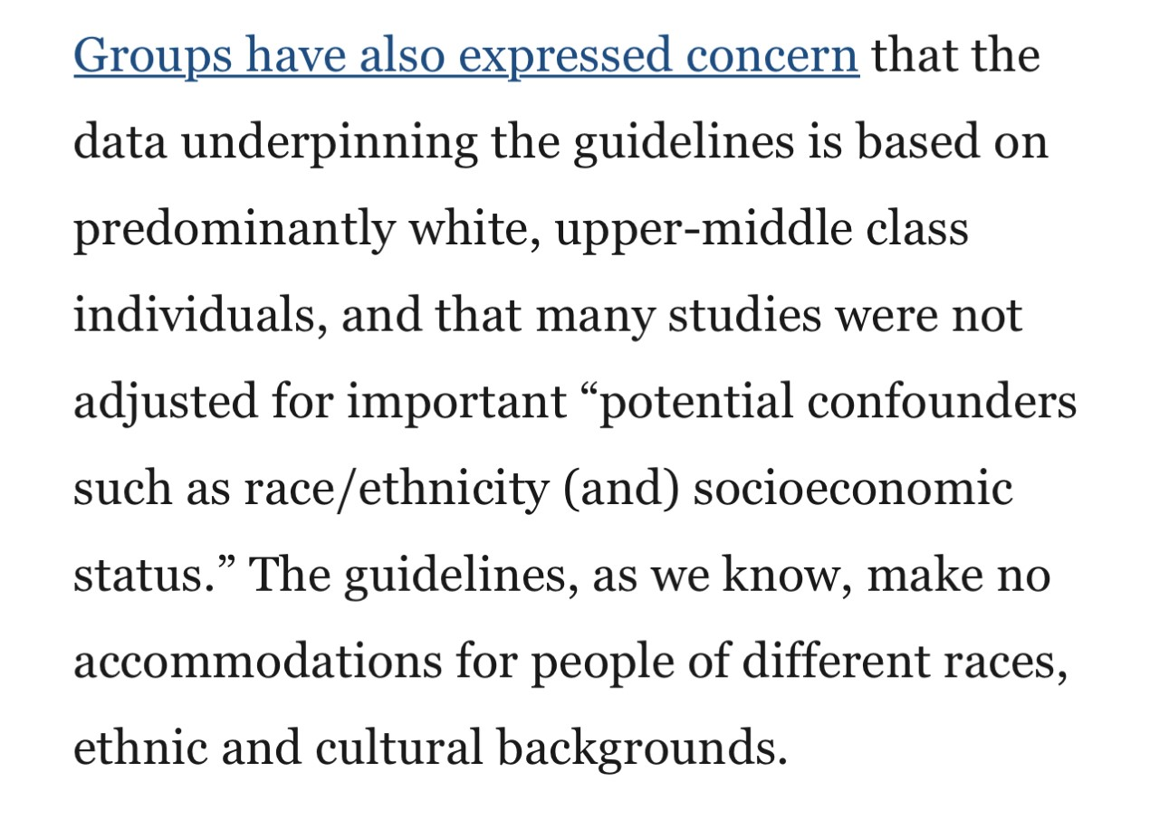
Ignore dietary guidelines?

Slide 18
To be successful, healthcare programs must create a paradigm shifts to address:
Metabolic Health AND
Social Determinants of Health

Slide 19
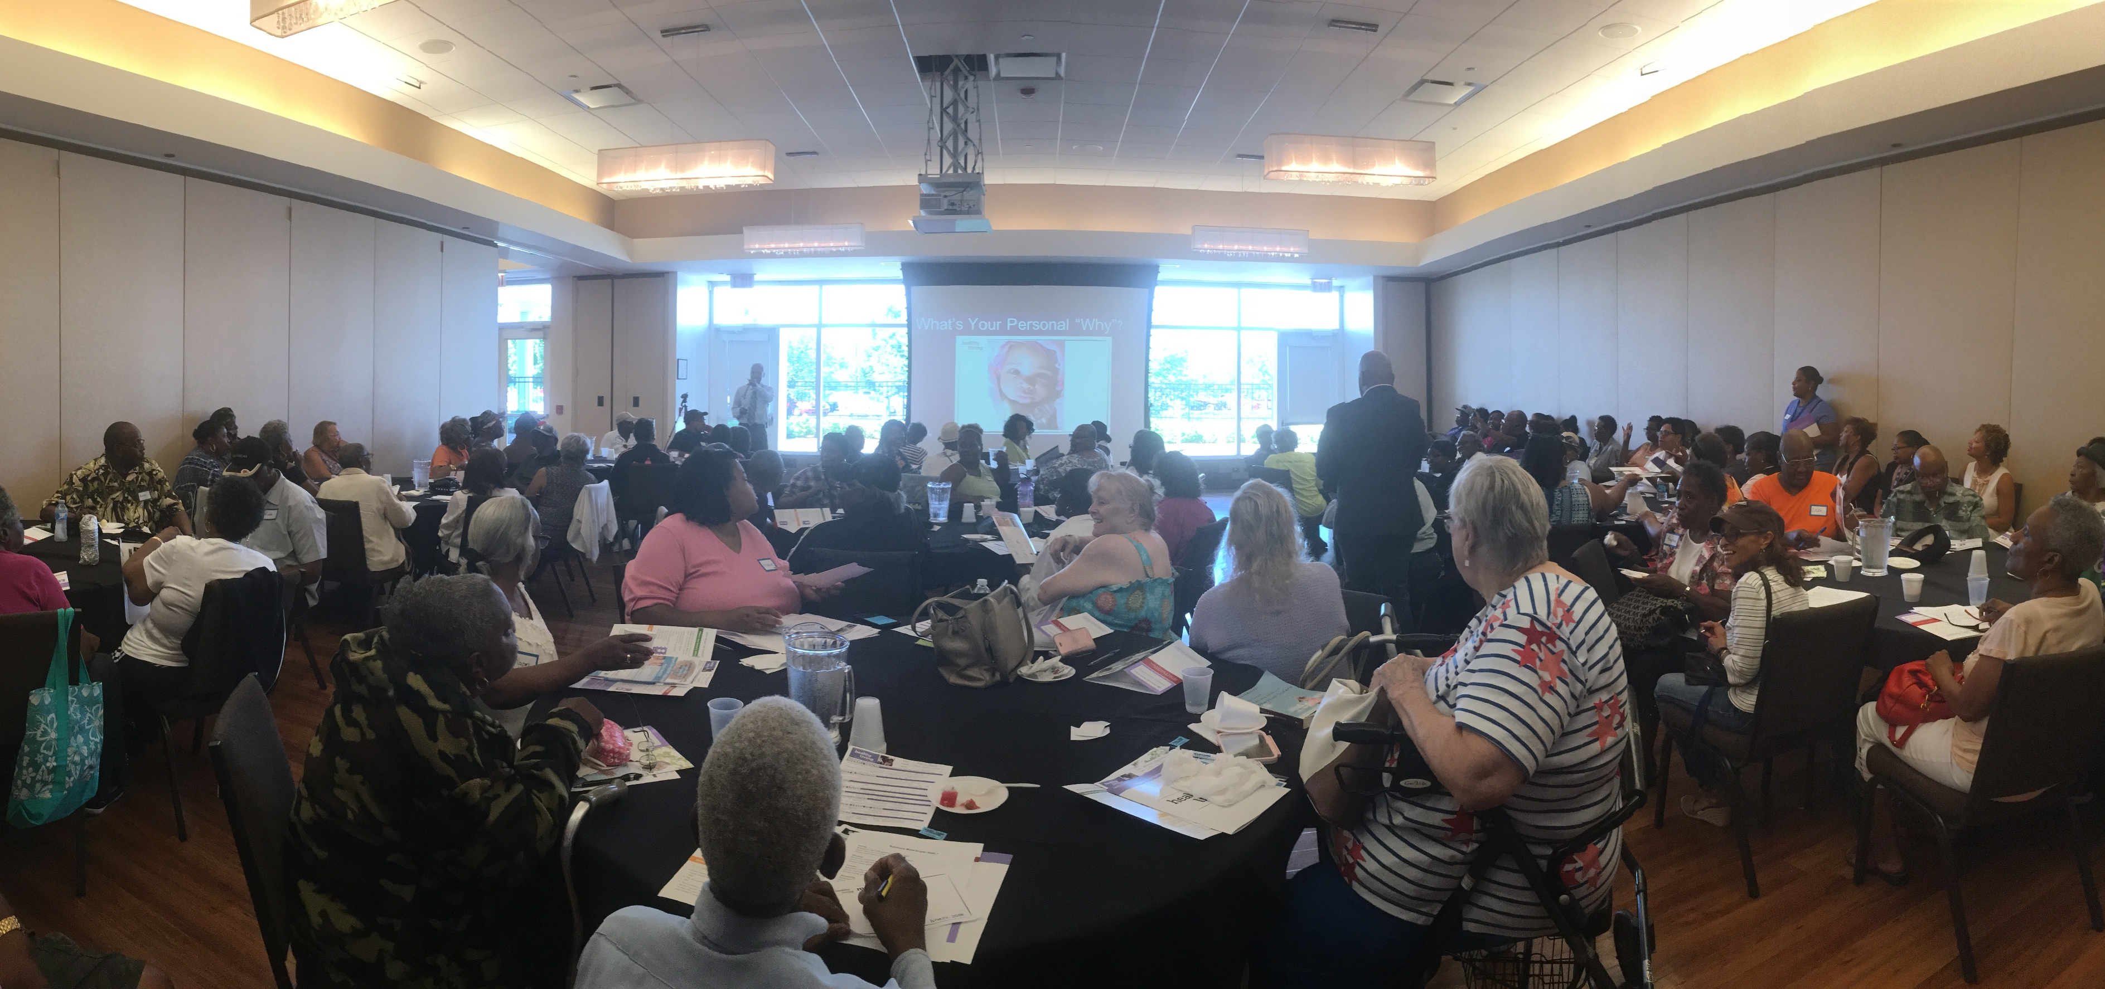
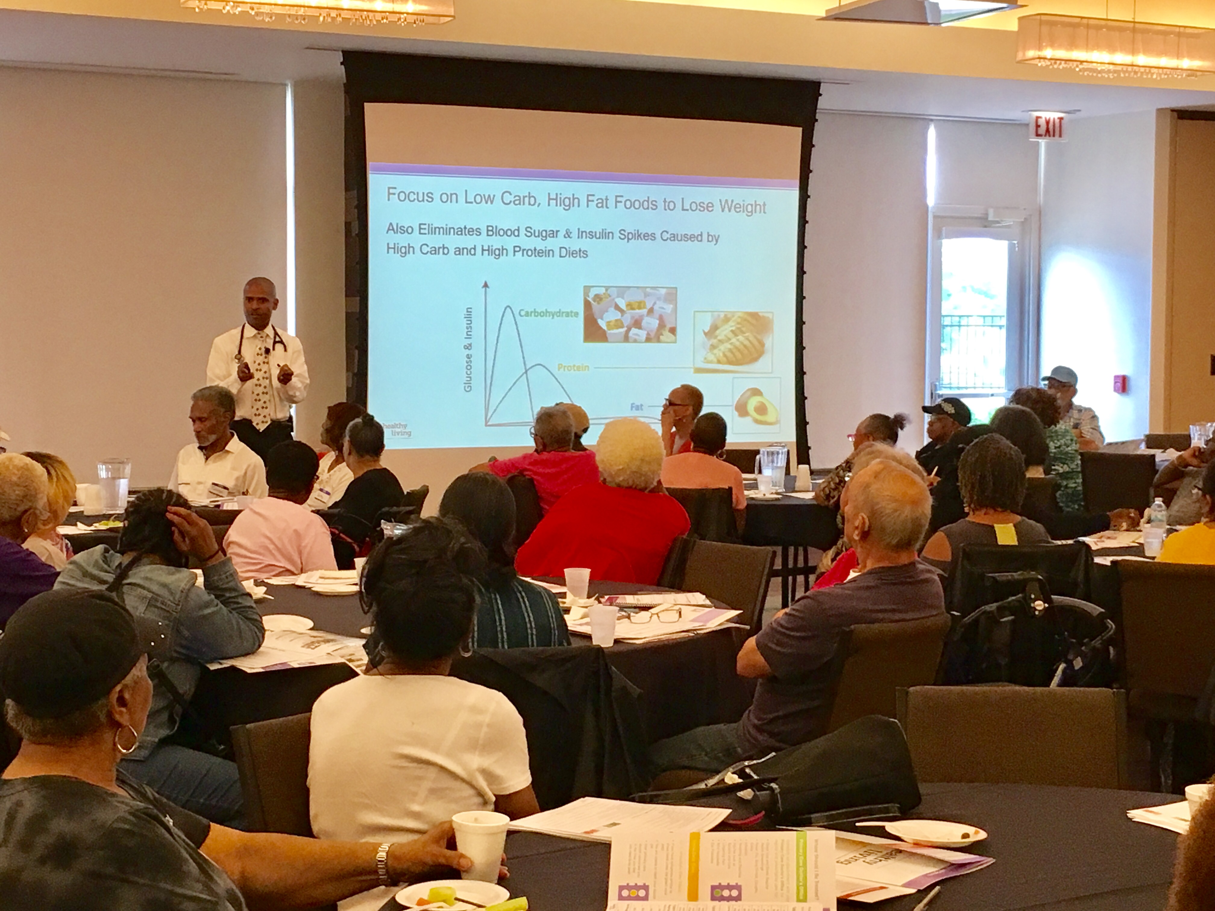
Healthy living program

Slide 20
Diabetes prevention program

Slide 21
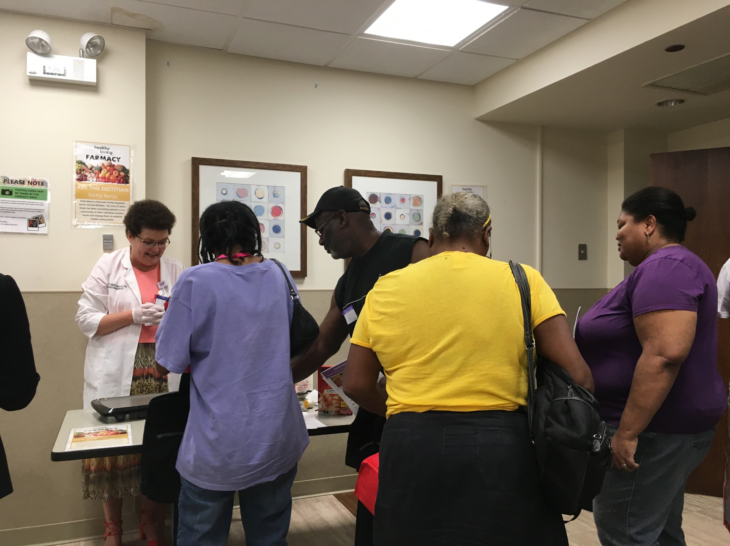
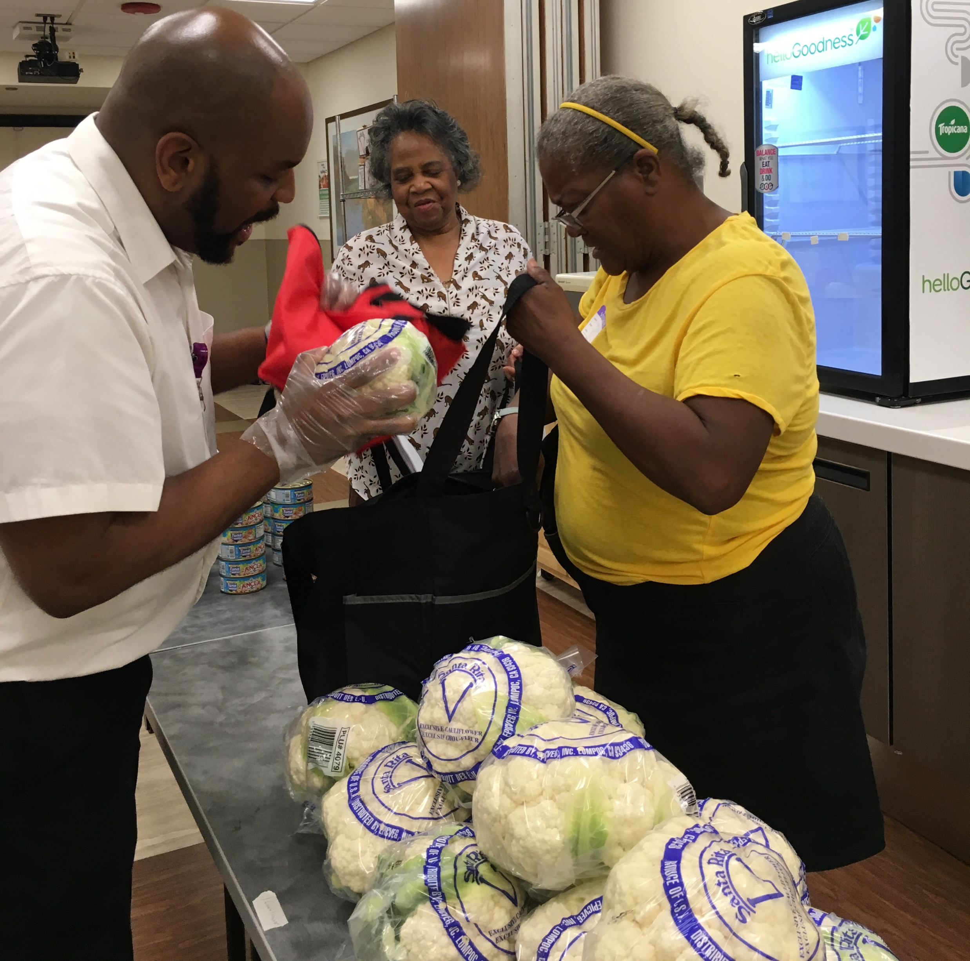
Food farmacy

Slide 22
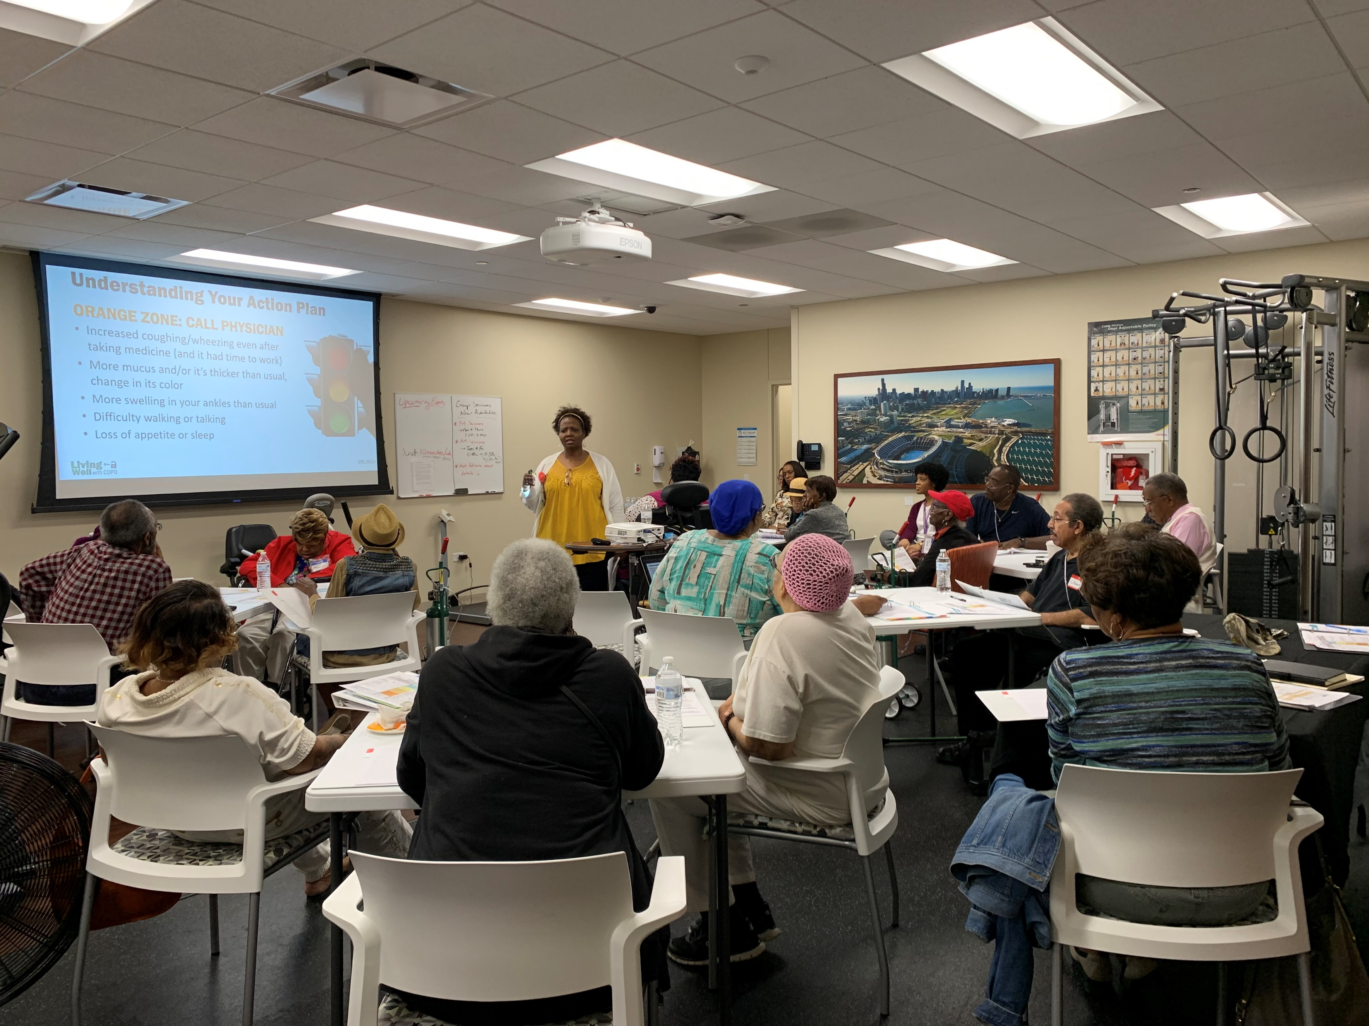
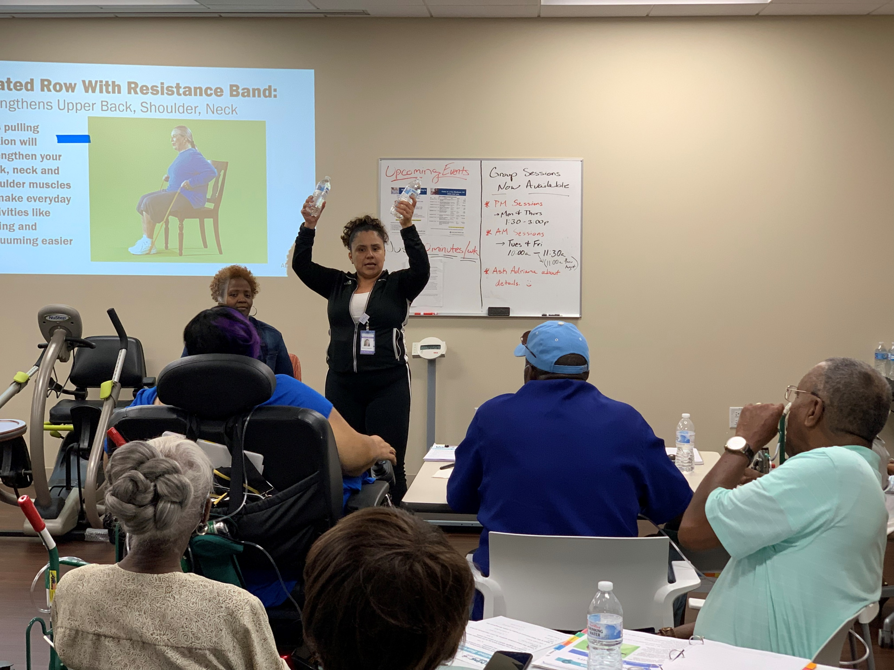
Copd education

Slide 23
Weight Management Program
With provider, patient decides best nutrition plan, ideally counseling with provider, otherwise referral out
Eating Plan/ Nutrition
Physical Activity/ Exercise
Lifestyle/Behavior Therapy
Pharmacotherapy
Bariatric Procedures
Nutrition Counseling (dietitian)
Diabetic Educator
HMR
Diabetes Prevention Program
Foodsmart
Obesity Specialist (Bariatrician) Referral
Physical Therapy – pain, deconditioning, billable and covered (identify locations with right access)
Massage Therapy
AAH Wellness Centers
Integrative Health Coaching (Healthy Me)
Behavioral Therapist
Eating disorder specialist
Sleep specialist referral
HMR
Diabetes Prevention Program
Employee Assistance Program (EAP)
Obesity Specialist (Bariatrician) Referral
Review of medications causing weight gain
Procedures (define appropriate referral/service)
Endoscopic
Restrictive
Malabsorptive
Revisional
Surgical
Long-term surgical care for sustained weight loss

Slide 24
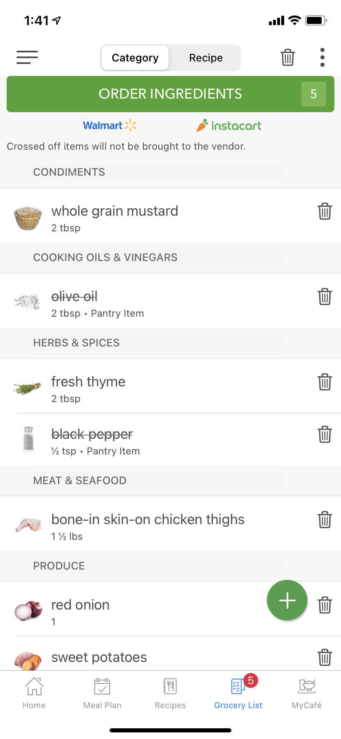
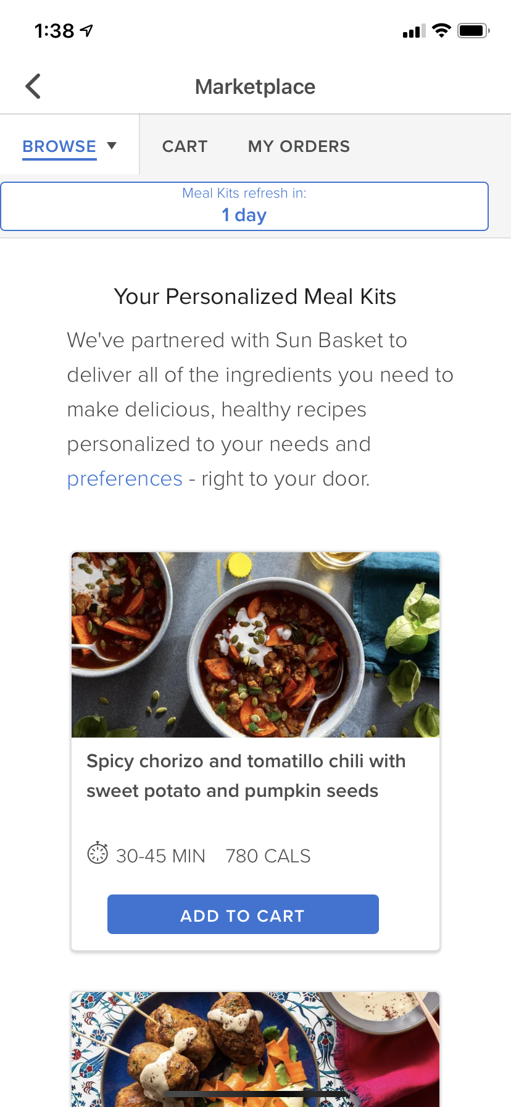
Foodsmart
An ecosystem for population health
Telenutrition
Network of Registered Dietitians
Digital Nutrition
Platform and Marketplace
Expert Guidance
A Supportive Environment
The first Foodcare ecosystem combining a national telenutrition network of Registered Dietitians using leading personalized digital nutrition platform with the most broadly integrated healthy food buying marketplace
Meal Planning
Grocery Ordering
and Delivery
Meal Ordering
Yields long term behavior change & results

Slide 25
Food Smart
Improving food security & health equity
INTEGRATIONS
OUTCOMES
Help members access food cards and medically tailored meals
Targeted nutrition assistance
Identify food
and nutrition
insecure
members
Integrate with PCP and other providers
Improved clinical guidance
Connect members with local food banks and support programs like WIC
Community engagement
Identify and enroll eligible members in SNAP
Food affordability

Slide 26
Additional Programs
Focusing on Diabetes, Stroke, CV Disease & Child Wellness
Love Your Heart
Blood Pressure Control Program
Community Baby Showers
City of Chicago’s Protect Chicago at Home Mobile Vaccinations

Slide 27
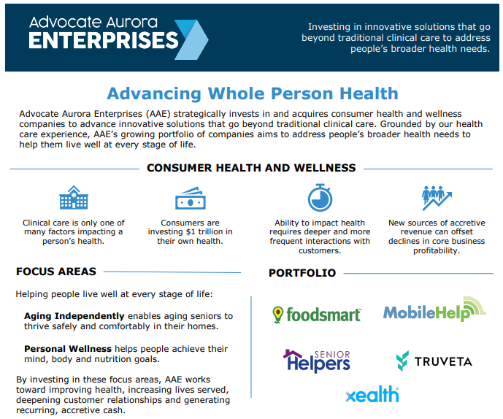

Slide 28
To be successful, healthcare programs must create a paradigm shifts to address:
WHAT IS THE CONVERATION?
Lifestyle Factors Influence Sustainability!

Slide 29
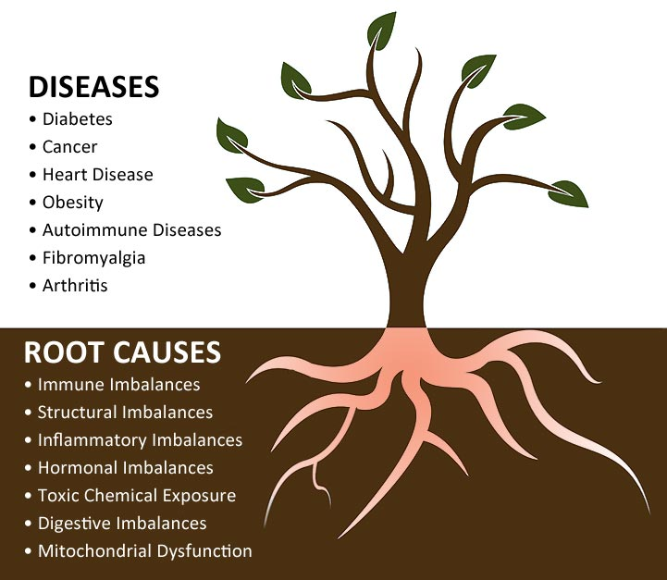
Lifestyle Changes
Focus on the Root Causes

Slide 30
Clinician Responsibilities:
Ask questions to understand our patients’ Social Determinants of Health
Look for Metabolic Disease as a Potential Underlying Health Concern
Support & Guide Patients to Make the Appropriate Lifestyle Changes

Slide 31
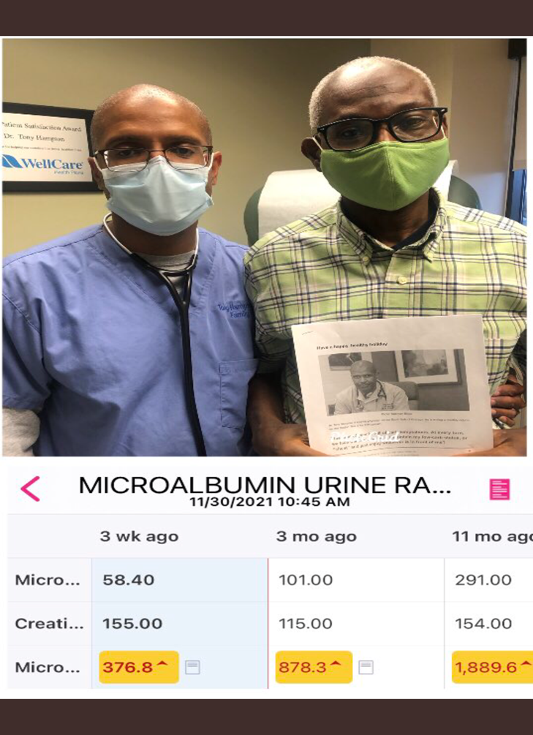
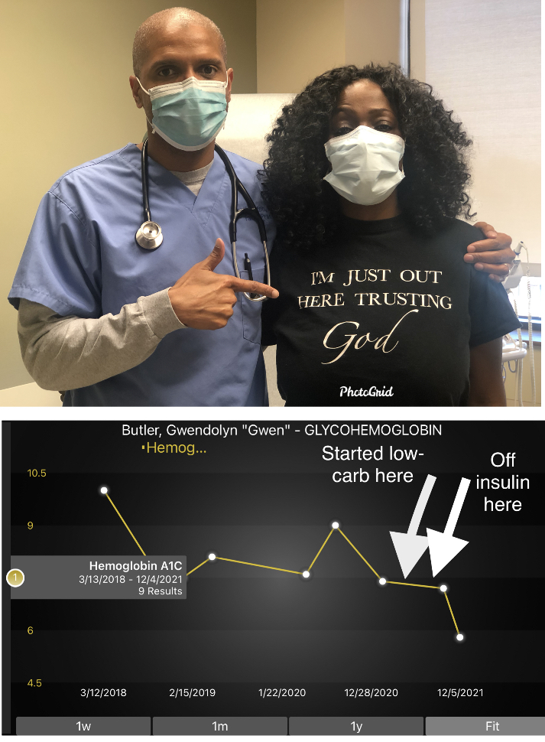
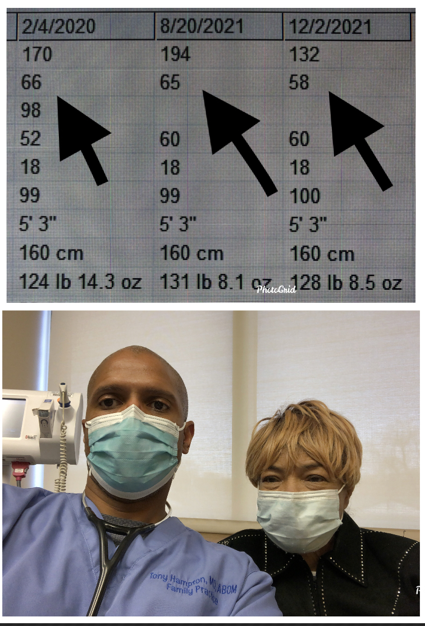
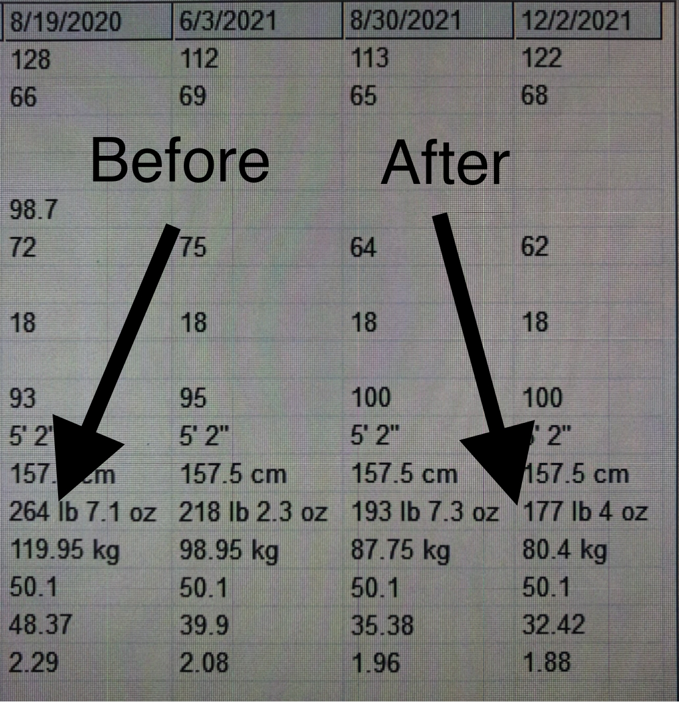
Patient Successes!
Renal
Diabetes
Blood Pressure
Obesity

Slide 32
THANK YOU!
Dr. Tony Hampton

