Slide 1
Metabolic Health Clinics
Your name here
Notes:
Hello everyone. I’m Matt Calkins, chair of the resources committee of the Society of metabolic health practitioners. Some of the feedback we’ve received is to create new resources for providers that want to start a metabolic health clinic with a focus on therapeutic carbohydrate reduction. As a first step of filling that need, I created this metabolic health pitch deck. This is meant for those that already work in a clinic setting but not yet practicing metabolic health. This can be used to demonstrate the effectiveness of therapeutic carbohydrate reduction to your administrators and hopefully persuade them to allow you to open a pilot metabolic health clinic in your larger practice. It was designed to be about 15- 20 minutes long to easily fit in a lunch hour. I will give you the talk, then you can practice it to perfection! Let’s start
- Good afternoon everyone! I am Matt Calkins. I’m excited and honored to discuss metabolic health and metabolic health clinics.
- 20 minute powerpoint but hopefully a long discussion afterwards. 60+ canned slides

Slide 2
Who I am
[Logo]
[Primary job]
[Primary Job description]
Society of Metabolic Health Practitioners
Metabolic health practitioner
[Secondary title, delete if not needed]
[Secondary title description]
[Tertiary title, delete if not needed]
[Tertiary title description]
[Logo or delete]
[Logo or delete]
Notes:
- I am a full time physician at Metabolic Hospital.
- I also have my metabolic health practitioner certification through the society of metabolic health practitioners, which is a professional organization that was founded to promote research and education on therapeutic carbohydrate reduction to treat disease.

Slide 3
Heart Disease
Fatty liver
Hypertension
Poor metabolic health
PCOS
Diabetes
Obesity
Sarcopenia
Depression
Migraines
Anxiety
Arthritis
Dementia
Notes:
Chronic conditions are the bane of the healthcare system.
Every single one of the conditions listed here is associated with or a direct cause of poor metabolic health, or insulin resistance.
They account for the majority of dollar spend, having one leads to having more, higher likelihood of hospital visits.
Most jarring statistics to me: 88% of americans have at least 1 of 5 criteria for metabolic syndrome. More recent study with results in 2018 shows that only 6.8% of americans have optimal cardiometabolic health
Problem is worsening
Conventionally treated with “lifestyle counseling” at annual physicals or problem visit every 3 months, which for years has been eat less move more and has not stemmed the surge of these diseases.
When that fails, medications are used
Today I want to talk about metabolic health clinics that use the ketogenic diet alongside consumer wearables like continuous glucose monitors to improve all the diseases listed here
Not internet keto, but prescription strength keto.

Slide 4
Heart Disease
Fatty liver
Hypertension
Poor metabolic health
PCOS
The cost of obesity
$149 billion
Annual healthcare costs
$26 billion
Productivity lost
Diabetes
Obesity
Sarcopenia
Depression
Migraines
Anxiety
Arthritis
Dementia
Notes:
-Finding a solution to our metabolic health crisis is paramount.
-Prevalence of obesity is 42% and rising
-The cost is $149 billion annually in healthcare costs and 26 billion in productivity loss
-This should be ringing alarm bells in any model of clinic. It’s unsustainable for the national budget in an RVU system and it is unsustainable for individual clinics in a value-based care model.
-These cost are compounded for self insured companies who must bear the brunt of both of these expenses.
-Antiobesity medications, GLP1 receptor agonists, have become extremely popular antiobesity medications. Lets look at wegovy first, then we’ll discuss metabolic clinics.

Slide 5
Are medications the answer?
Must be continued long term
Coverage is at the whim of insurance and supply chains
They are expensive
Notes:
- The net-net is that these medications are incredibly useful in certain patients. Average weight loss over the period of the STEP trials was around 15% of total weight loss.
Unfortunately as good as these results are they don’t translate into these drugs being a panacea for the healthcare system or most patients.
First, current data indicate they must be continued long term to see continued benefits as seen in the step 4 trial
Most patients who have an indication for these medications find that their insurance does not cover them, and when they do they encounter supply chain issues
Finally, and most strikelingly, they are wildly expensive. I believe this is the brewing storm specific to my niche in medicine that will eventually spill over into a crisis.

Slide 6
Are medications the answer?
Must be continued long term
Coverage is at the whim of insurance and supply chains
They are expensive
X =
142,000,000
Eligible to be treated
$13,618 annually
Semaglutide yearly net price
$1.9T annual cost
Notes:
There are 142m adults who have indications for these medications and if you multiply that figure by the total cost of wegovy yearly you come up with $1.9T.
This is nearly half of the current US budget on healthcare of 4.2T.
Current spending on prescription medications is approximately $350 billion
I have used these medication in clinic alongside lifestyle counseling and they can be helpful in certain patients.
But lifestyle changes remain first line, and with these disadvantages we need to operate in a world where these medications are a tool in the toolkit but not the toolkit itself.

Slide 7
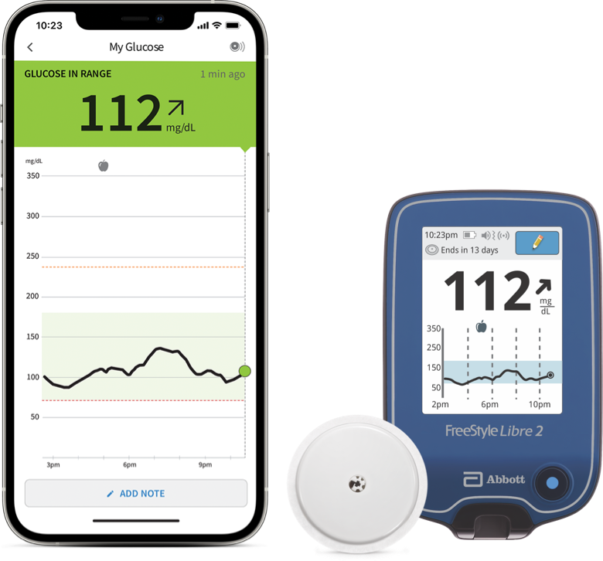
21st century lifestyle intervention
Immediate metabolic feedback
Insight into food addiction
Well formulated
ketogenic diet
+
+
Notes:
- Now, the alternative to medications and the meat of the talk
-There are three components to the modern metabolic clinic: a well formulated ketogenic diet and two new concepts: the use of consumer wearables such as continuous glucose monitors that provide immediate feedback and (2) new insights into food addiction
- The well formulated ketogenic diet places limits on some foods that people might be able to overindulge in and focuses on whole foods. This is a prescription strength keto diet than an internet keto diet. They are not difficult to implement because there’s no calorie counting. New data also shows that the ketones themselves provide benefit to satiety and hunger that can help with weight loss.
In general, 40% of patients will say yes to trying a ketogenic diet to improve their metabolic health and get off of medication,
The second component of an effective clinical intervention is the use of smart devices that provide immediate feedback. I don’t know how many of you have seen or worn a CGM, but I’m wearing one now. Depending on the model, taking my blood glucose is as simple as lifting my phone to my arm or checking my phone. I’ve found that using CGMs in my patients motivates them to see how their lifestyle affects their sugar moreso than just diet alone, including sleep, stress, exercise, and alcohol. Essentially the CGM inspires them to get inquisitive about how their lifestyle is impacting their health, almost like getting healthy is being gamified.
Finally, there are new insights into food addiction that can be applied to lifestyle interventions. Food addiction may explain why some people have a more difficult time with lifestyle changes than others. This allows for more accurate targeting of those that may require more intensive intervention, like closer followup.

Slide 8
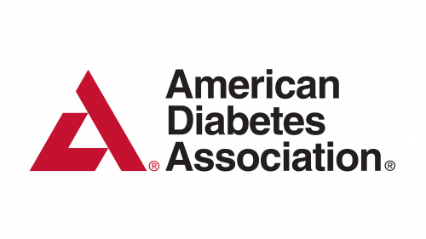
Low carbohydrate diet endorsements
2019 Consensus Report
“Reducing overall carbohydrate intake for individuals with diabetes has demonstrated the most evidence for improving glycemia and may be applied in a variety of eating patterns that meet individual needs and preferences.”
2022 Scientific Statement
“Very low–carbohydrate …. diets yield a greater decrease in A1c, more weight loss and use of fewer diabetes medications in individuals with diabetes.”
2023 Publication
“There is good evidence that ketogenic diets help with weight loss, epilepsy, type 2 diabetes, and improvement in cardiometabolic risk factors. There is emerging evidence … for acne, polycystic ovarian syndrome, certain brain cancers, and brain diseases like Alzheimer’s.”
Notes:
- First, Due to the increasing data that supports a low carbohydrate diet, many professional organizations now endorse low carb diets asphalt interventions for improving metabolic health.
- The American diabetes in their 2019 consensus report that reducing carbohydrate ntake has the most evidence for improving glycemia in Type 2 diabetes.
- The AHA has a similar statement in a 2022 scientific statement
- and an obesity medicine publication in 2023 reports that ketogenic diets help with weight loss, epilepsy, type 2 diabetes, and improvement in cardiometabolic risk factors with emerging evidence that they improve acne, PCOS, glioblastomas, and neurodegenerative diseases. I would go one step further as there’s new data with case reports that ketogenic diets improve eating disorders such as anorexia and severe, refractory, treatment resistance mental illness such as bipolar, schizoaffective disorder, and severe MDD.

Slide 9
The old paradigm of metabolic feedback
Food Choice
Time to Feedback
Notes:
Next, I want to discuss why and how smart devices like continuous glucose monitors have changed how we go about lifestyle changes
Historically the only feedback you were getting on your metabolic health came in the form of a scale. Change took a long time.
Physicians didn’t find out about the change until your next visit and patients would worry about fluctuations in water weight, likely derailing attempts to improve health.

Slide 10
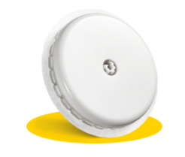
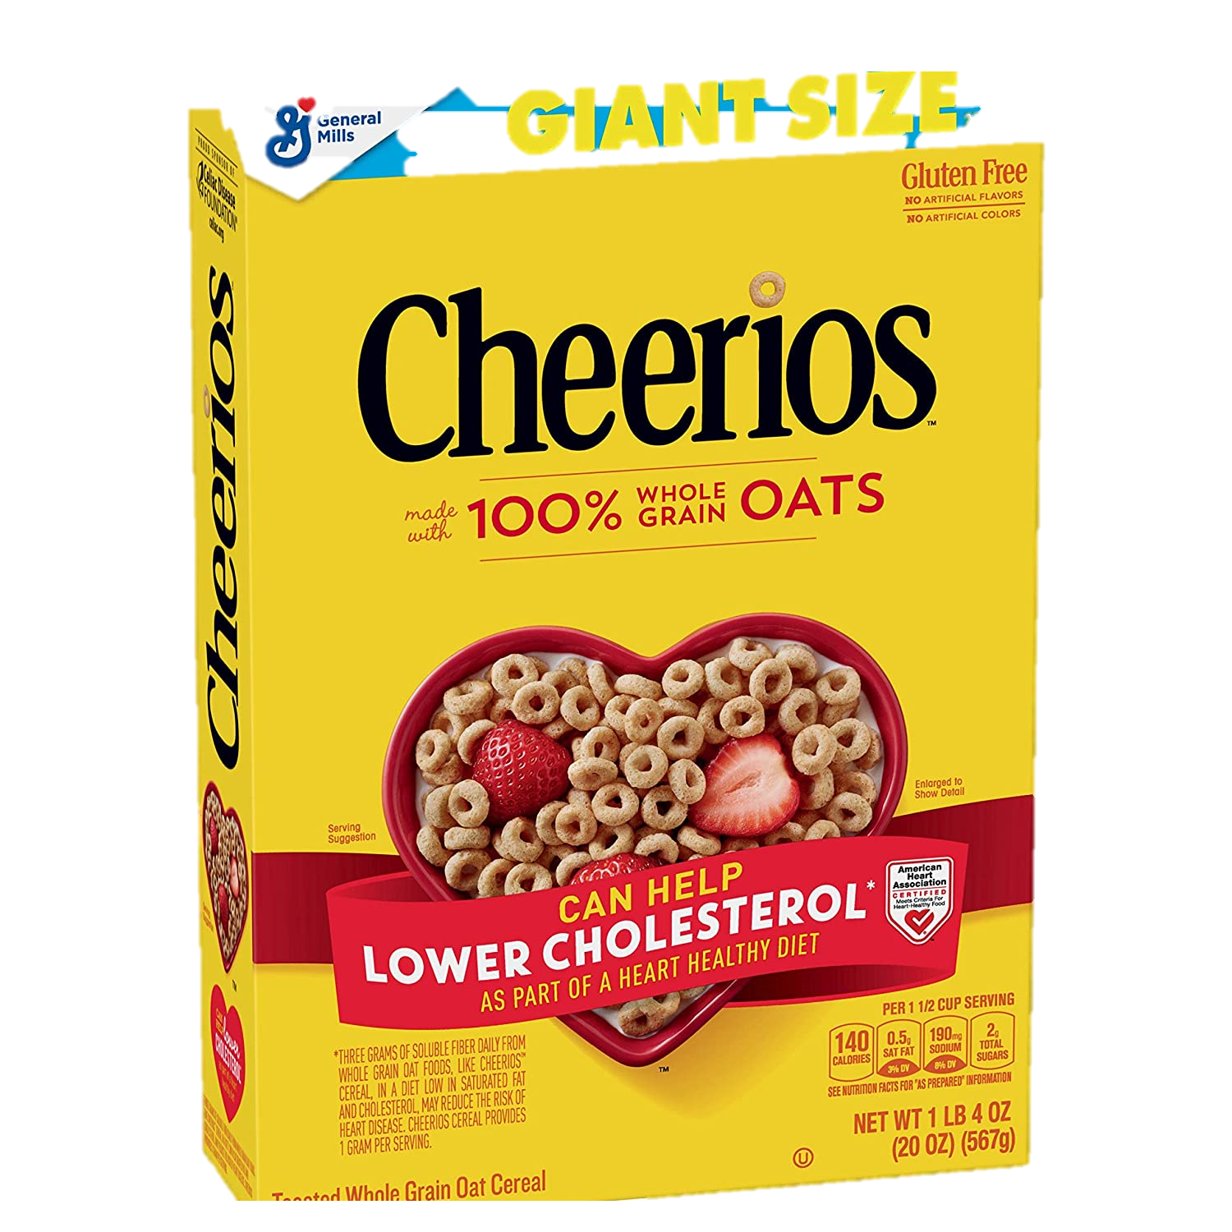
The new paradigm of immediate metabolic feedback
✓
Blood Sugar
Blood Sugar
Notes:
Now we have the ability to eat a meal and, if you are on a low carb ketogenic diet, know if that meal fit your diet, which impacts your future food choices as early as the next meal.
No one knows the impact of what they’re eating on their glucose until these were invented.
Patients frequently will eat foods that are marketed as healthy yet will spike their blood sugar to above 200 mg/dl.
This will not allow us to achieve our goal of getting patients off of medication and putting diabetes into remission
The CGM doesn’t fall for healthy marketing techniques; it will tell you the truth.

Slide 11
The new paradigm of immediate metabolic feedback
✓
Blood Sugar
Blood Sugar
Notes:
Immediate feedback results in behavior change.
Wearing a CGM is like having a health coach standing right in front of you watching everything you do.
Patient’s don’t want to see their glucose spike.
A patient eating five of the foods over the course of the day would know which do not spike their sugar.

Slide 12
The new paradigm of immediate metabolic feedback
✓
Blood Sugar
Notes:
-And which do spike their sugar, which is important because sugar hides everywhere- sauces, condiments, dressings- except sugar can not hide from the CGM
- In this way, patients are empowered to try foods themselves to see how foods affect their body.
-Patients are able to make the connection between foods that spike their sugar and worsen their A1c.
-This gamifies the process and patients love trying to keep their line as flat as possible with diet and exercise.

Slide 13
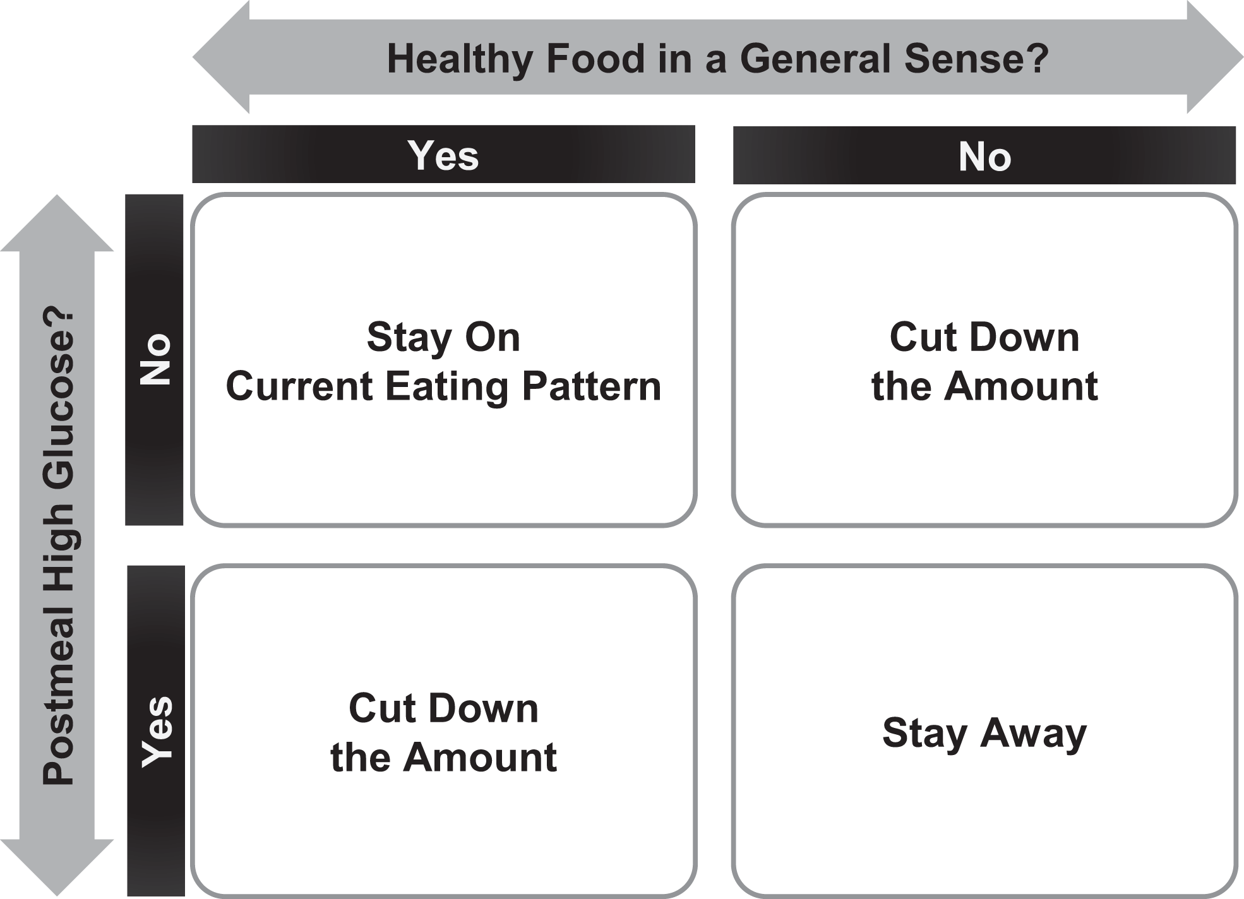
Data supports immediate metabolic feedback
A1c improved 0.5%
Body weight -1.5 kg
+
=
A1c improved from 8.0% to 6.2%
BMI improved from 36.5 to 34.4
4-chapter booklet on improving glycemic excursions
=
+
Choe et al. 2022
Oser et al. 2022
Notes:
-Published data supports this.
-Two studies with entirely patient led interventions showed marked metabolic improvement
-Both studies used a CGM. First study used a diagram that would change behavior towards eating healthier foods that do not spike blood sugar. That’s it, no other intervention.
Over 3 months, a1c improved 0.5% and body weight improved 1.5kg
second, more impressive outcome from giving patients a 4- chapter booklet on improving glycemic excursions
Subjects with newly diagnosed diabetes improved A1c from 8% to 6.2% and BMI from 36.5 to 34.4
https://diabetesjournals.org/care/article/45/10/2224/147469/Effects-of-Patient-Driven-Lifestyle-Modification

Slide 14
Grapes and blueberries
Notes:
Here’s example of a glycemic graph from a patient.
This patient ate grapes and blueberries
His sugar increased from 100 to 227 mg/dl
This will halt our progress of improving metabolic health

Slide 15
Grapes and blueberries
Blueberries and cottage cheese, coffee with cream.
Notes:
-Armed with this knowledge, the patient cut out the graphs and ate blueberries with more protein.
-His sugar remained stable from 100 to 140 mg/dl

Slide 16
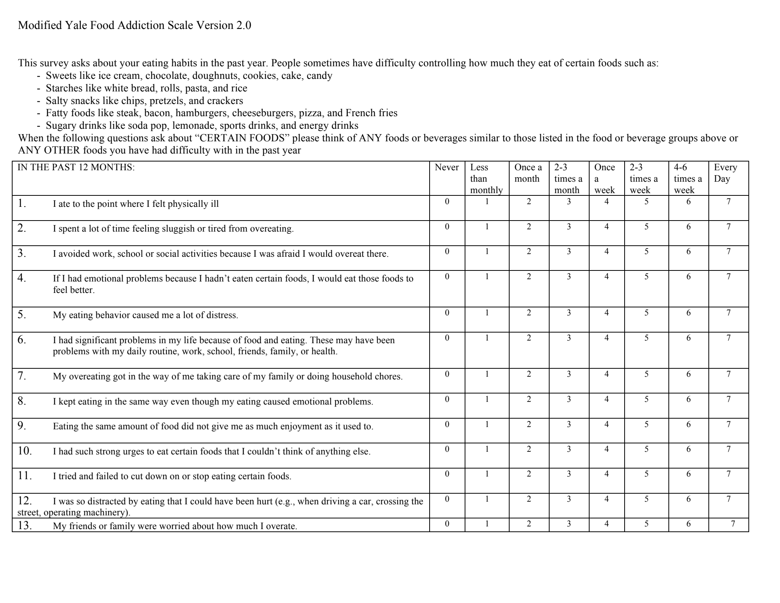
Insights into food addiction
Notes:
Finally, the last component of the 21st century metabolic clinic is a focus on food addiction.
Here is the modified yale food addiction survey, or YFAS. This is a research tool that has also been used clinically to evaluate for food addiction.
The creators of the survey say that there are “Parallels in biological, psychological, and behavioral systems have led to the hypothesis that an addictive process may contribute to problematic eating and that Yale Food Addiction Scale (YFAS) was developed to provide a validated measure of addictive-like eating behavior based upon the diagnostic criteria for substance dependence.”
This is a contentious diagnosis as, even though it is based on the criteria for substance dependence, it is not listed in DSM-5
However, many weight management centers screen for food addiction on every patient that goes through their program. We will talk about a few metabolic clinics near the end of the talk that make food addiction a cornerstone of their interventions.

Slide 17
Insights into food addiction
Food addiction prevalence
Community: 5-10%
Obesity: 15-25%
Class III Obesity/ Bariatric surgery: 30-50%
Food addiction validity
Patients who met criteria for FA had significantly increased levels of binge eating (p < 0.001), emotional eating (p < 0.001), and lower self-efficacy (p < 0.001).
Koball et al. 2021
Notes:
Why measure food addiction?
Food addiction is common and is more prevalent with worsening metabolic disease
Food addiction is associated with binge eating, emotional eating, and lower self efficacy

Slide 18
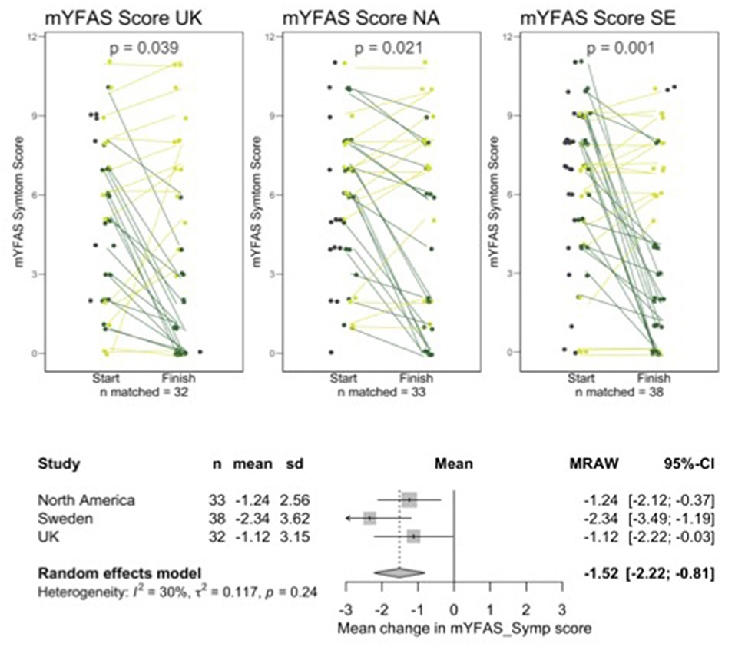
Insights into food addiction
Nonrandomized, noncontrolled trial
N=103, 3 month follow up. 2022.
“The current data are the first to demonstrate the short-term clinical effectiveness of a low-carbohydrate “real food” intervention delivered in an online group format with education and social support for individuals with FA symptoms.”
Unwin et al. 2022
Notes:
What can we do about food addiction symptoms?
Data published last year from a nonrandomized, noncontrolled study shows that a low carbohydrate diet can improve food addiction symptoms by 1.5 points, with the median decreasing from 5 (moderate) to 3 (mild).
103 subjects across 3 clinics (UK, north America, sweden). 3 monthfollow up
https://www.frontiersin.org/articles//fpsyt.2022.1005523/full

Slide 19
Four different metabolic clinics
DukeHealth
Keto Medicine Clinic
Notes:
- What kind of results can be expected by incorporating keto diets and smart devices into treatment?
- There’s data on three different metabolic clinic practices that intervene with a low carbohydrate ketogenic diet. Their profiles vary widely.
- Norwood is spearheaded by Dr. David Unwin. It is a primary care practice that is NHS funded based in the UK. In the UK system, you must go to the GP practice that you’re assigned to based on your location. For his case series, David asked all patients with type 2 diabetes if they were interested in getting off their medications by trying a ketogenic diet and 40% of subjects said yes.
- Virta is the most famous of all four and is a largely a national telemedicine based clinic. Their vision is to reverse type 2 diabetes in 100 million patients and have recently went through a funding cycle to increase their valuation to $2 billion dollars.
-Dr. Tro Kalaijian’s practice is the one that has invested more into infrastructure for both metabolic feedback and food addiction counseling than any of the others.
--DukeHealth Ketomedicine clinic is run by Eric Westman, one of the past presidents of the obesity medicine association, and it is a single physician practice that focuses almost exclusively on diet. He not only treats obesity and type 2 diabetes, but also migraines and any other disease for which a patient wants to try a ketogenic diet for. He does not have a pragmatic clinic case series to discuss, however he has numerous RCTs on low carb versus other dietary patterns.
- But, the most important point to walk away with is that each of these clinics has seen impressive results.

Slide 20
Compare
Study | T2D Reversal | A1c | Weight | BP (mmHg) | Deprescribing
Virta Health | 53% | ↓ 7.7% to 6.7% (-1.0%) | ↓ 114kg to 102 kg (-12kg) | ↓ 131/81 to 126/78 (-6/3) | ↓ Insulin dose 81% ↓ 30% DM meds
Dr. Unwin Pilot Program | 51% | ↓ 6.9% to 6.0% (-0.9%) | ↓ 98kg to 89kg (-8.8kg) | ↓ 144/85 to 135/79 (-9/6) | 13% stopped at least 1 medication
Dr. Tro Pilot Program | --- | ↓ 7.1% to 6.0% (-1.1%) | ↓ 131kg to 114kg (-17.4kg) | ↓ 141/83 to 124/78 (-17/6) | Saved $4,500 per patient per year
LOOK AHEAD | --- | 7.3% to 7.3% NS | ↓ 100kg to 93kg (-7kg) | 128/70 to 127/65 NS | INCREASE in medications
Notes:
-Here are the outcomes from the studies that virta health, Dr. Unwin in the Norwood Surgery Southport clinic, and Dr tro have published along with the LOOK AHEAD trial for comparison.
-LOOKAHEAD was a large 2013 study of 5000 patients that were randomized to close lifestyle follow up with a low calorie diet and meal replacements.
-T2d reversal defined as A1c <6.5% off of medications, sometimes metformin is allowed. Virta health 17% remission (a1c <5.7, no meds)
-Compared to the Look Ahead study, all saw significant drops in A1C, more weight reduction, greater improvements in blood pressure, and material savings through de-prescribing.
-I want to call attention to Dr. Tro’s pilot program which saw a huge savings – that figure is on a per patient basis, and this study was done with a large company that was self-insured.
LOOK AHEAD 2013 NEJM. 5145 randomized to intensive lifestyle or diabetes education and support over 10 years. Intervention: 1500- 1800 kcal goal. 30% from fat and 15% from protein. Meal replacements. One-on-one coaching. Within group difference

Slide 21
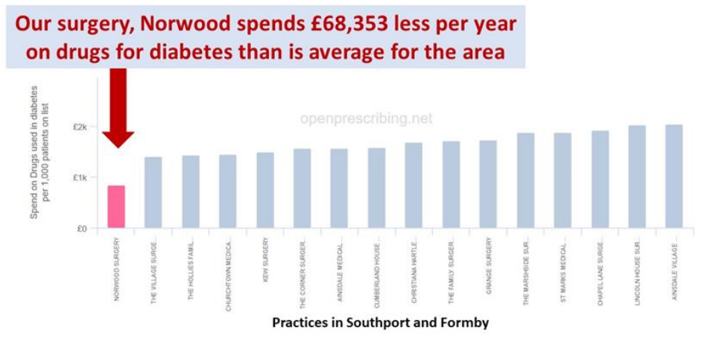
Deprescription
Notes:
This is the deprescription data from Dr. Unwin comparing his Norwood practice to other practices in Southport. They spend about half as much as the other clinics on T2d medications

Slide 22
A metabolic clinic at Clinic
Staff
Single provider with MA to room in person visits.
Clinic Setting
In person in Winston Salem, Charlotte, or telehealth
Clinic Schedule
Start at one day per week. 40-minute initial visits, 20-minute follow up.
Clinic Growth
Obtain internal consults by asking “Would you like to get off your medications?” at annual exams, T2D problem visits
Notes:
- So what might a first step look like at our clinic?
-It could be as easy as having a dedicated metabolic medicine physician accept internal consults and starts with a half day or full day of clinic per week.
-Most importantly, Other physicians and providers would need a basic understanding of the role a ketogenic diet plays in metabolic health. And maybe most importantly, we’d need to start getting comfortable asking patients, either new patients during their initial visit with us or existing patients during their annual check-ins or chronic problem visits: “Would you like to try and get off of some medications?”

Slide 23
Impact
Notes:
I want to end with the impact that these interventions can have in our patients lives

Slide 24
Weight Loss Wednesday: A company working to help their employees get into shape
May 3, 2023. NEW ORLEANS — Imagine if you went to work, and your company gave you the tools and time you needed to get in top health and lose weight. Well, that's exactly what a local company is doing. And it is working, helping employees get off medications while being more productive and transforming their lives.
“We wanted to give people the tools, because as a business, what we're trying to do is attract talented, committed, self-managed people,” said Jay Lapeyre, CEO and Chairman of the Board of Laitram.
Employees already have access to an on-site doctor's clinic, for physical and mental health care, a pharmacy, physical therapy, a dentist, and a state-of-the-art gym, complete with trainers and classes.
[Dr. Tro’s] team is in constant contact with each person. They have blood sugar monitors, scales in their offices that measure fat and muscle mass, and blood pressure cuffs, that his team can measure remotely.
Employees are off of heart and diabetes medications. Their spouses and families are now inspired and losing weight too.
“We want people to think independently, and bring their best and in return to help us improve, and in return we bring the best to impact their lives in a positive way,” said [the CEO].
Like for Gregg, who finally felt ready for the family trip to Disney World. “And I fit on the plane, didn't have the seat belt extender. I went on all the rides, probably walked about 30 miles, and I never had a pain in my body. And so to experience Disney World with a three-year-old, that was just heaven,” Schenck said.
Notes:
- Dr. Tro’s work with Laitrum, a 4000 employee self insured manufacturing company in Louisiana, was recently highlighted in their local news. The CEO said quote “we wanted to give people the tools, because as a business, what we're trying to do is attract talented, committed, self managed people end quote”

Slide 25
Weight Loss Wednesday: A company working to help their employees get into shape
May 3, 2023. NEW ORLEANS — Imagine if you went to work, and your company gave you the tools and time you needed to get in top health and lose weight. Well, that's exactly what a local company is doing. And it is working, helping employees get off medications while being more productive and transforming their lives.
“We wanted to give people the tools, because as a business, what we're trying to do is attract talented, committed, self-managed people,” said Jay Lapeyre, CEO and Chairman of the Board of Laitram.
Employees already have access to an on-site doctor's clinic, for physical and mental health care, a pharmacy, physical therapy, a dentist, and a state-of-the-art gym, complete with trainers and classes.
[Dr. Tro’s] team is in constant contact with each person. They have blood sugar monitors, scales in their offices that measure fat and muscle mass, and blood pressure cuffs, that his team can measure remotely.
Employees are off of heart and diabetes medications. Their spouses and families are now inspired and losing weight too.
“We want people to think independently, and bring their best and in return to help us improve, and in return we bring the best to impact their lives in a positive way,” said [the CEO].
Like for Gregg, who finally felt ready for the family trip to Disney World. “And I fit on the plane, didn't have the seat belt extender. I went on all the rides, probably walked about 30 miles, and I never had a pain in my body. And so to experience Disney World with a three-year-old, that was just heaven,” Schenck said.
Notes:
- The CEO felt the need to offer metabolic wellnesss in addition to what was already offered, which was an on-site doctor’s office, a pharmacy, PT, dentist, gym, and personal trainer

Slide 26
Weight Loss Wednesday: A company working to help their employees get into shape
May 3, 2023. NEW ORLEANS — Imagine if you went to work, and your company gave you the tools and time you needed to get in top health and lose weight. Well, that's exactly what a local company is doing. And it is working, helping employees get off medications while being more productive and transforming their lives.
“We wanted to give people the tools, because as a business, what we're trying to do is attract talented, committed, self-managed people,” said Jay Lapeyre, CEO and Chairman of the Board of Laitram.
Employees already have access to an on-site doctor's clinic, for physical and mental health care, a pharmacy, physical therapy, a dentist, and a state-of-the-art gym, complete with trainers and classes.
[Dr. Tro’s] team is in constant contact with each person. They have blood sugar monitors, scales in their offices that measure fat and muscle mass, and blood pressure cuffs, that his team can measure remotely.
Employees are off of heart and diabetes medications. Their spouses and families are now inspired and losing weight too.
“We want people to think independently, and bring their best and in return to help us improve, and in return we bring the best to impact their lives in a positive way,” said [the CEO].
Like for Gregg, who finally felt ready for the family trip to Disney World. “And I fit on the plane, didn't have the seat belt extender. I went on all the rides, probably walked about 30 miles, and I never had a pain in my body. And so to experience Disney World with a three-year-old, that was just heaven,” Schenck said.
Notes:
- From the amazing work he put in, and with Dr. Tro’s guidance, Gregg, one of the patients in the program, lost 115 lbs. He was ready to go to Disney World. And Gregg said“And I fit on the plane, didn't have the seat belt extender. I went on all the rides, probably walked about 30 miles, and I never had a pain in my body. And so to experience Disney World with a three-year-old, that was just heaven”.
- Personally, I’m passionate about metabolic health because I’ve seen how obesity and diabetes have stolen lives and limbs. I’ve seen proper focus on metabolic health improve lives.
-This is why we do this. This is patient centered. This is improving lives.
Ill leave excerpts from the article up for you to read. Thank you` for having me here and your interest in metabolic health.

Slide 28
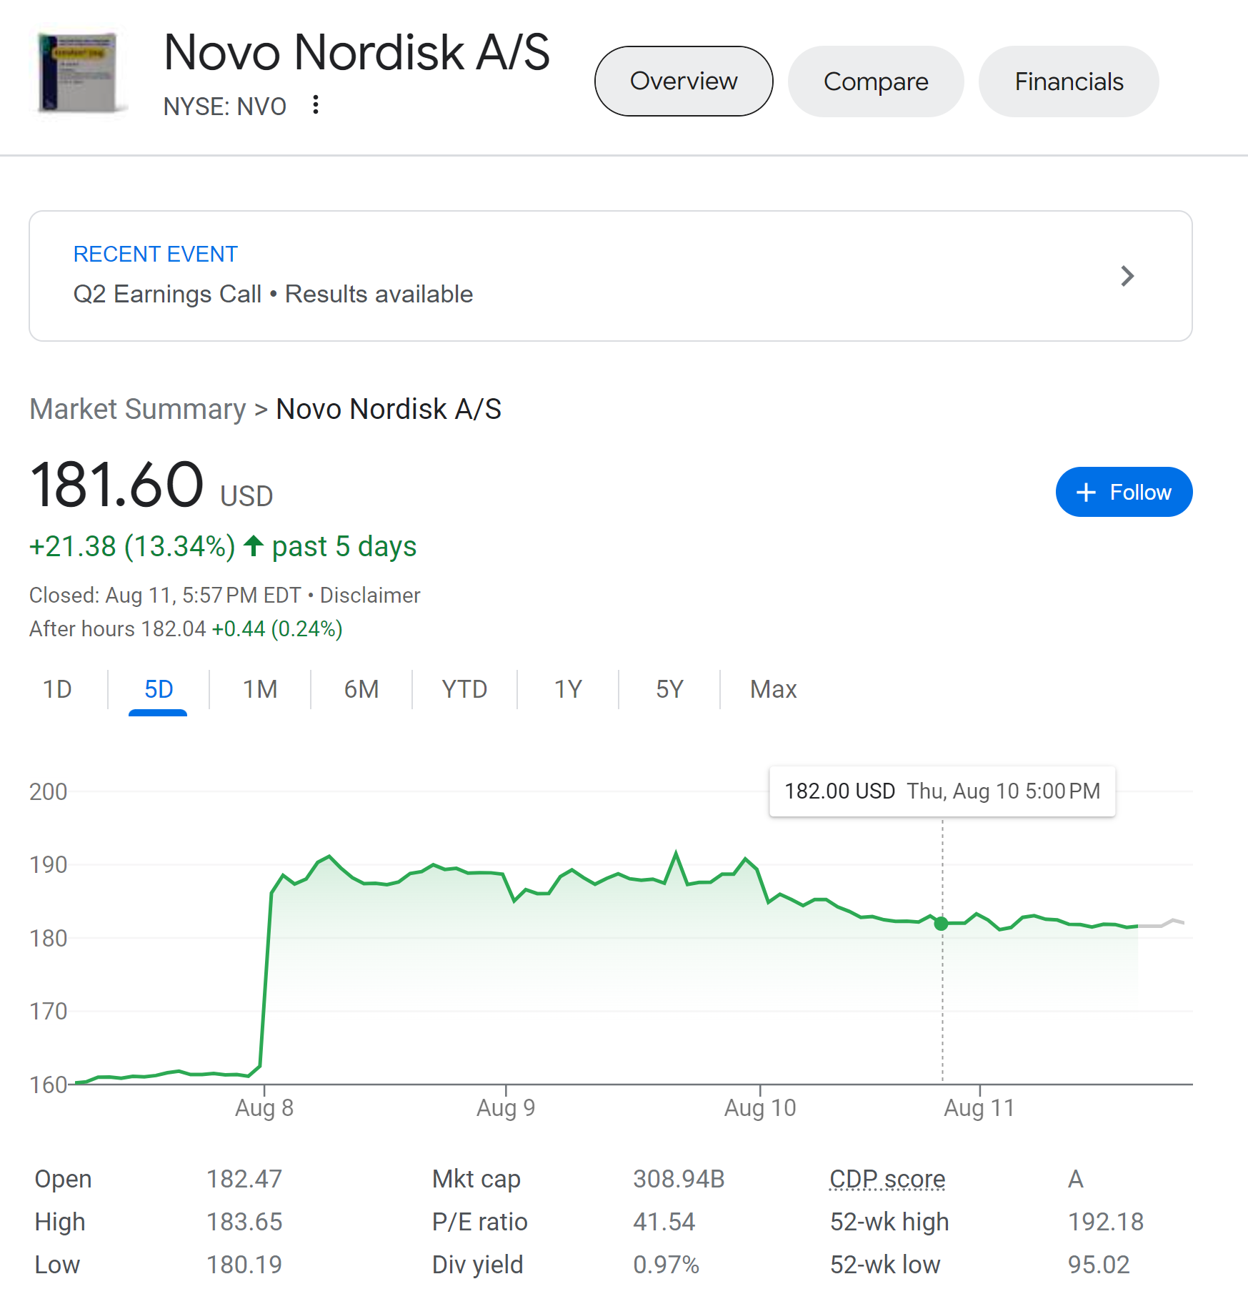
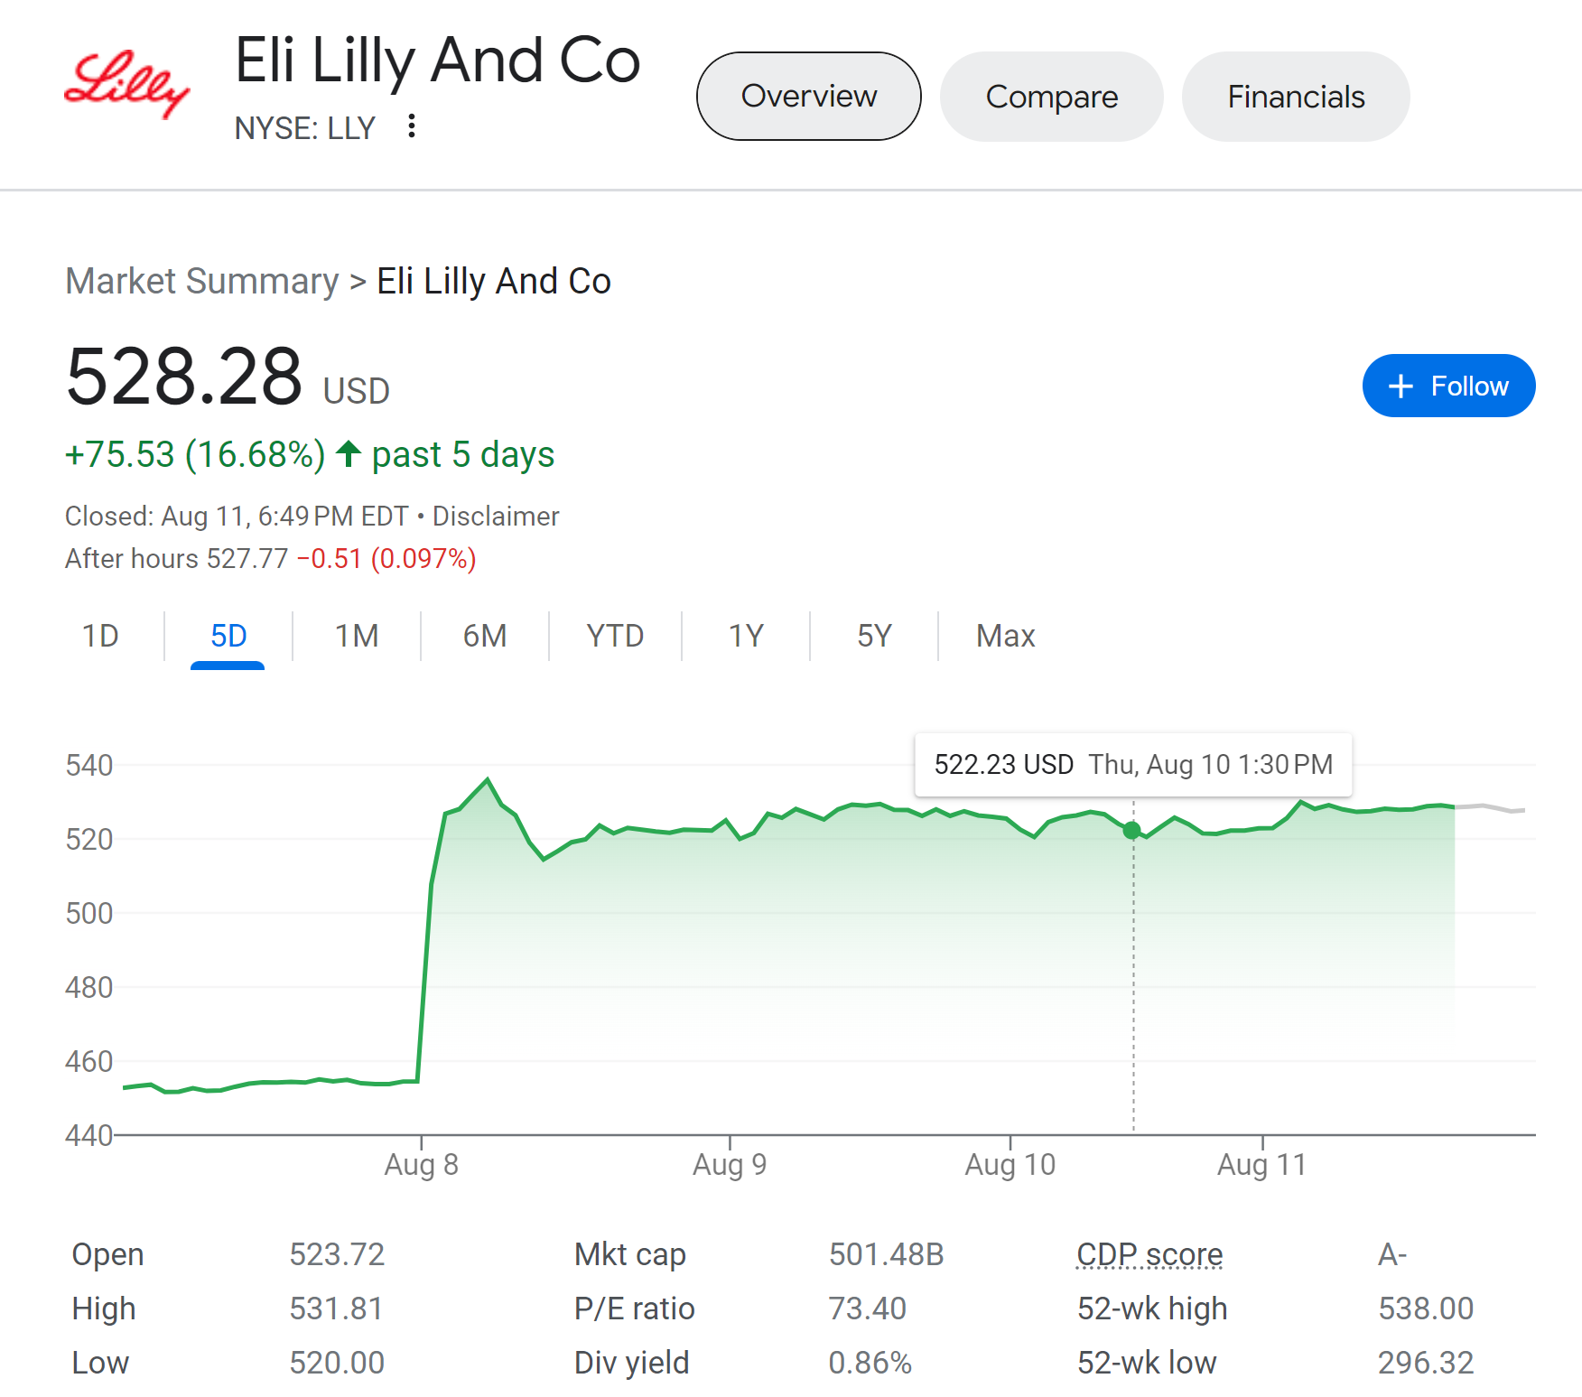

Slide 29
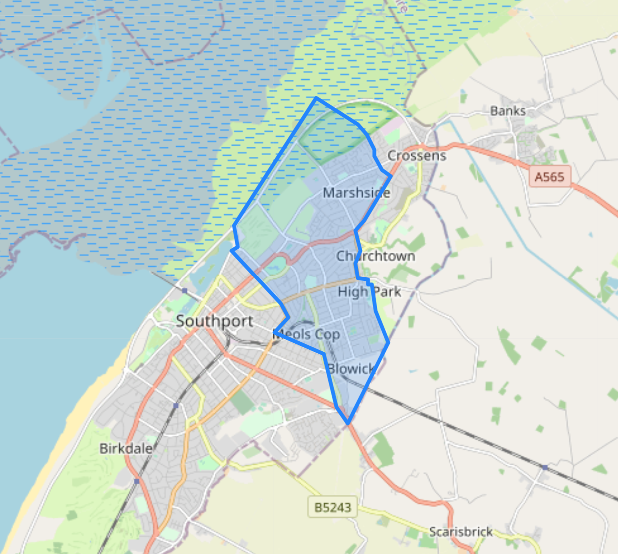
Setting
NHS general practice
Personnel
Nine physicians
Three practice nurses
Notes:
General practice in the NHS. This is unique because all patients in this geographical area just north of Liverpool MUST go to this clinic.

Slide 30
Setting
NHS general practice
77%
Diabetes remission if diagnosis <1 year
97%
Experienced better glycemic control
13%
Stopped at least 1 medication
Personnel
Nine physicians
Three practice nurses
A1c -0.9% (6.9% to 6.0%)
Wt -8.8kg
(98kg to 89kg)
BP -9/6mmHg
(144/85 to 135/79)
Intervention
Low Carbohydrate Counselling
Food Addiction Counselling
Metabolic feedback
Notes:
- This data is from a paper published by Dr. David Unwin in March of this year in BMJ.
PRAGMATIC STUDY. Cohort of T2D patients in a GP practice that were offered low carb from 2013 to 2021. 473 had T2d, 186 (39%) chose low carbohydrate approach over 8 years.
DATA. Remission defined= A1c <6.5% for 3 months with no DM medication
Note that this is nonrandomized but semi controlled data.
We are using selection bias in our favor for these interventions.
Some people are not going to tolerate a ketogenic diet due to food preferences (although a well formulated ketogenic diet can even be vegan) or other concerns, which is OK. We are selecting those who are motivated and maximizing the results our intervention in the real world.
In this case, 40% of subjects said yes and improved their metabolic health without medications.

Slide 31
Notes:
This is the deprescription data from Dr. Unwin comparing his Norwood practice to other practices in Southport. They spend about half as much as the other clinics on T2d medications

Slide 32
DukeHealth
Keto Medicine Clinic
Setting
Academic Consult
Personnel
Physician
Notes:
The single physician is Eric Westman. Past president of Obesity Medicine Assocation.
Numerous publications on therapeutic carbohydrate reduction

Slide 33
Setting
Telehealth consultation
Notes:
Virta health is the most famous of the metabolic clinics. Founded 2014 with goal of…
Sami is founder and CEO
It is a telehealth consulation service based out of California.

Slide 34
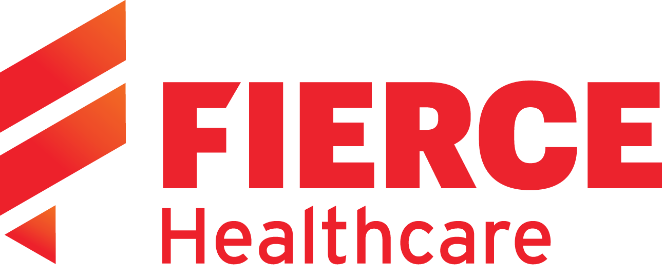
Setting
Telehealth consultation
Notes:
It also has a large valuation of $2 billion dollars to help in its endevours.

Slide 35
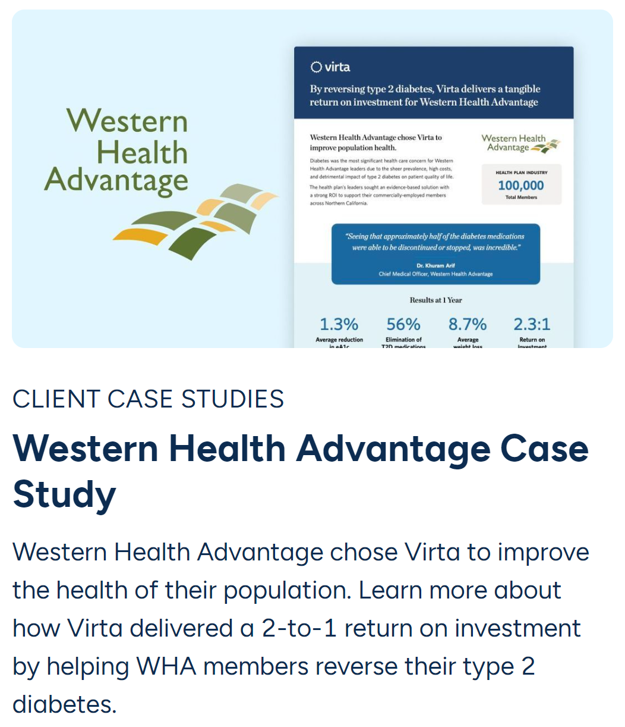
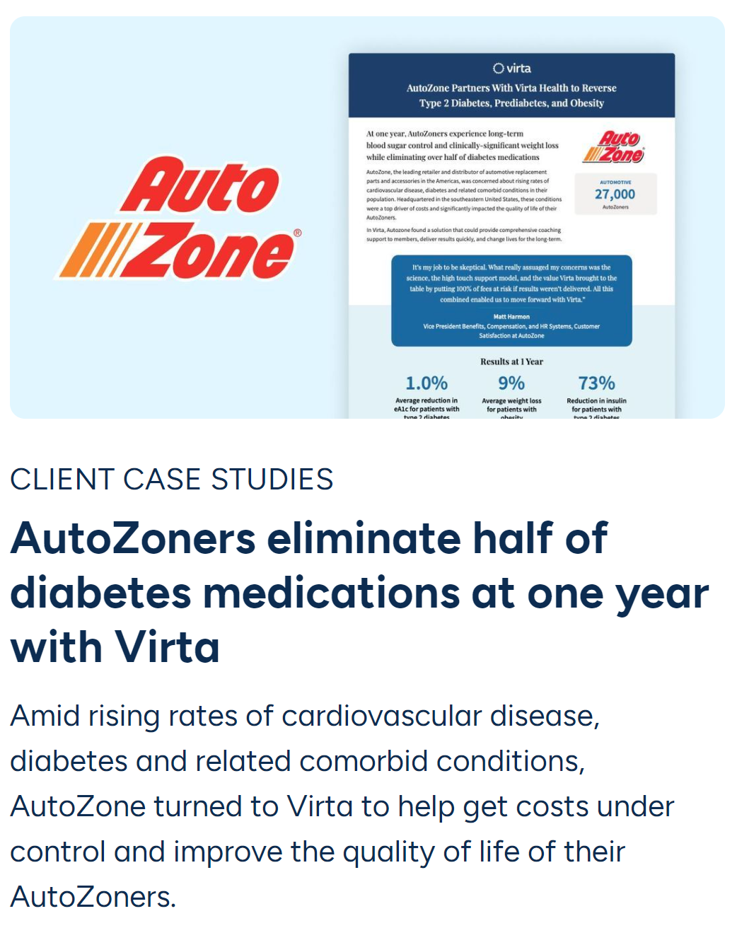
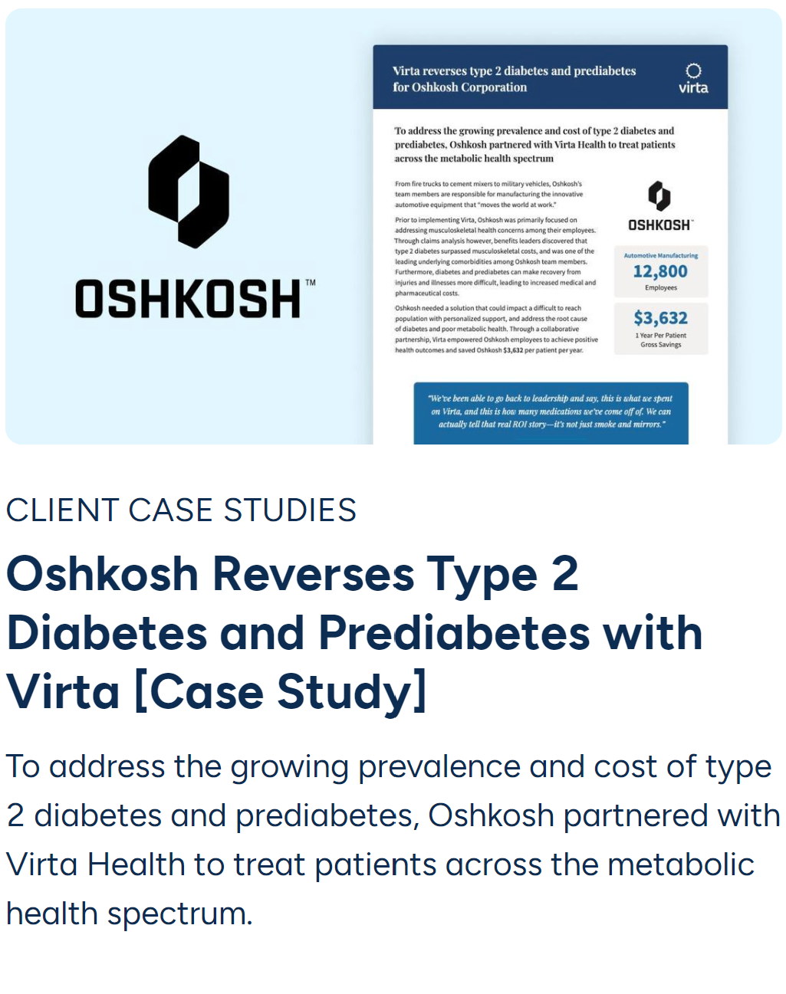
Setting
Telehealth consultation
Partners with healthcare providers, employers, and health plans
Notes:
Virta health partners directly with patients, with providers, with payors, or with self insured employers as seen here.

Slide 36
Setting
Telehealth consultation
17%
Diabetes remission
53%
Diabetes reversal
30%
Reduction in DM medications
Personnel
Numerous providers
Health coaches
A1c -1.0% (7.7% to 6.7%)
Wt -12kg
(114kg to 102kg)
BP -6/3mmHg
(131/81 to 126/78)
Intervention
Low carb counselling
Metabolic feedback
Notes:
For their intervention, they focus on low carb counseling and metabolic feedback with CGMs, Bluetooth scales, Bluetooth blood pressure cuffs, and ketone meters.
Nonrandomized controlled trial, 2 year data. 262 low carbohydrate group and 87 controls.
Remission= A1c <5.7% without medication for 1 year

Slide 37
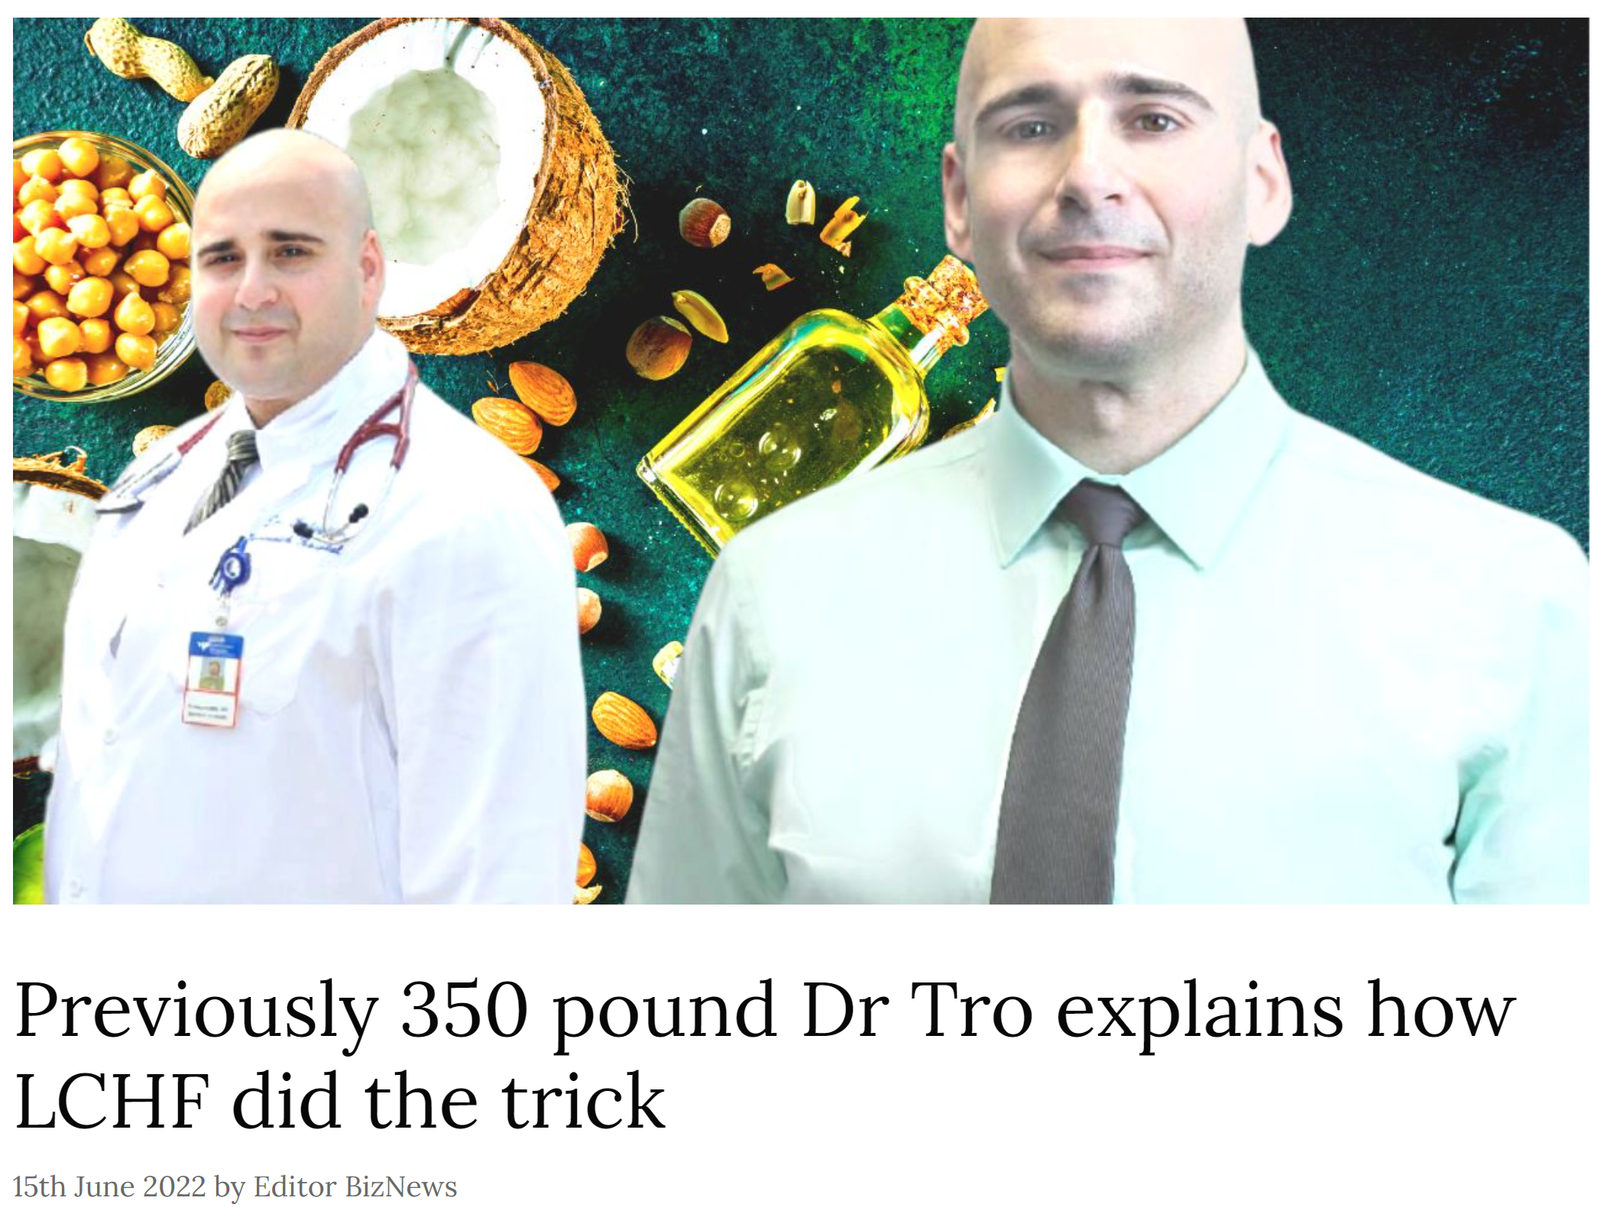
Setting
Telehealth consultation
Personnel
Three physicians
Physician assistant
Health coaches
Fitness trainer
Notes:
Finally, there’s Dr. Tro’s clinic, who my wife works part time for and I’m PRN.
This is also a telehealth consulation service that is licensed in the 48 states contiguous US
I had the amazing opportunity to also work with Dr. Tro during an elective in residency.
He has improved his own metabolic health markedly through low carb which inspired him to create is metabolic health clinic

Slide 38
Setting
Telehealth consultation
Personnel
Three physicians
Physician assistant
Health coaches
Fitness trainer
Intervention
Low Carb Counseling
Food Addiction Counseling
Metabolic Feedback
Smartphone App
Social platform
Notes:
This clinic is the most intensive of the four.
In addition to low carb counseling, there is a special focus on food addiction.
Additionally, CGMs and and Bluetooth BP cuffs and weight scales are used
A smartphone app is included which includes numerous writeups of all health literacy levels on topics such as what causes t2d and heart disease to inform and empower patients
The app also has a social platform where patients can connect to post recipes, struggles, and wins.

Slide 39
Setting
Telehealth consultation
Personnel
Three physicians
Physician assistant
Health coaches
Fitness trainer
$4,500
Annual savings per patient
17
Medications deprescribed
44%
Reduction in 10-year ASCVD risk
A1c -1.1% (7.1% to 6.7%)
Wt -17kg
(131kg to 114kg)
BP -17/6mmHg
(141/83 to 124/78)
Intervention
Low Carb Counseling
Food Addiction Counseling
Metabolic Feedback
Smartphone App
Social platform
Notes:
Pilot program for self insured manufacturing company. 12 patients with obesity, preDM, or DM. 10 completed. 6 month data
https://www.mdpi.com/2218-1989/12/9/848

Slide 40
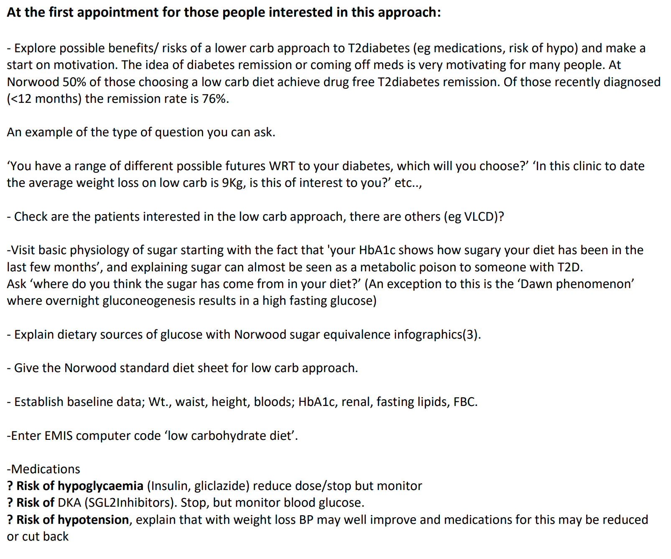
David Unwin opening questions

Slide 41
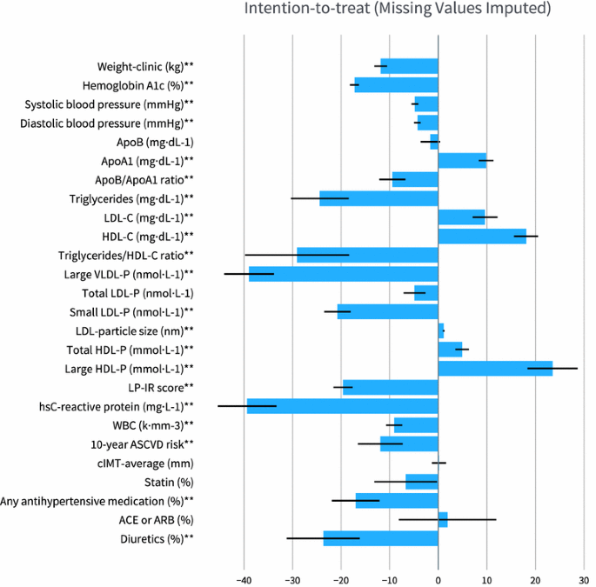
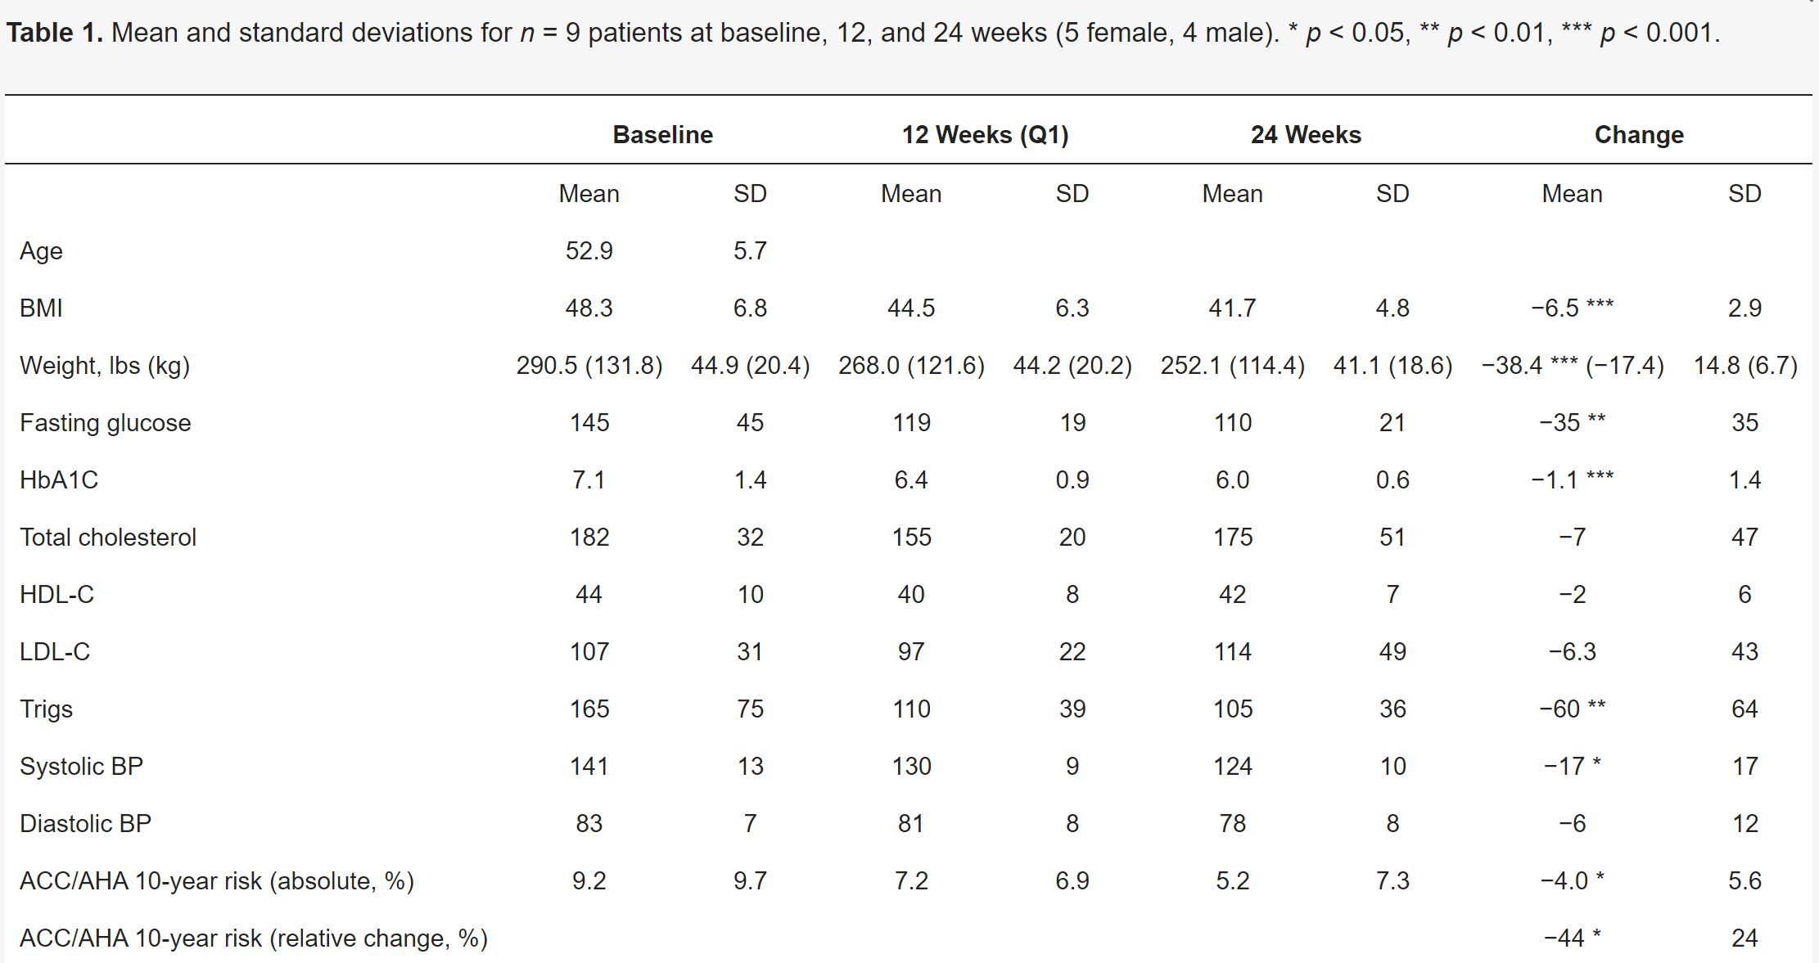
Cardiovascular disease, LDL
Virta Health
Dr. Tro

Slide 42
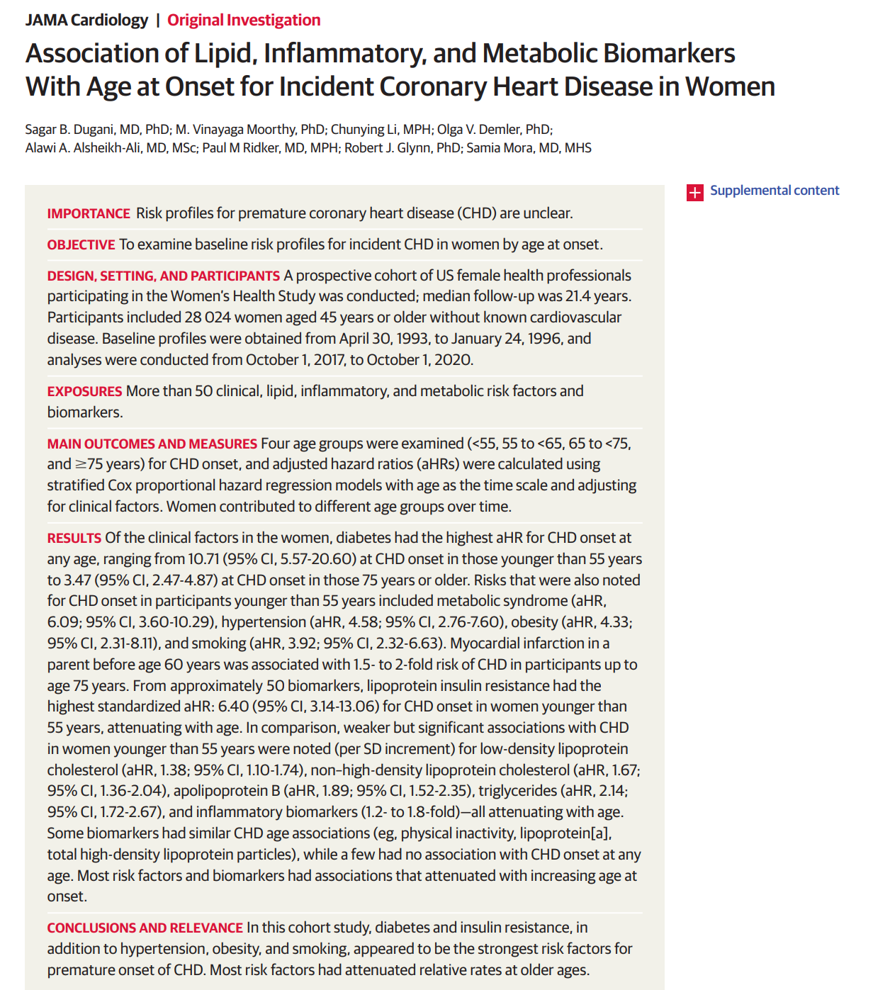

Slide 43
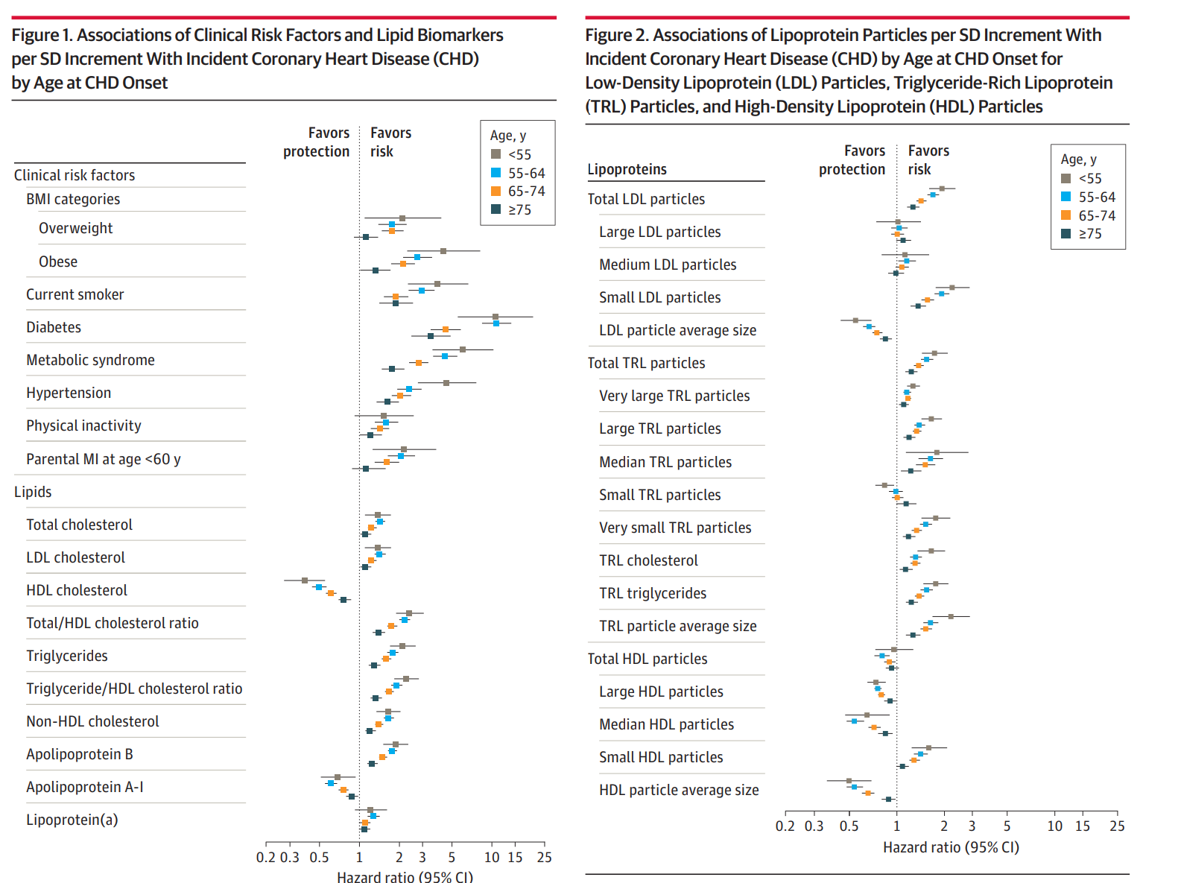
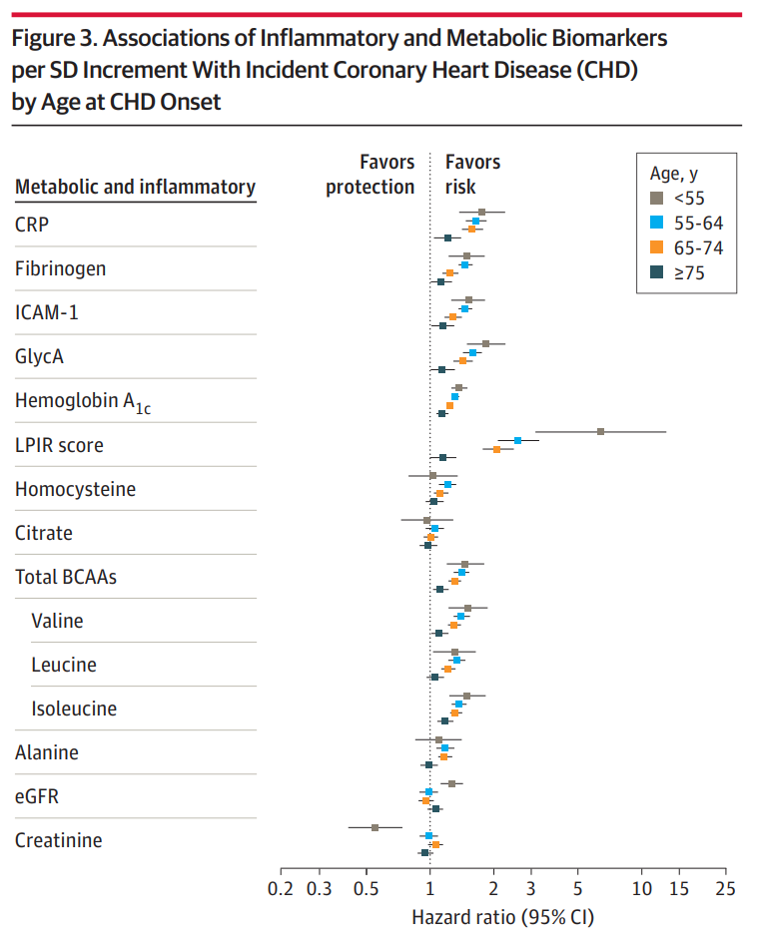

Slide 44
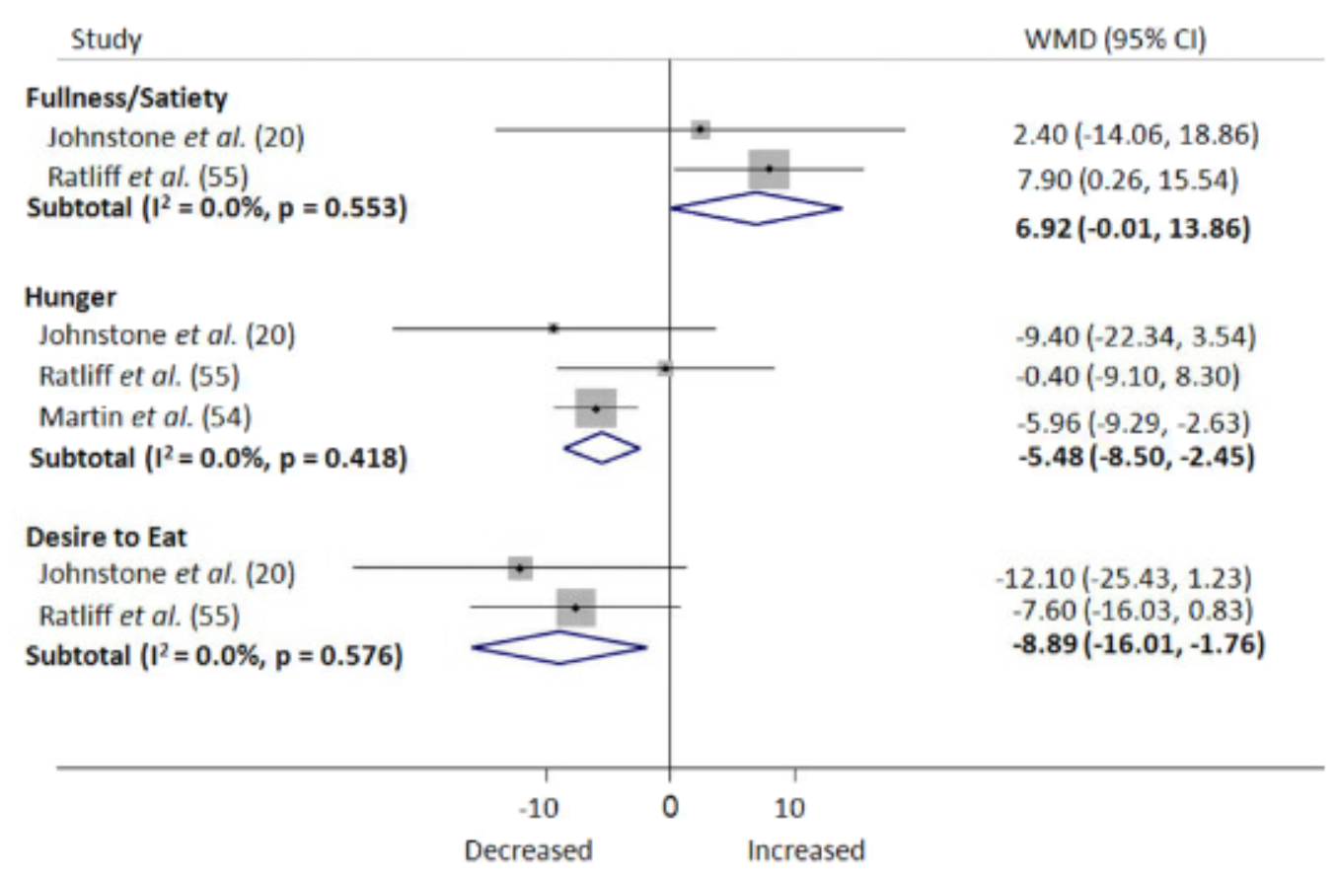
Well formulated ketogenic diet
Ketogenic diets
promote satiety and decrease hunger even with weight loss
Gibson et al. 2014

Slide 45
Virta Health 2 Year Data

Slide 46
Methods
Baseline
Duration: 2-year data from a 5-year study
Type: Nonrandomized controlled trial
Location: Onsite in San Francisco or virtual
Mean Age: 53.8 years old
Mean BMI: 40.4 (UC 36.7)
Mean A1c: 7.6

Slide 47
Intervention
Nutritional ketosis as measured by BHB > 0.5- 3.0 mmol/L
Initial CHO <30g/day
Web-based software application for telemedicine, online resources, and biomarker tracking
Virtual or onsite
Onsite: clinic-based group meetings
Weekly for 12 weeks → Biweekly for 12 weeks → Monthly for 12 months → Quarterly in 2nd year

Slide 48
Outcomes
Primary
Retention, a1c, HOMA-IR, fasting glucose, fasting insulin, c-peptide, weight
Secondary
Body composition, BP, lipids, NAFLD related outcomes, kidney related outcomes

Slide 49
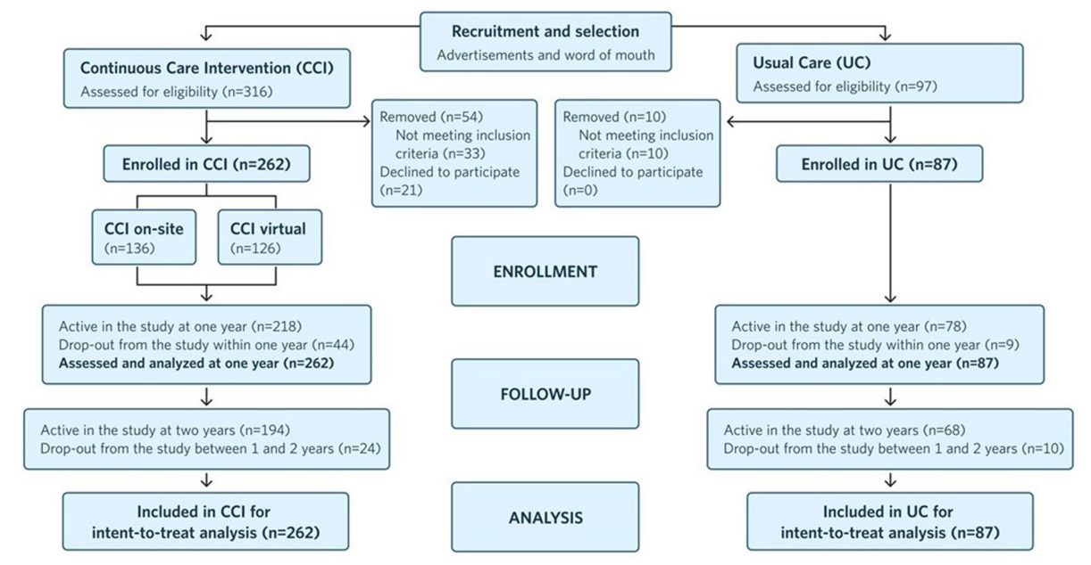

Slide 50
Results

Slide 51
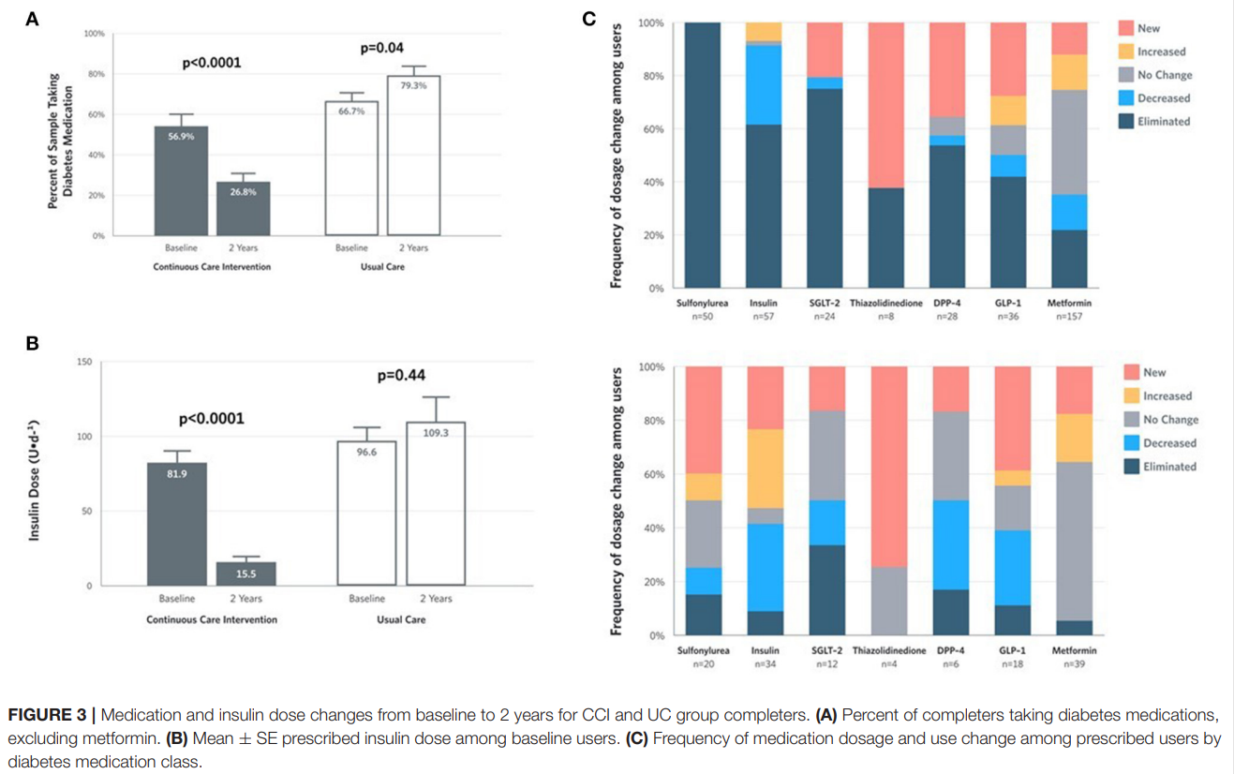
Results

Slide 52
Results

Slide 55
Major Points
75% of participants remained enrolled at 2 years
Durable improvements in multiple metabolic markers while deprescribing 67.0% DM medications
A1c -0.9%, Weight loss 10%
53.5% had diabetes reversal, 17.6% had diabetes remission
Improvements in multiple cardiovascular risk factors

Slide 56
David Unwin Data

Slide 57
Background and Objective
Emerging data is incompatible with the old paradigm that type 2 diabetes (T2D) is a chronic progressive disease. Reversal and remission has now been well documented.
However, more data is needed in the clinical setting
This primary care cohort study seeks to demonstrate the difference between low carbohydrate subjects who attained T2D remission versus those that did not

Slide 58
Methods
Baseline
Retrospective chart review comparing a cohort of patients that achieved T2D remission from a low-carbohydrate diet versus those that did not
186 low carbohydrate participants (39% of T2D in practice)
61% male
Median age 63 years old
Median follow up 33 months
37% of cohort were within 1 year of T2D diagnosis

Slide 59
Intervention
At Norwood Surgery (UK based primary care office)
Time: 2013-2021 (8 year period)
Follow up
Approximately 3 10-minute visit per year
Offered 90-minute group sessions every 6 weeks
Online materials
Exclusion: severe mental illness, terminal illness, eating disorders

Slide 60
Results
186 subjects with T2D on low carb diet
Cohort of 94 subjects that achieved remission
Cohort of 92 subjects that did not achieve remission
Remission (WHO definition): HbA1c <6.5%, not on any T2D medication, sustained for >3 months

Slide 61
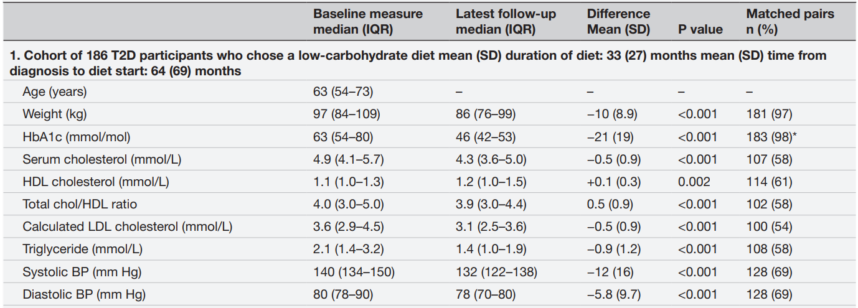
All 186 Subjects with T2D on LCD
213 lbs
189 lbs
-22 lbs
7.9%
6.4%
-1.5%
189.5 mg/dl
166.3 mg/dl
-20 mg/dl
42.5 mg/dl
46.4 mg/dl
3.9 mg/dl
139 mg/dl
120 mg/dl
-19 mg/dl
186 mg/dl
124 mg/dl
-80 mg/dl

Slide 62
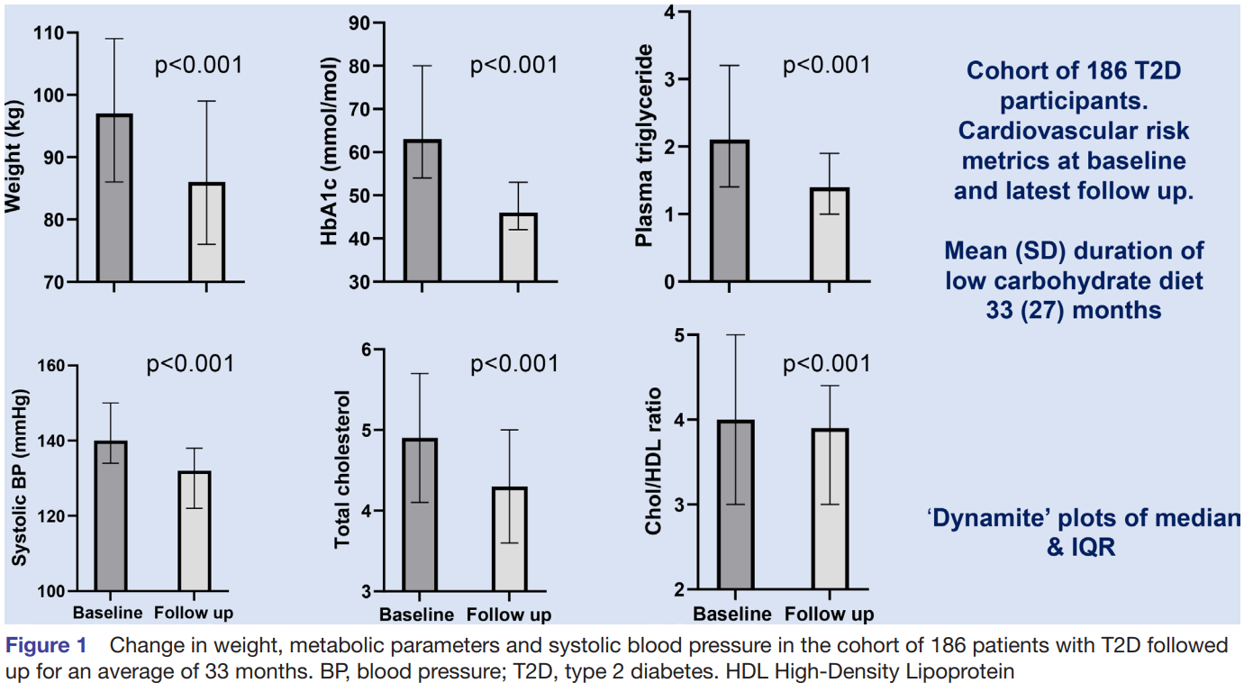
All 186 Subjects with T2D on LCD

Slide 63
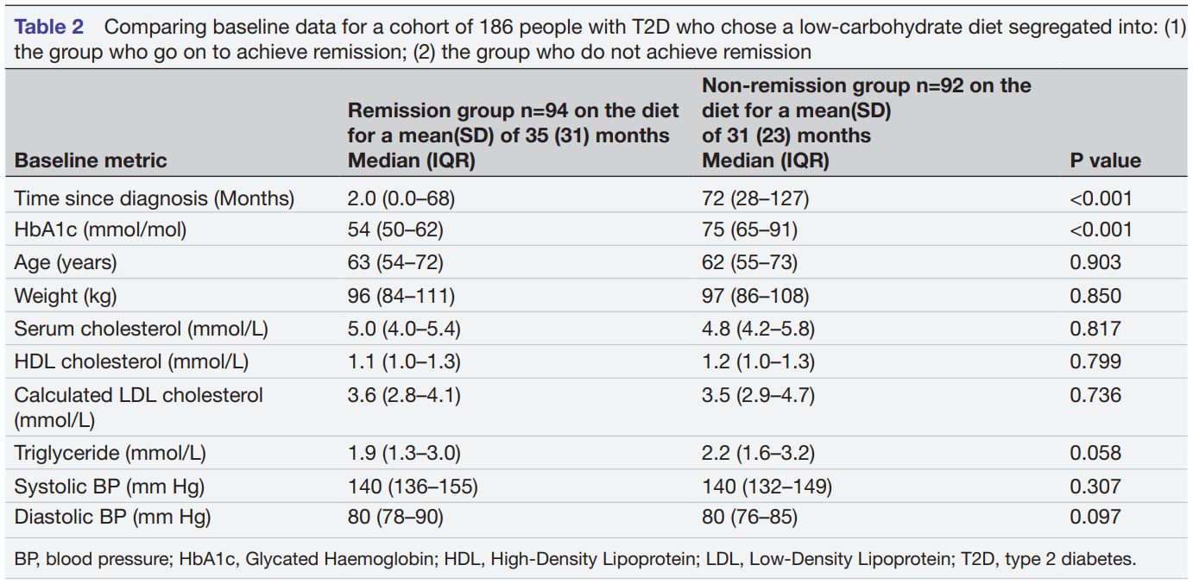
Comparing Remission vs Non-remission
6 years (2.3-10.5 years)
7.1%
9.0%

Slide 64
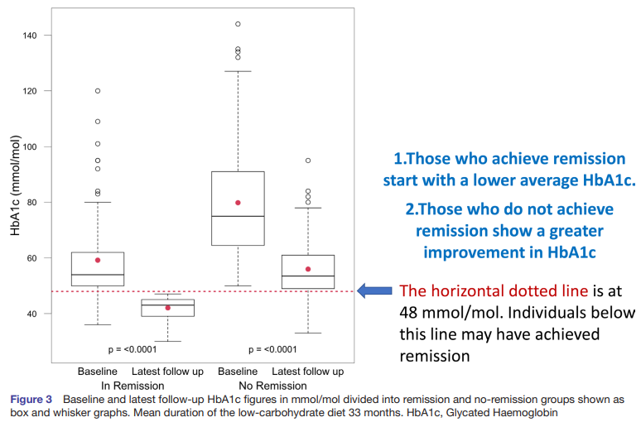
Comparing Remission vs Non-remission

Slide 65
Deprescription

Slide 66
Major Points
Remission was achieved in 51% of subjects
$82,693/year was saved from deprescription
Median follow up 33 months, which is currently the longest LCKD study follow up
All patients who achieved remission had weight loss (however 3 patients had <1kg weight loss)
Only 5 out of 183 (3%) on low carb had worse A1c

Slide 67
Discussion
Median age was 63. You are never too old to reverse T2D!
New diagnosis of T2D should be treated as an outpatient emergency
No equivalent data for low fat diets
A retrospective study of Mastering Diabetes published in 2019 by Sarver et al. relied on patient reported survey data and had a response rate of 10%
Supports our data, Dr. Westman’s data, Dr. Cucuzella’s data, and Virta health data

Slide 69
Background and Objective
“The robust evidence base supporting the therapeutic benefit of ketogenic diets in epilepsy and other neurological conditions suggests this same metabolic approach may also benefit psychiatric conditions”
The objective of this paper is to provide a retrospective review of a ketogenic diet on patients with severe, persistent mental health illness

Slide 70
Methods
Retrospective analysis
Single center inpatient psychiatric hospital in France
31 adults with severe, persistent mental illness
Depression (n=7), bipolar (n=13), schizoaffective (n=12)

Slide 71
Intervention
Informed consent was obtained
Participants resided on the unit for 6 days/week and were free to leave for 36 consecutive hours per week
Conventional inpatient psychiatric care plus ketogenic diet (<20g carbohydrate/ day)
3 meals prepared by hospital staff, 1 snack, and list of approved foods.
Vitamins and mineral supplement was given

Slide 72
Outcomes
Primary Outcomes
Change in depression symptoms as measured by
Hamilton Depression Rating Scale (HAM-D)
Montgomery-Asberg Depression Rating Scale (MADRS)
Change in psychosis symptoms
Positive and Negative Syndrome Scale (PANSS)
Secondary Outcome
Change in illness severity
Clinical Global Impressions Scale (CGI-s)

Slide 73
Outcomes
Outcome | Number improved | Baseline | Post-KD | Change | Comment
Psychosis | 10/10 (100%) | PANSS 91.4 (15.3) | 49.3 (6.9) | -42.1 | 16.5 is clinically significant
Depression | 23/23 (100%) 21/21 (100%) | HAMD-D 25.4 (6.3) MADRS 29.6 (7.8) | 7.7 (4.2) 10.1 (6.5) | -17.7 -19.5 | 4 is clinically significant 7 is clinically significant
Severity | 27/27 (100%) | CGI-S 4.9 (1.2) | 2.0 (1.1) | -2.9 | 1 is clinically significant
Notes:
All values are statistically significant
PANSS max 204
HAMD-D max 50
MADRS max 60
CGI-S max ***

Slide 74
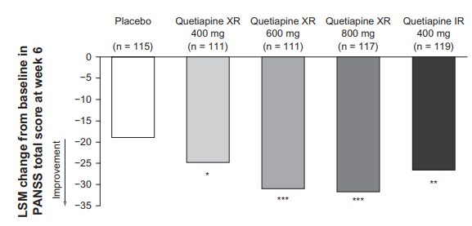
Outcomes
Outcome | Number improved | Baseline | Post-KD | Change | Comment
Psychosis | 10/10 (100%) | PANSS 91.4 (15.3) | 49.3 (6.9) | -42.1 | 16.5 is clinically significant
Depression | 23/23 (100%) 21/21 (100%) | HAMD-D 25.4 (6.3) MADRS 29.6 (7.8) | 7.7 (4.2) 10.1 (6.5) | -17.7 -19.5 | 4 is clinically significant 7 is clinically significant
Severity | 27/27 (100%) | CGI-S 4.9 (1.2) | 2.0 (1.1) | -2.9 | 1 is clinically significant
Notes:
PANSS max 204
Compare -42.1 on ketogenic diet to Seroquel for NONTREATMENT RESISTANT acute schizophrenia. PANSS= -18.8 for placebo, 25~31 based on formulation

Slide 75
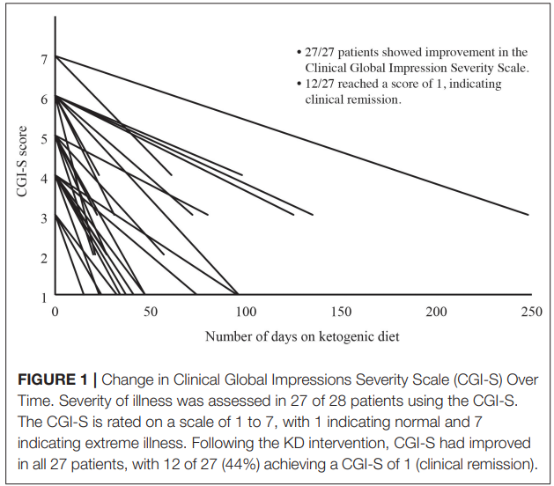

Slide 76
Results
Number or dose of psychotropic medications were reduced in 18/28 (64%)
Most experienced headache, insomnia, irritability, excitation, dizziness or cravings during induction phase of KD
These resolved within 2 weeks
27/31 (87%) experienced no side effects.

Slide 77
Adherence
Urine ketones were positive in 18/ 28 subjects (64%)
>6 days adherence in 11 patients (39%)
>5 days adherence in 12 (43%)
>4 days adherence in 5 (18%)
Three of 31 patients (10%) dropped out due to:
Aversion to dietary fat
Lack of family and financial support
Aversion to dietary fat and restrictiveness

Slide 78
Out of Hospital Adherence
After hospital discharge:
13/28 (46%) reported good adherence
5/28 (18%) partial adherence
6/28 (21%) discontinued
3 lost to follow up

Slide 79
Major Points
First study since 1965 investigating KD for severe inpatient mental illness
Symptoms improved markedly for all patients
12/28 (43%) achieved clinical remission
Only 10% dropout

Slide 80
Discussion
Thoughts on biological plausibility: KD improves inflammation, blood-brain-barrier integrity, mitochondrial function, and glutamate excitotoxicity (all similar to KD in epilepsy)
The well formulated ketogenic diet used was modified Atkins with “protein eaten to satiety”. Thoughts on benefits if a “classic” KD was used (90% fat, 6% protein, 4% carbohydrate; used for pediatric epilepsy)
Why the hesitancy in researching KD for otherwise severe, terminal conditions?
What are the next steps in researching KD for mental illness?

Slide 81
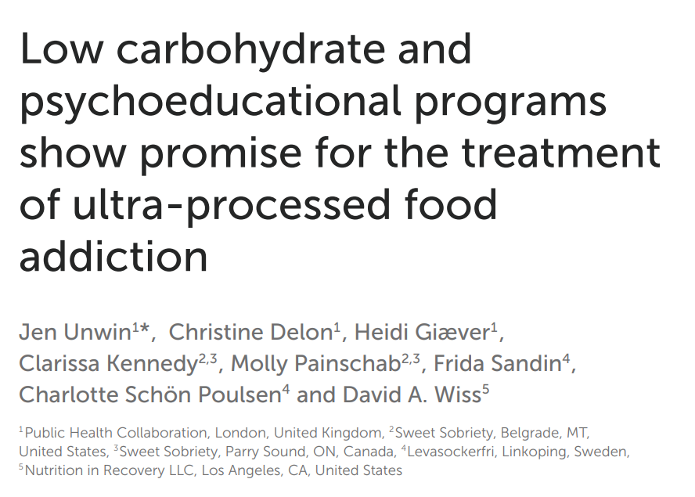

Slide 82
Background and Objective
20% of adults meet criteria for food addiction, however it is not a recognized diagnosis
There is a lack of research in this area
This paper investigates the effects of a whole food low-carbohydrate diet on food addiction symptoms

Slide 83
Methods
Data audit from 3 clinics (UK, Sweden, US)
UK n= 32, Sweden n=38, US n=33

Slide 84
Intervention
Online group meetings
Initially: 10-14 weeks of weekly 90-120 minute sessions
Maintenance: monthly support
Content: understanding addiction, reflection, food plans
Abstinence from sugar, grains, processed food, and any food individuals were unable to moderate

Slide 85
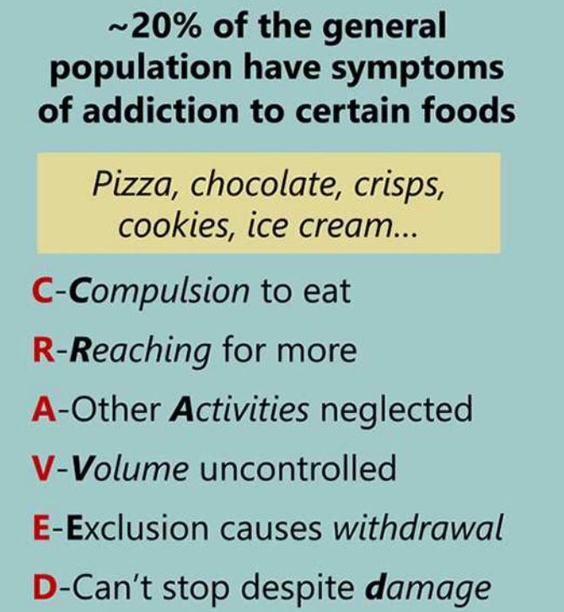
Outcomes
Changes in mYFAS2
Changes in CRAVED

Slide 86
Baseline
Mean age ~50 years old
91-100% female
YFAS preintervention= 5
CRAVED preintervention= 5

Slide 87
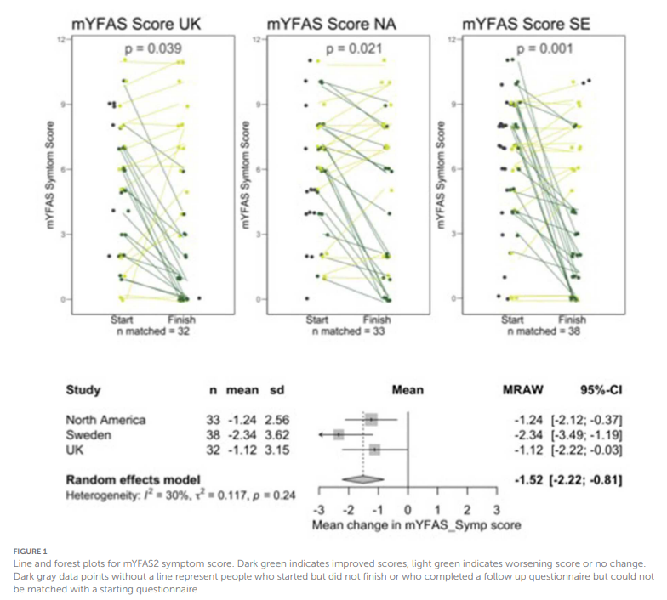
Results- YFAS

Slide 88
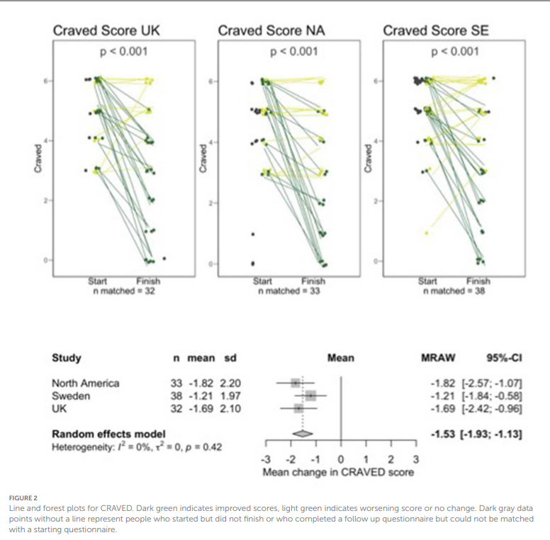
Results- Craved

Slide 89
Major Points
An intensive behavioral intervention using a low carbohydrate approach improved food addiction symptoms
Retention was 82.%, 48%, and 70% for UK, NA, and SE, respectively

